Slide 1
Creating our Greenfoot Project in Eclipse

Slide 2
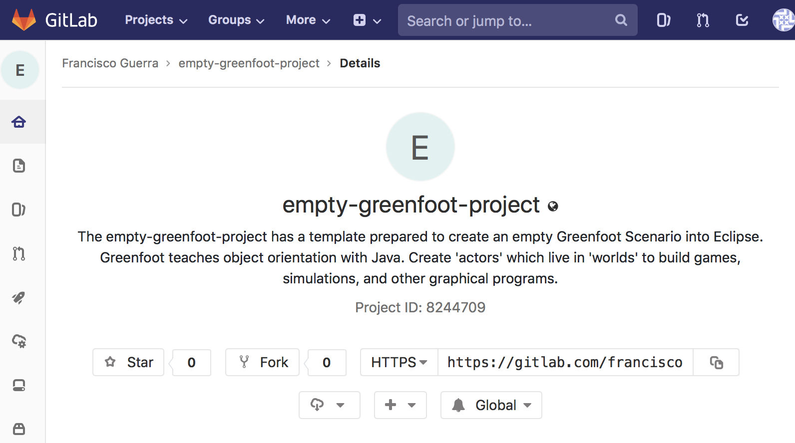
Greenfoot scenario template for Eclipse are on the WEB
https://gitlab.com/franciscoguerra/empty-greenfoot-project.git

Slide 3
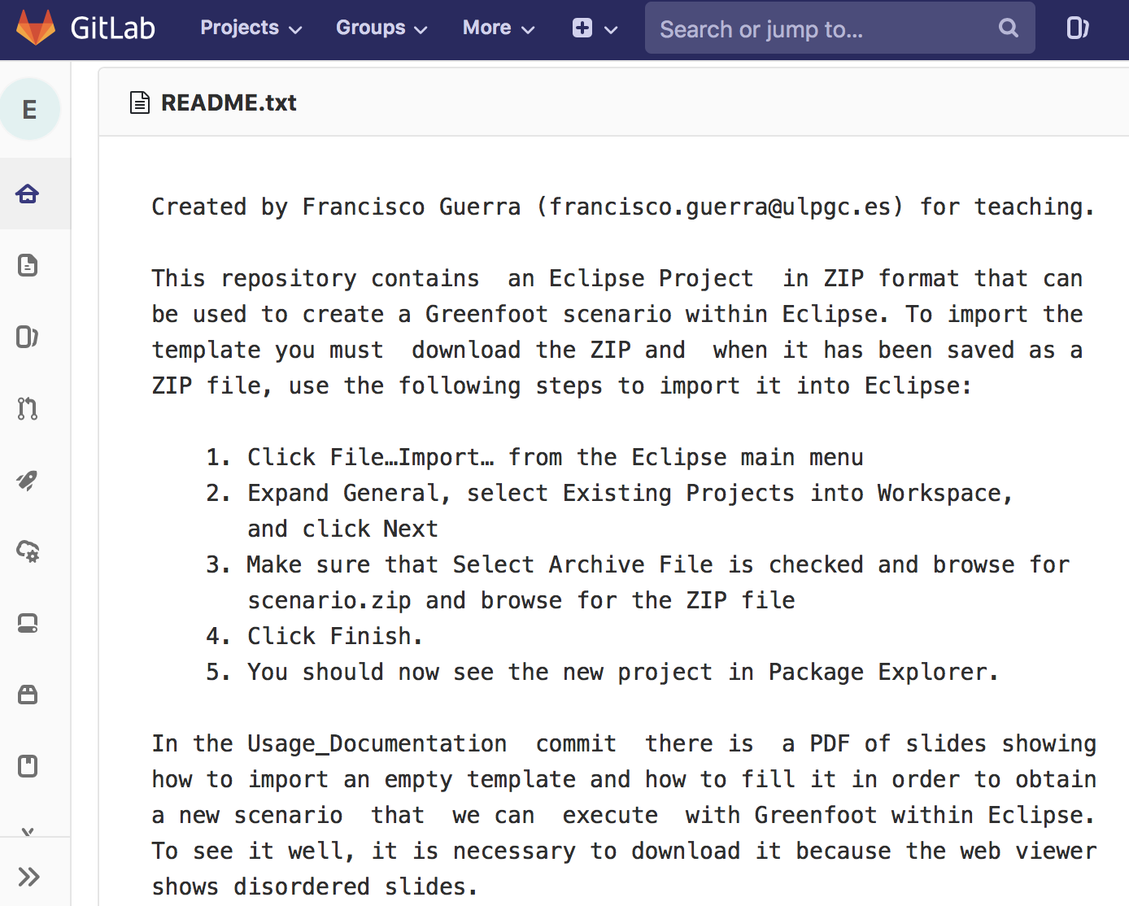
README explains how to import the template

Slide 4
Let's choose the ZIP file ...

Slide 5
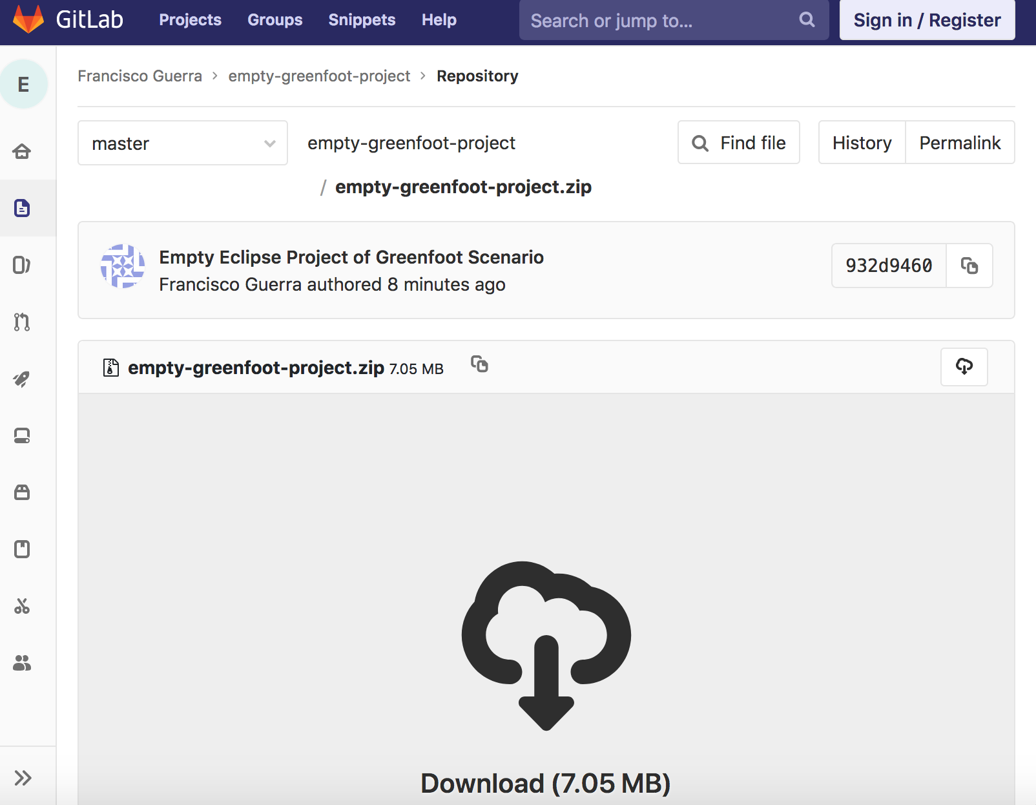
... and download to local folder

Slide 6
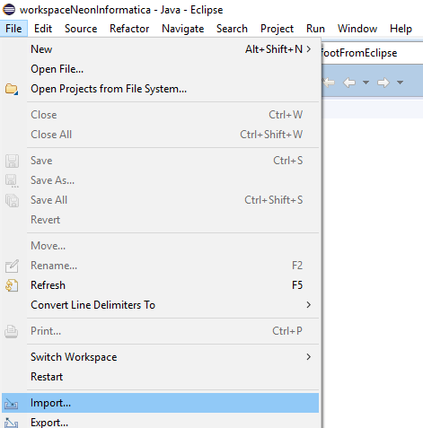
Now, we can import the zip from download folder …

Slide 7
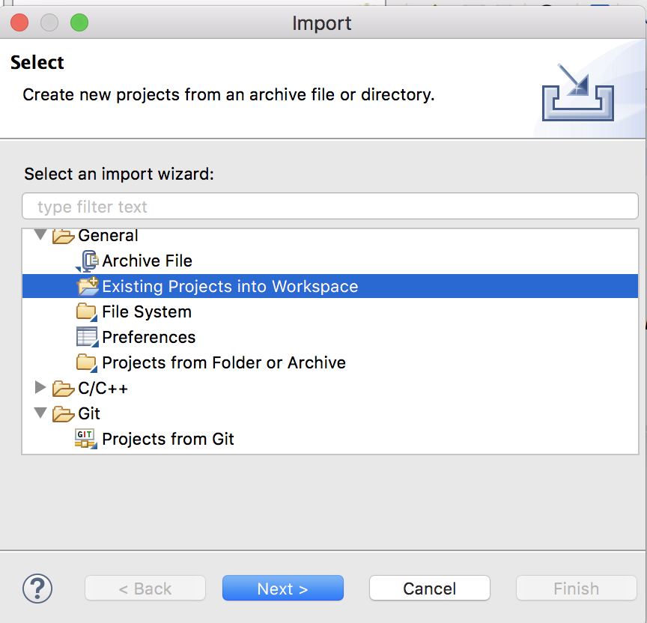
… first, click “Existing projects into Workspace” ...

Slide 8
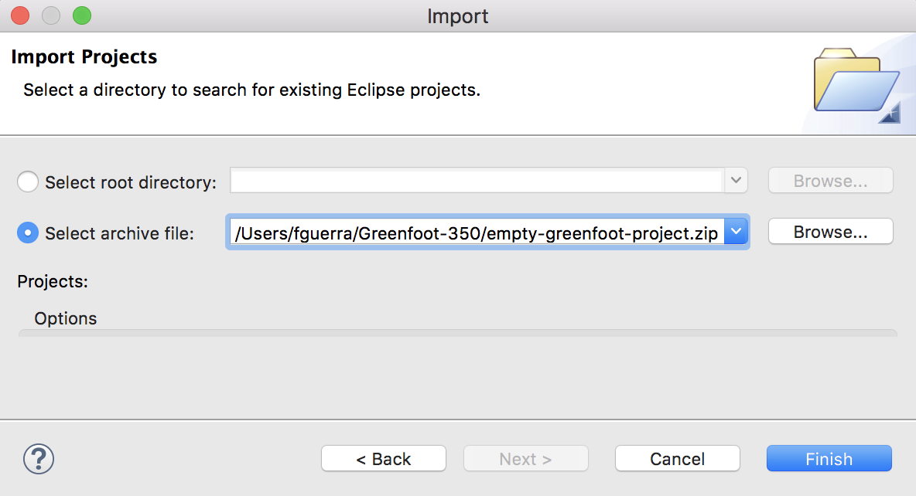
… second, browse up to the zip file …

Slide 9
… and third, click “Finish”

Slide 10
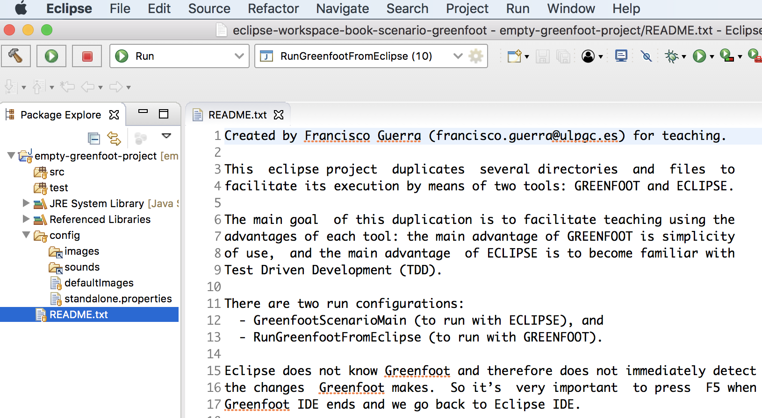
We already have the project in Eclipse

Slide 11
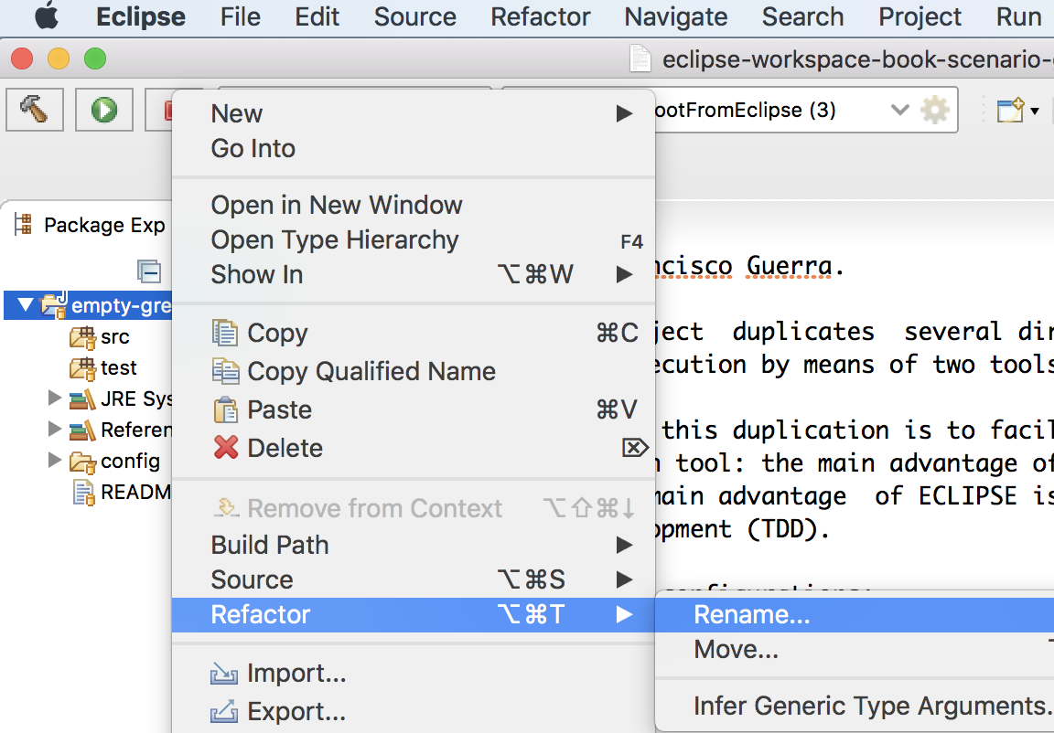
Let´t change the name of the project

Slide 12
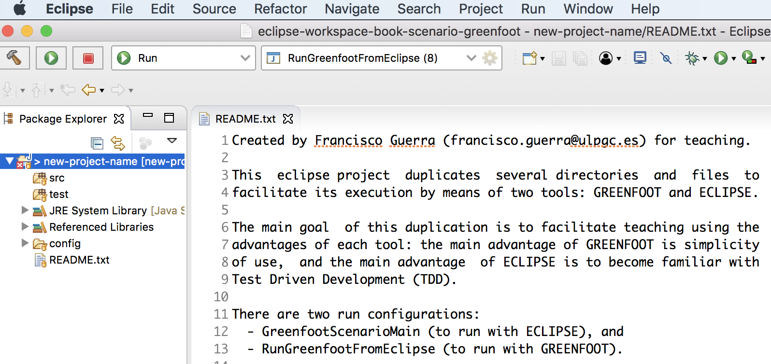
Eclipse has an internal error
The bug is fixed when RunGreenfootFromEclipse is executed

Slide 13
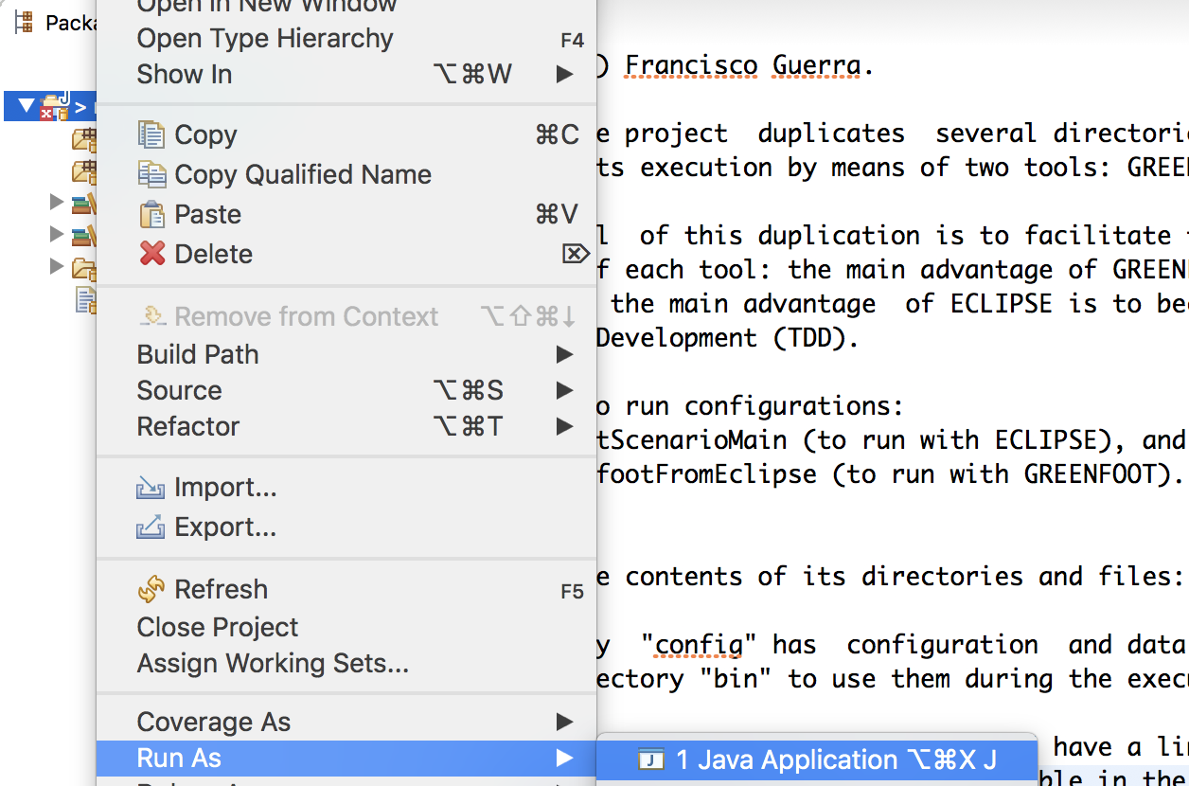
Let´t go to execute …

Slide 14
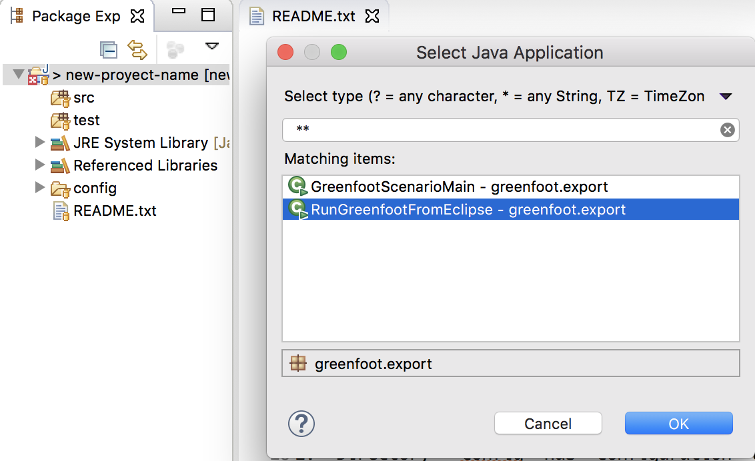
… selecting RunGreenfootFromEclipse …

Slide 15
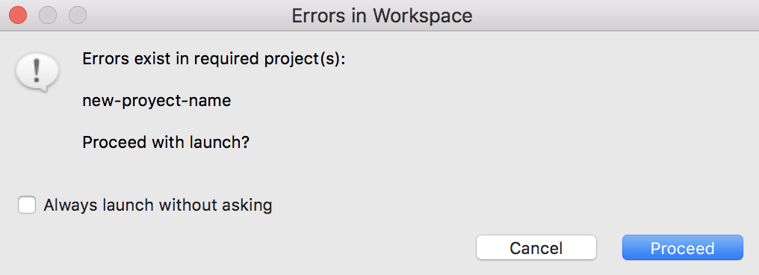
… let´t even go to execute with errors
This is the only case that we will execute with errors

Slide 16
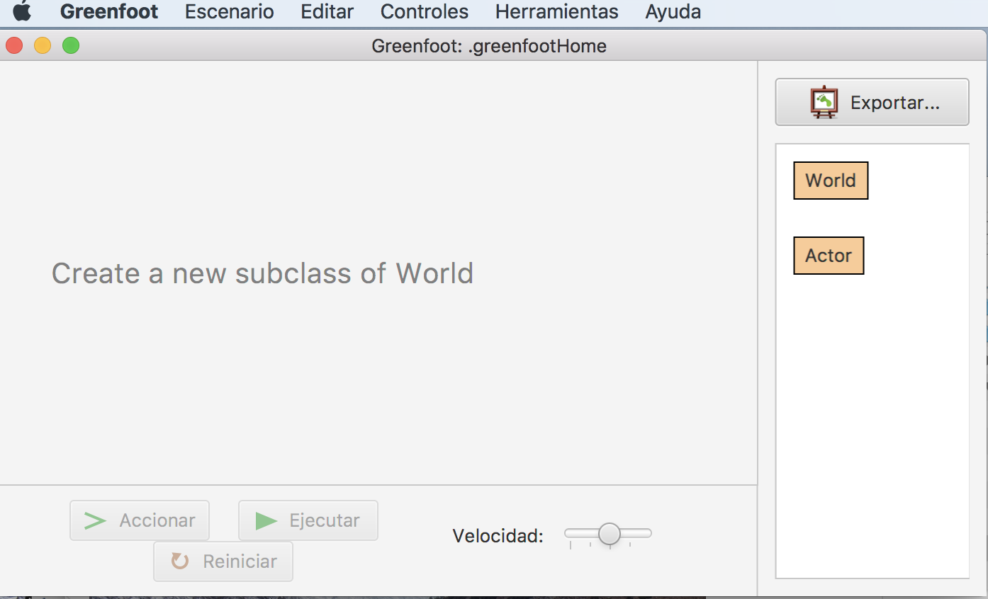
A world has not yet been defined
In every Greenfoot application the world class must be defined

Slide 17
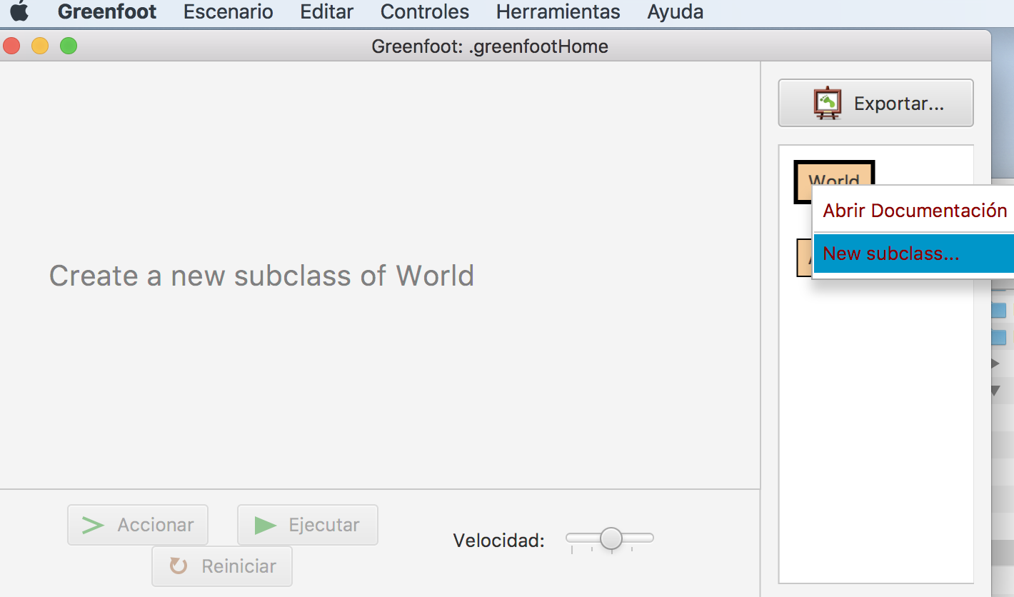
We must create a world
The world must extend the World class

Slide 18
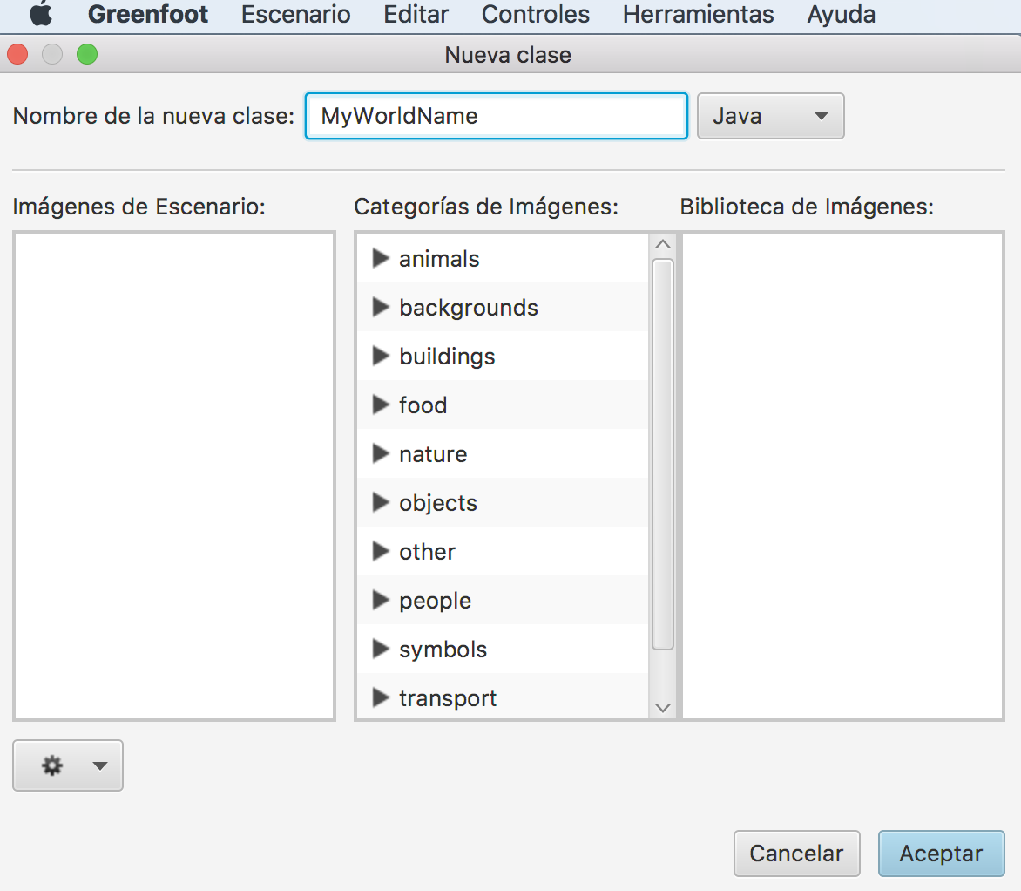
We assigne name to the new world
The world must have a name

Slide 19
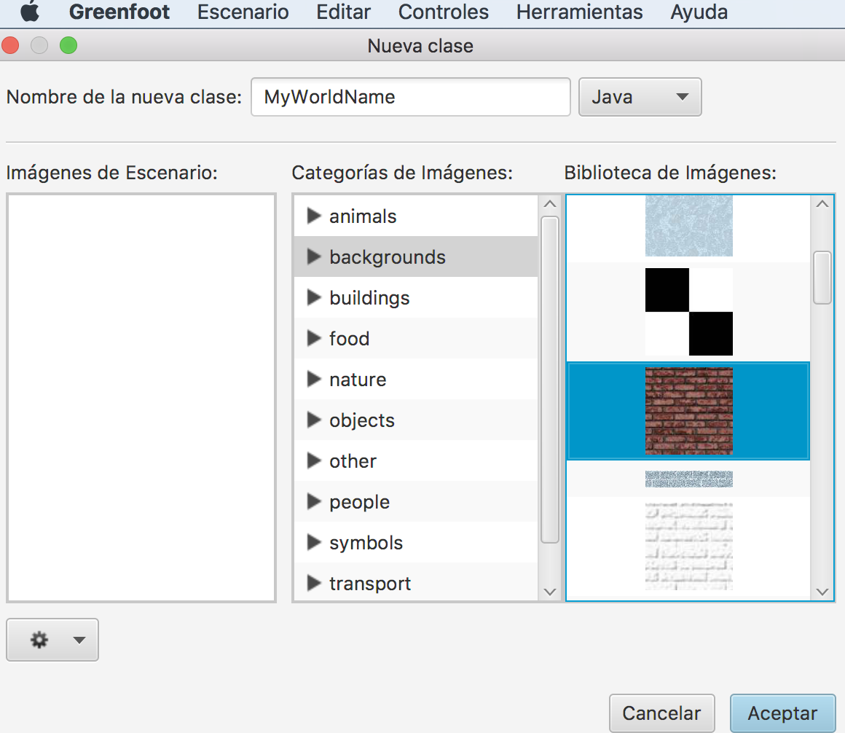
We assigne image to the new world
The world must have a image

Slide 20
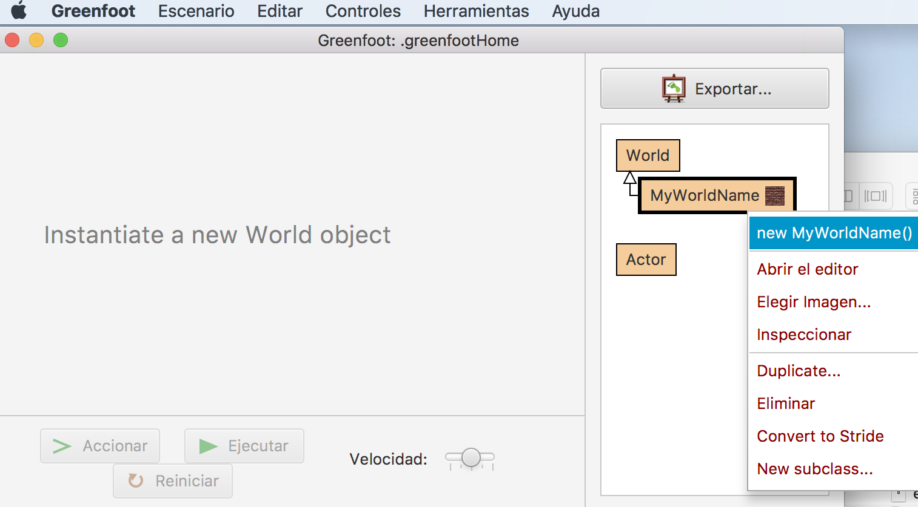
Each scenario begins with a world object
We must create an object of class MyWorldName

Slide 21
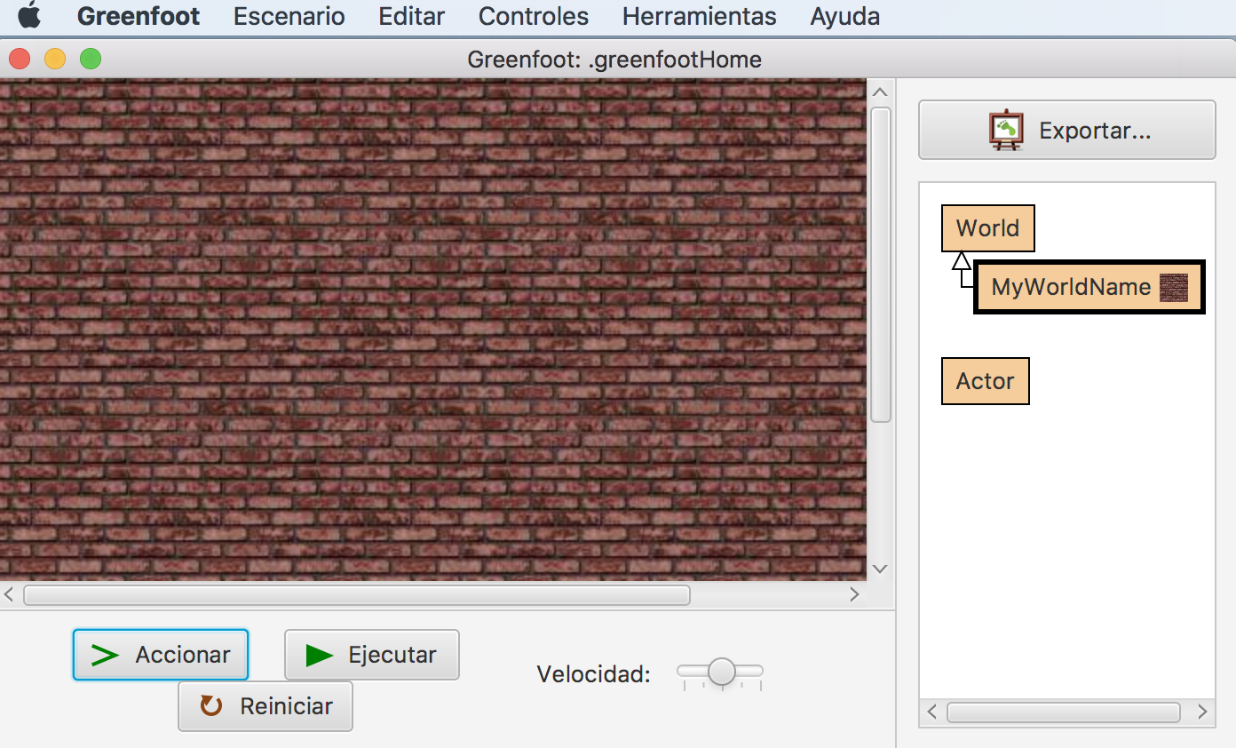
We have our project ready to use
It is already executable because you can create a world object

Slide 22
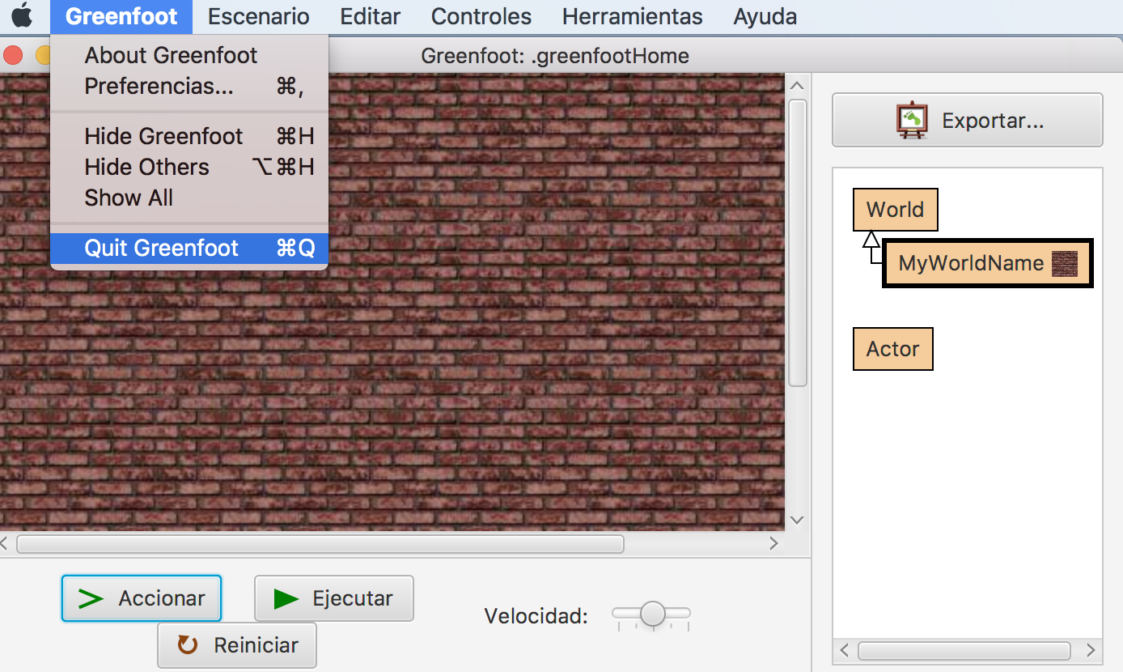
We left Greenfoot IDE
We left Greenfoot mode to return to Eclipse mode

Slide 23
The F5 key updates the view in Eclipse
Eclipse does not know the changes made in Greenfoot mode

Slide 24
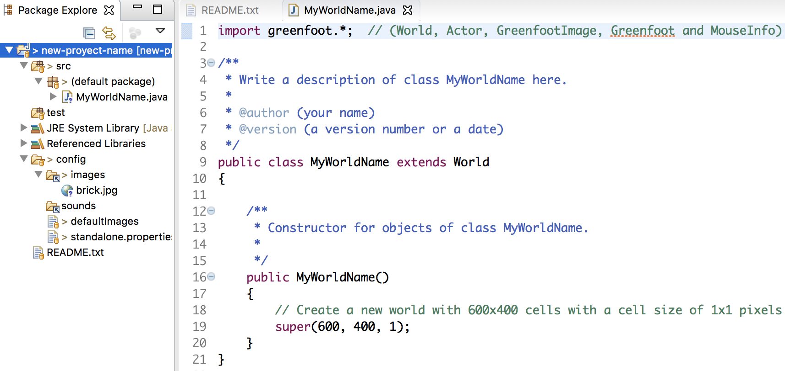
The project already has a world
There are two new files: MyWorldName.java and brick.jpg

Slide 25
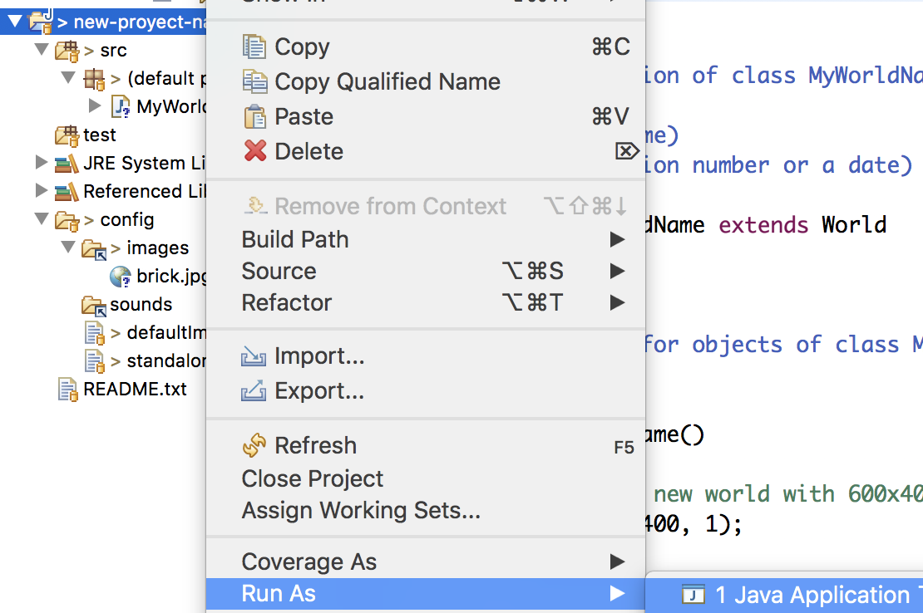
We return to Greenfoot mode ...

Slide 26
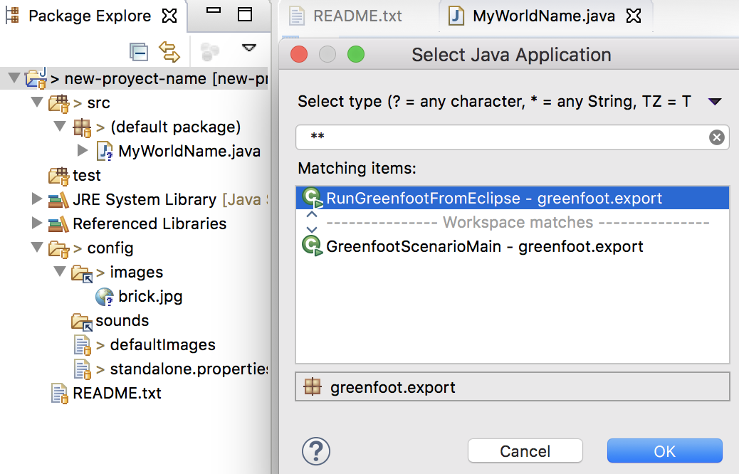
.. with RunGreenfootFromEclipse ...

Slide 27
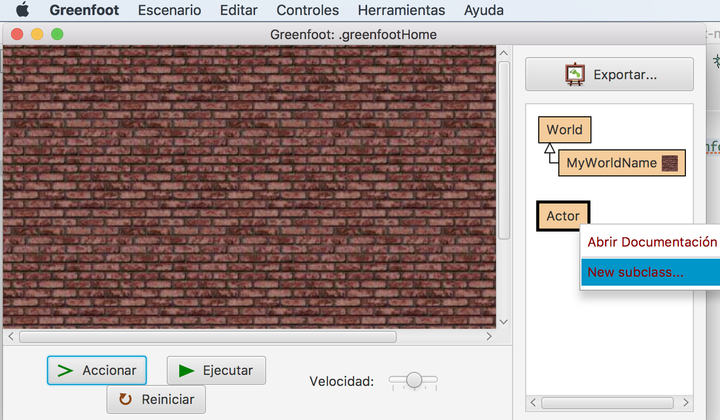
.. to add actors

Slide 28
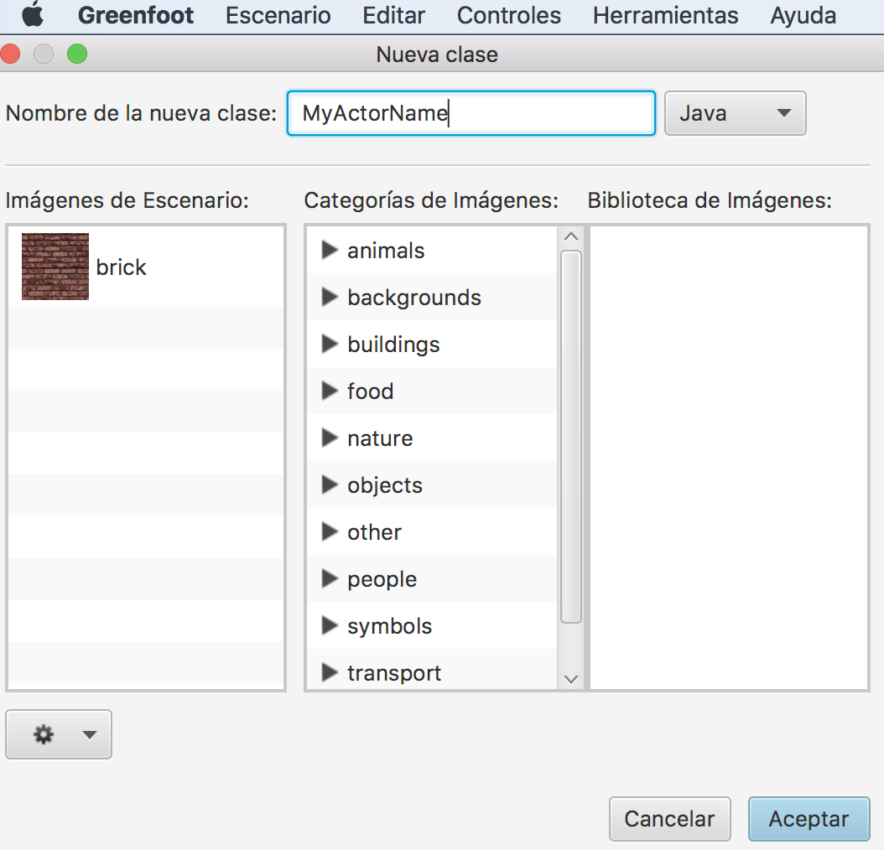
The new actor must have a name ...

Slide 29
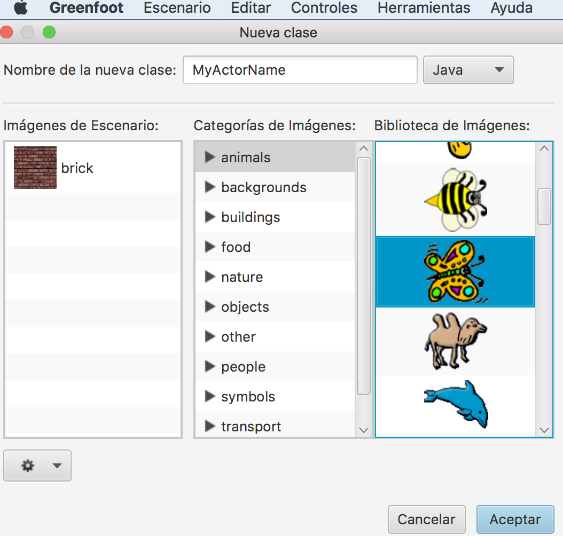
... and an image

Slide 30
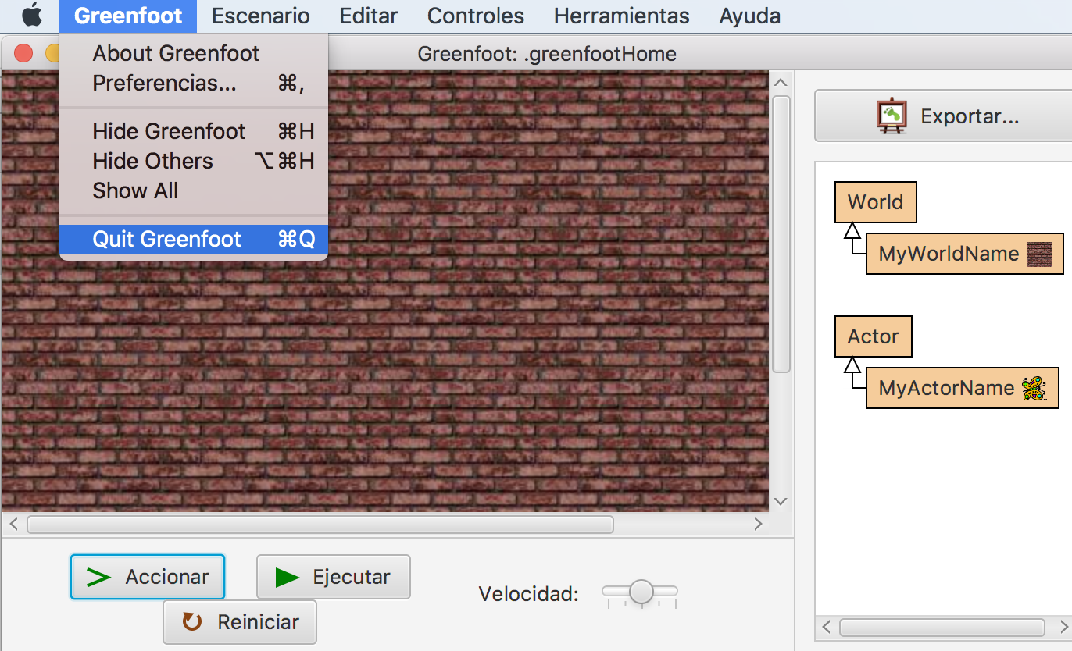
If we go back to Eclipse mode ...

Slide 31
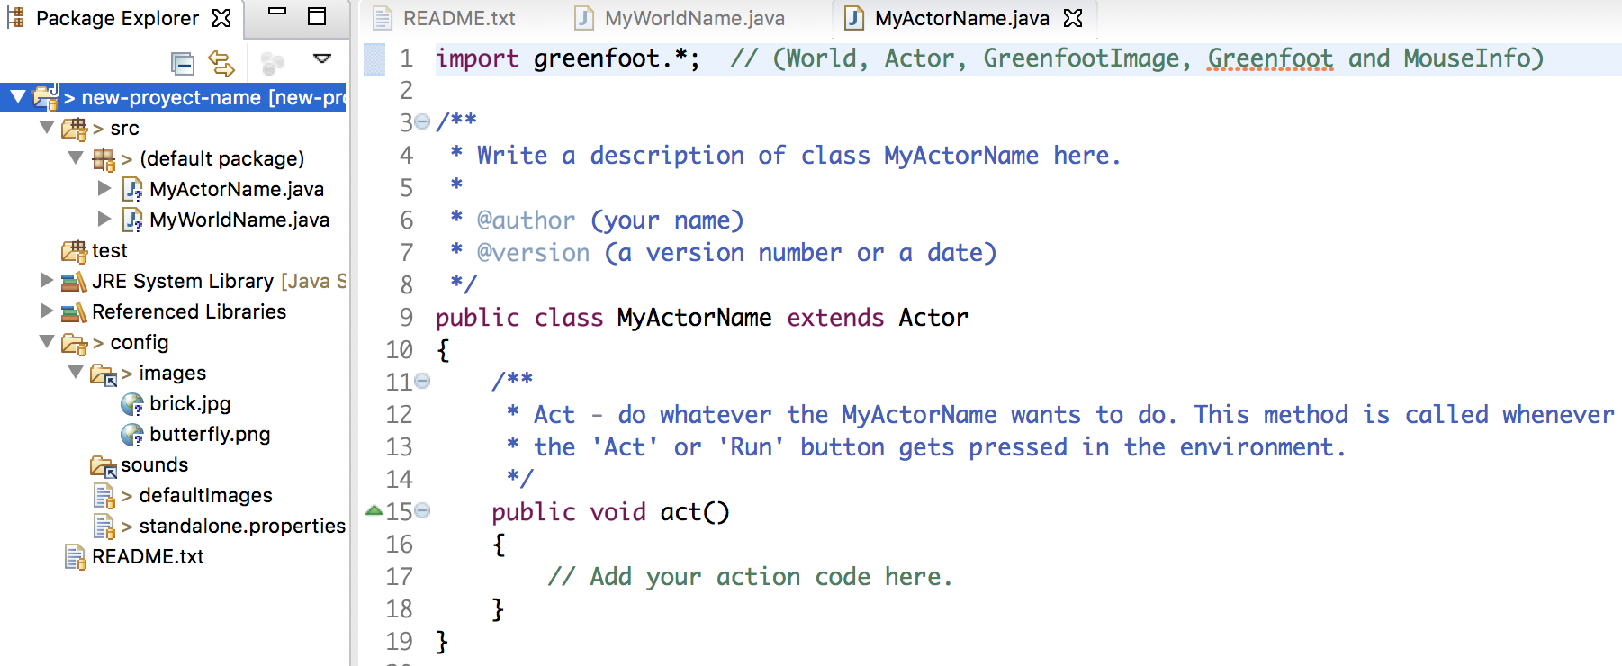
... with F5 we can see two new files

Slide 32
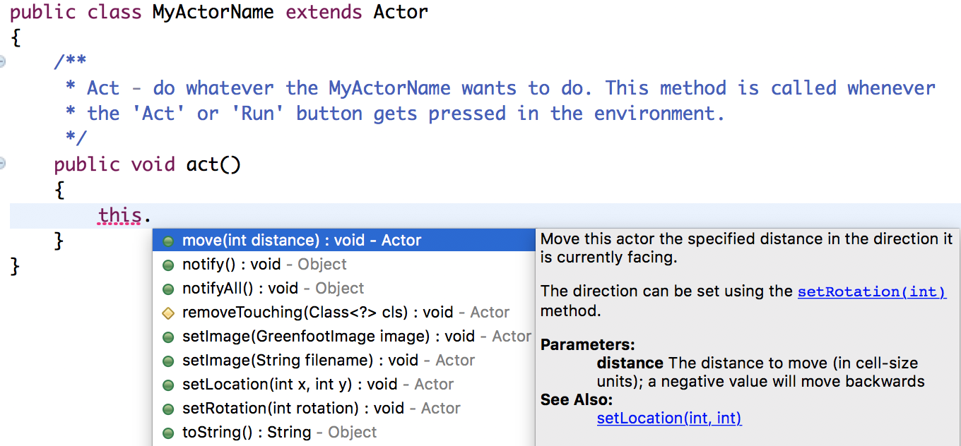
Eclipse helps us to program ...

Slide 33
... offering documentation ...

Slide 34
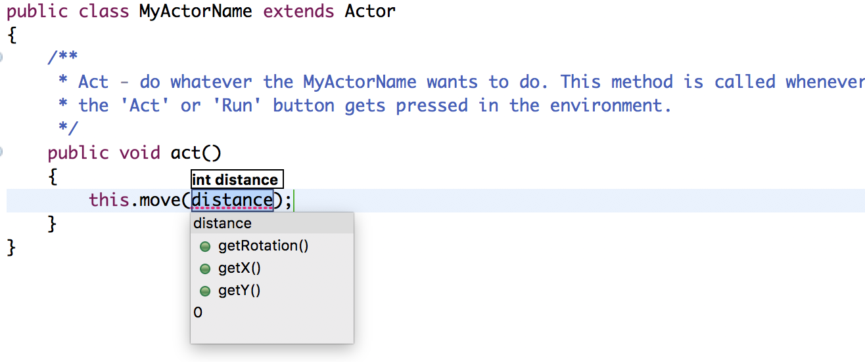
… and proposing values

Slide 35
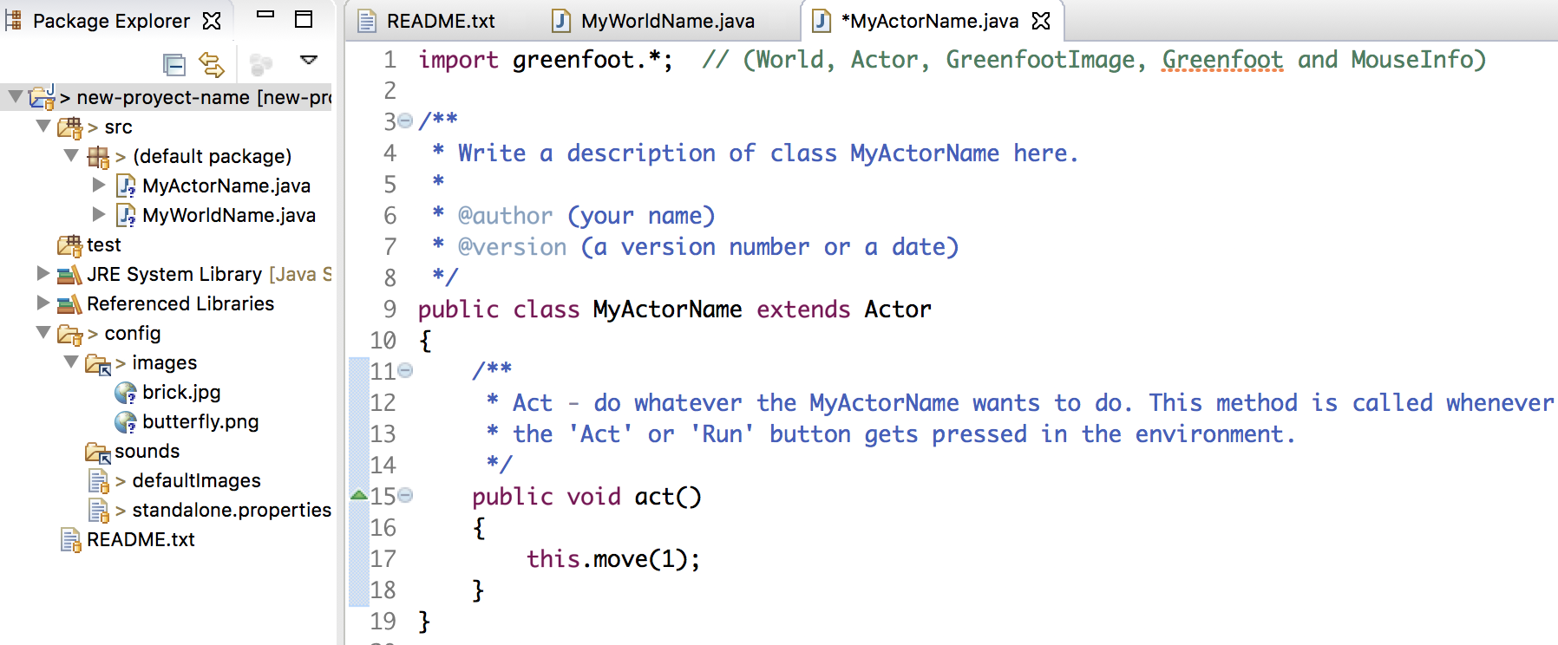
What is programmed in Eclipse mode ...

Slide 36
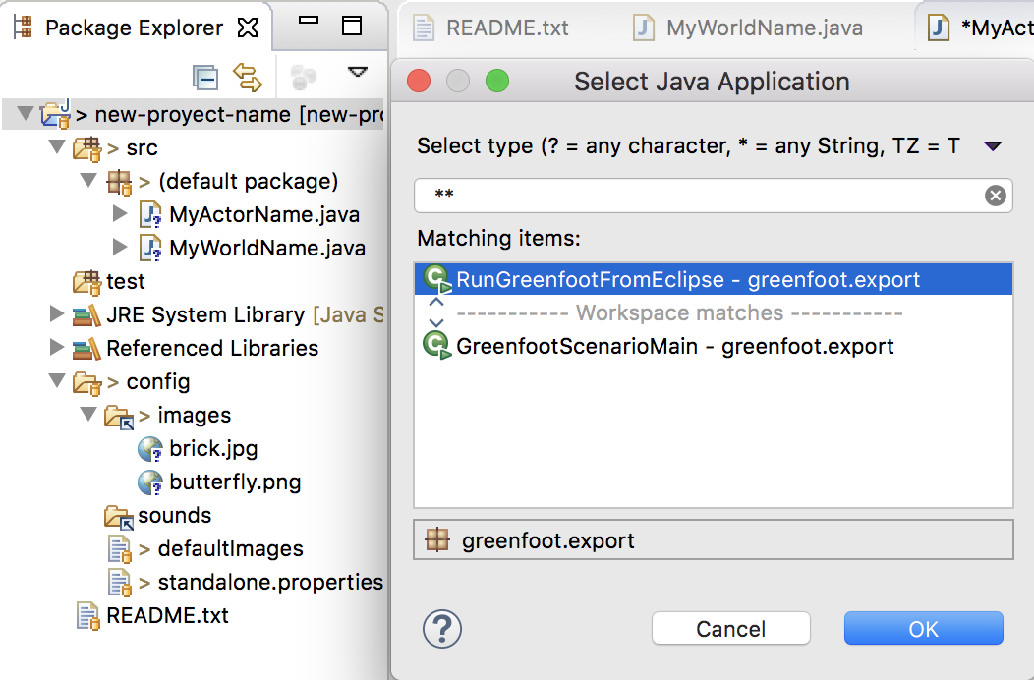
... when we move to Greenfoot mode ...

Slide 37
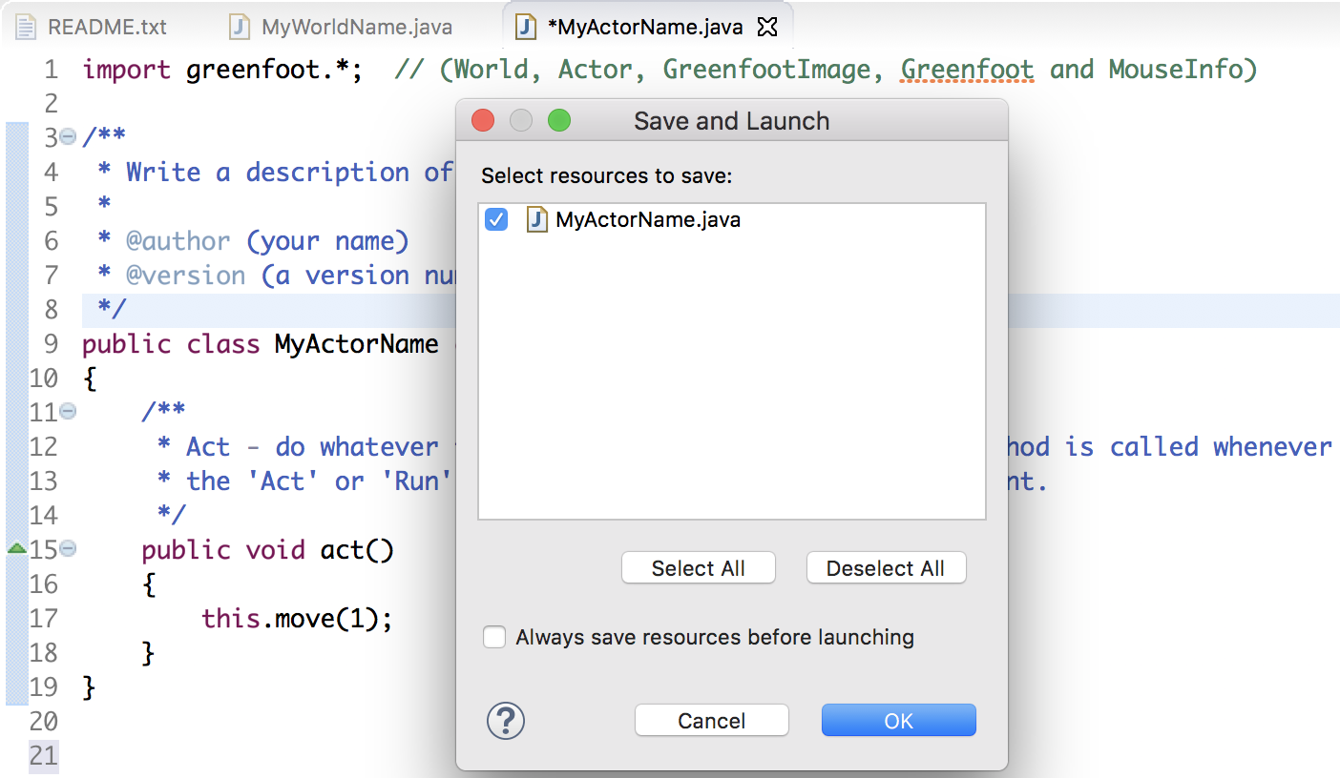
... must be saved ...

Slide 38
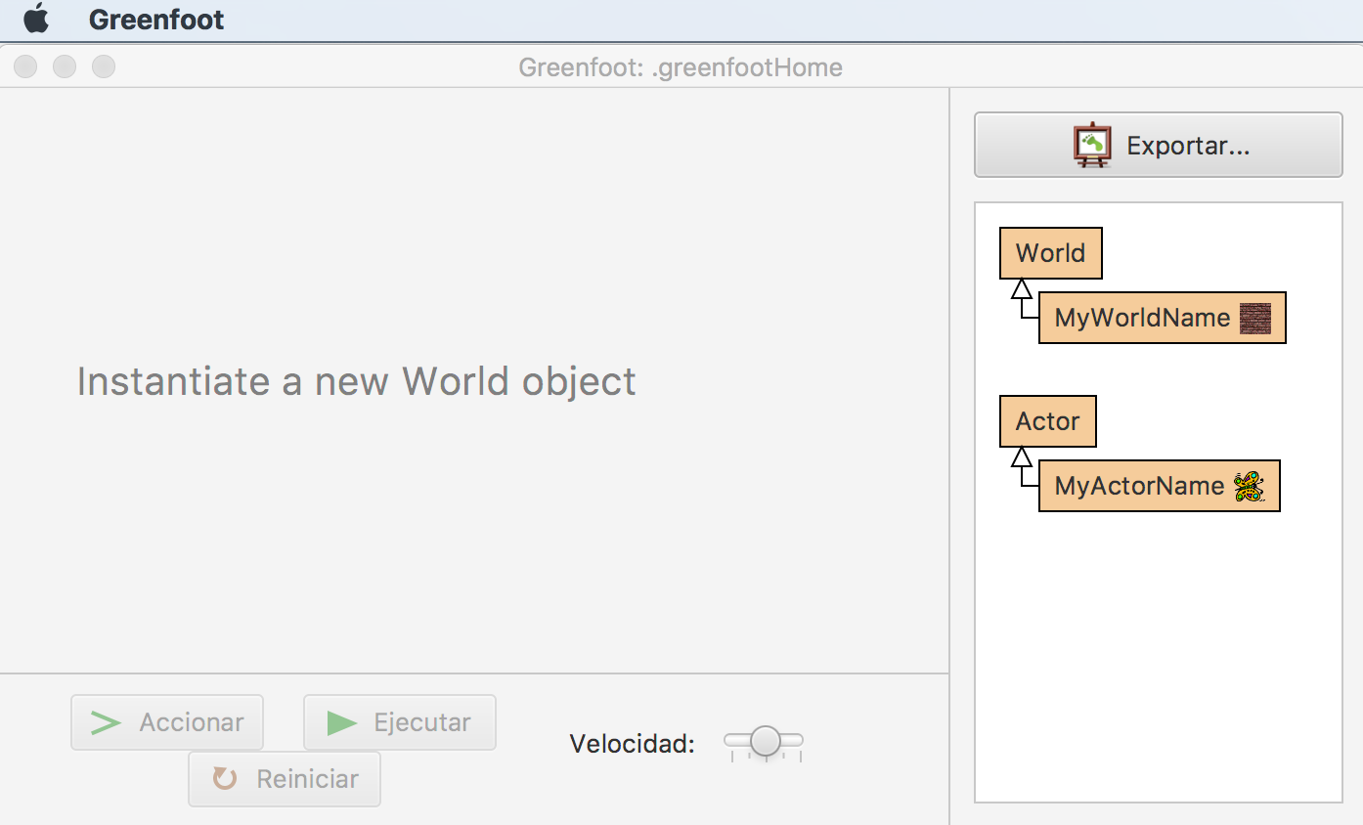
.. indicating the world to Greenfoot with a click ...

Slide 39
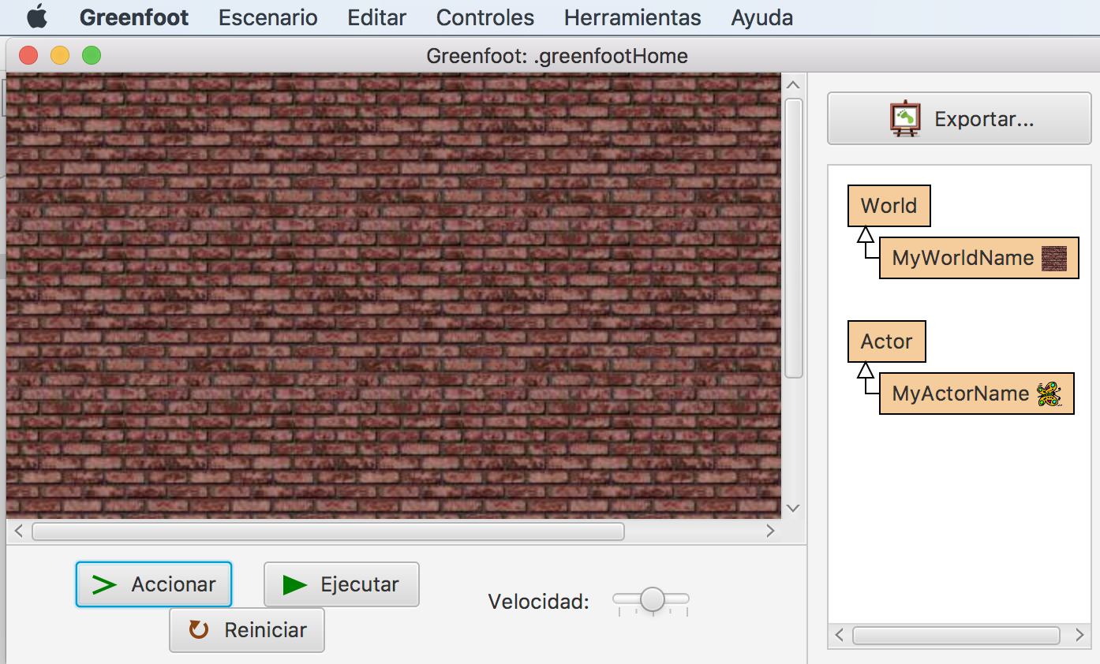
... so that in Greenfoot mode ...

Slide 40
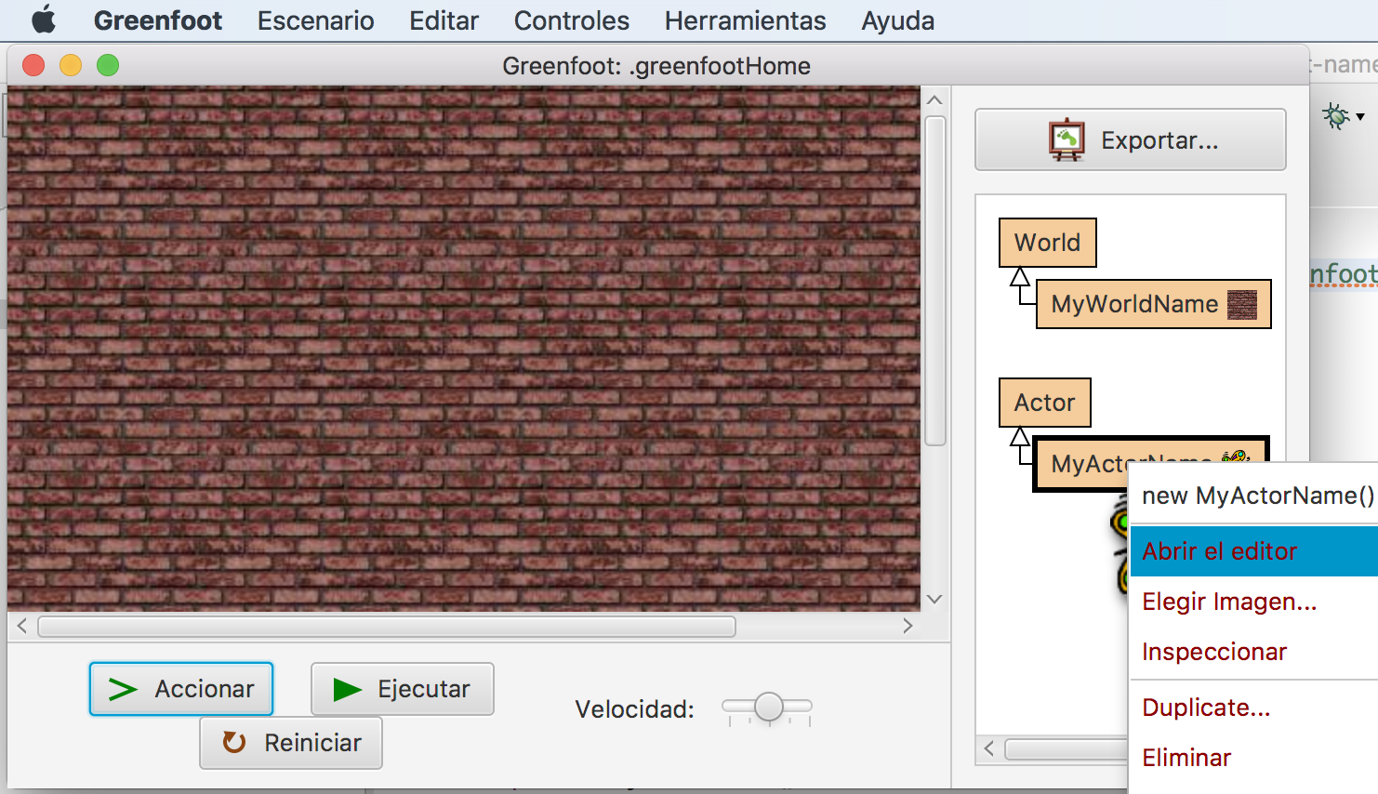
... when we open the editor ...

Slide 41
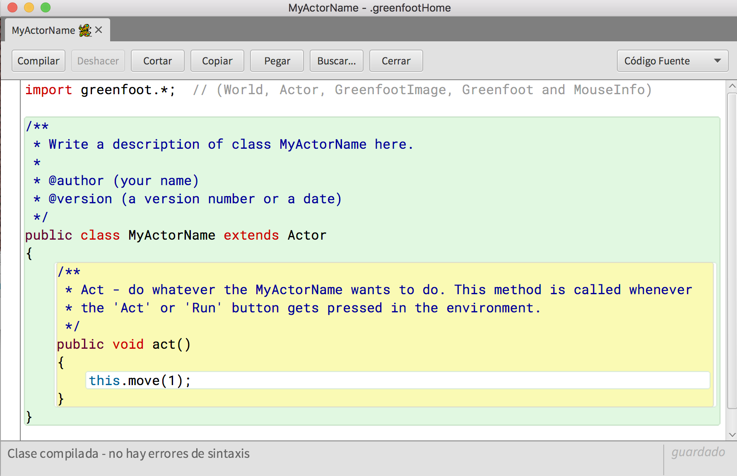
... the changes are seen

Slide 42
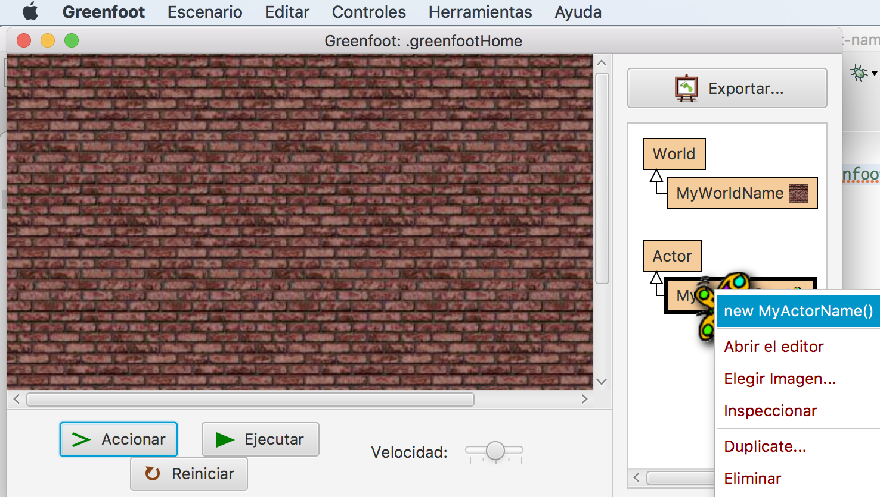
If we create actors objects ...

Slide 43
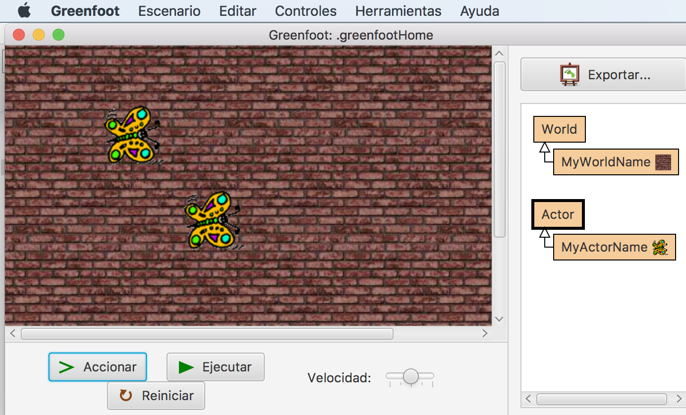
... to define an initial scenario ...

Slide 44
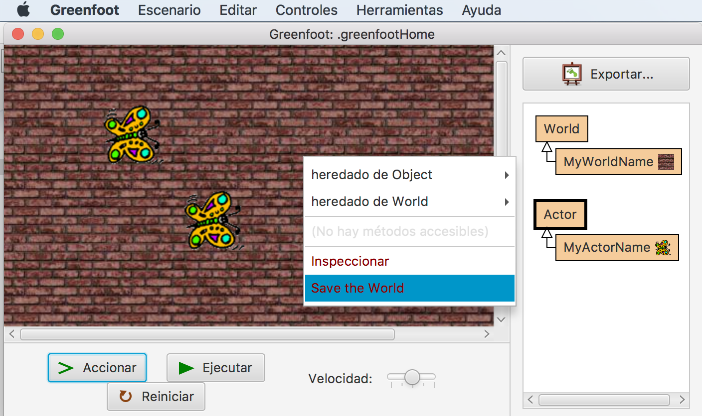
... we can save the current world ...

Slide 45
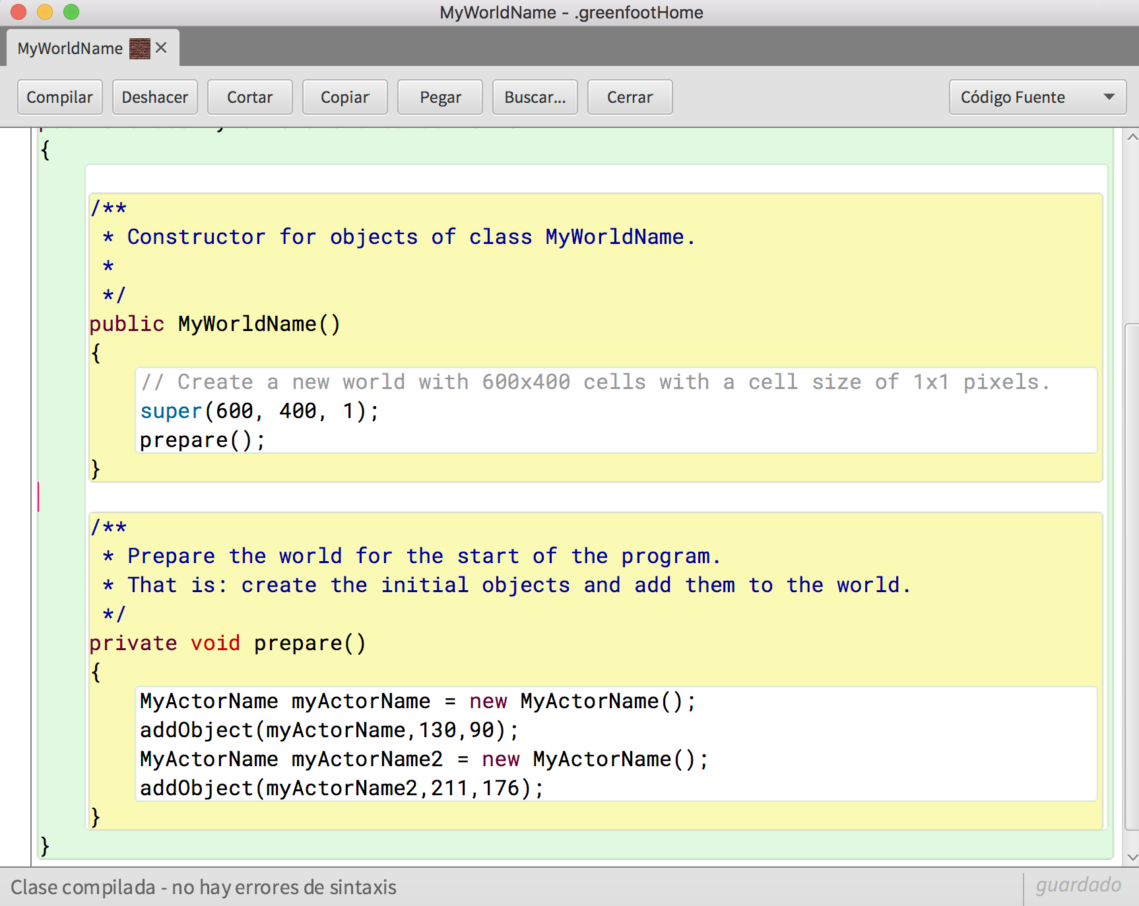
... and Greenfoot modifies the world's constructor

Slide 46
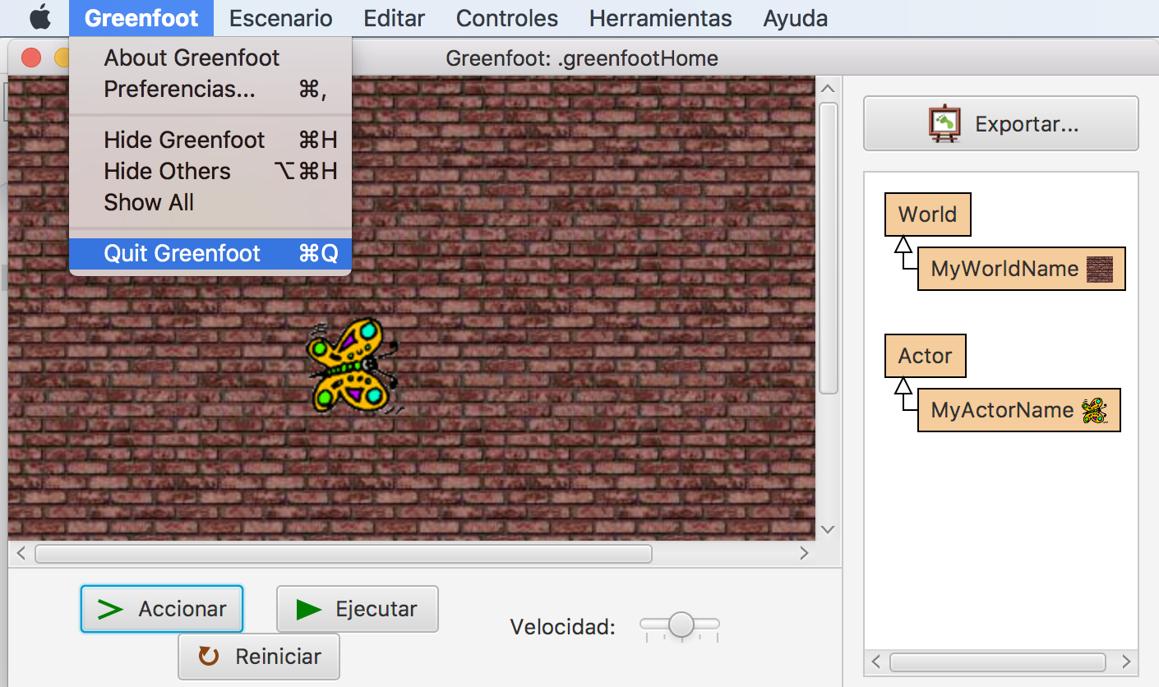
When returning to Eclipse mode ...

Slide 47
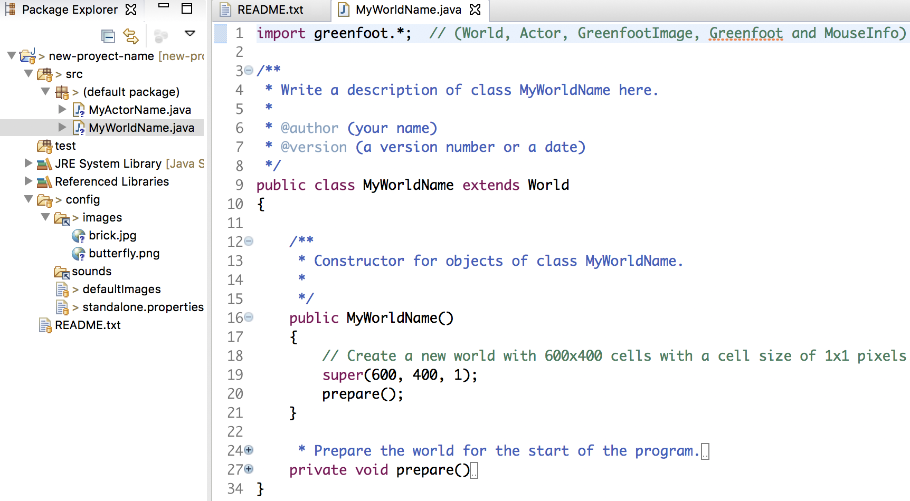
.. with F5 we see the changes in the world ...

Slide 48
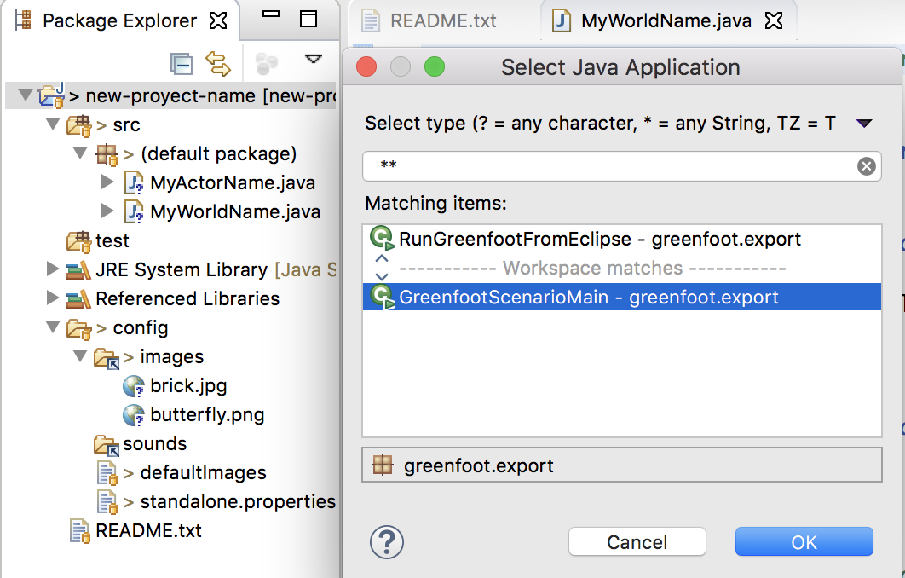
... and if we run in Eclipse mode ...

Slide 49
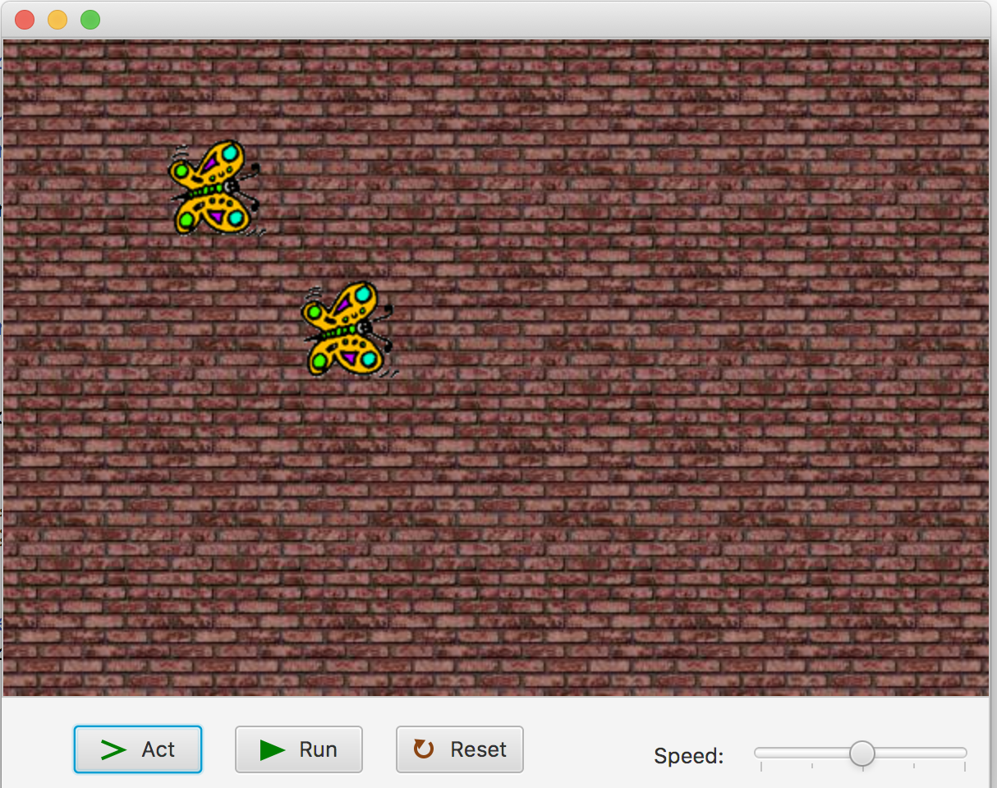
... we see the initial world that was defined

Slide 50
Before returning to edit we must finish !!!

Slide 51
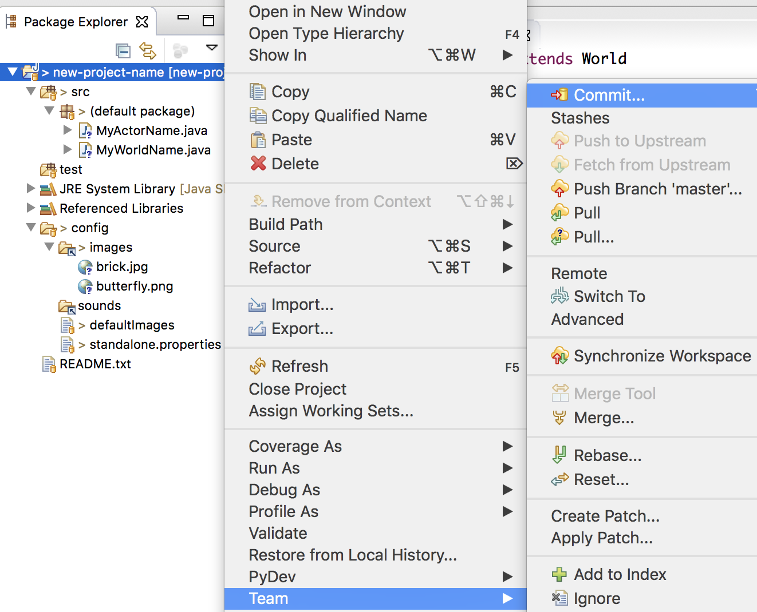
Eclipse can register the scenario changes with git ...

Slide 52
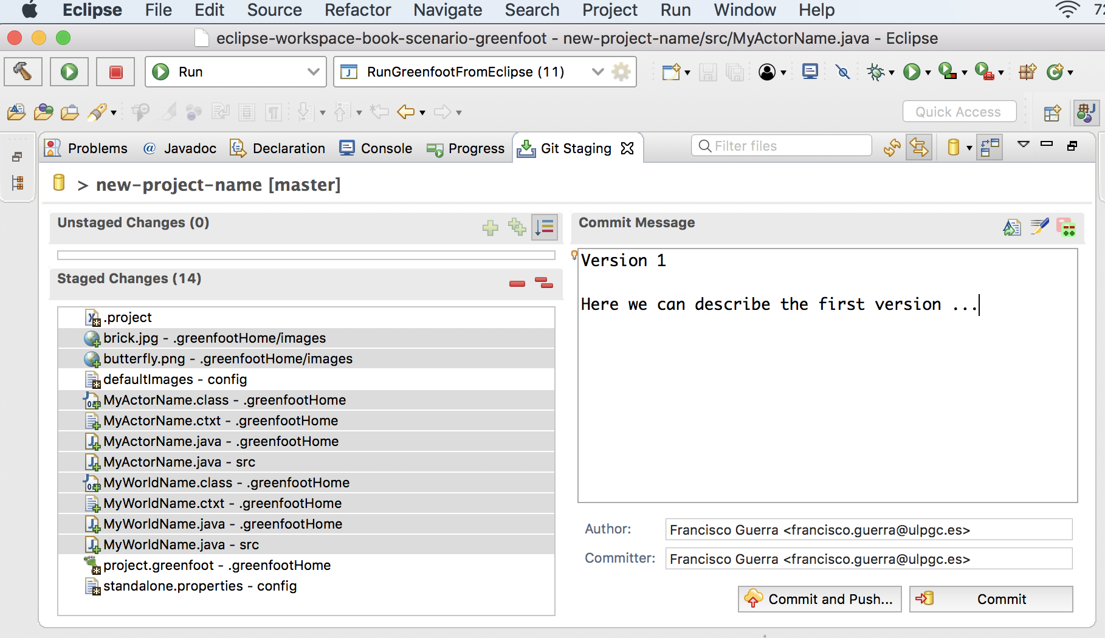
... so we can register world and actor created

Slide 53
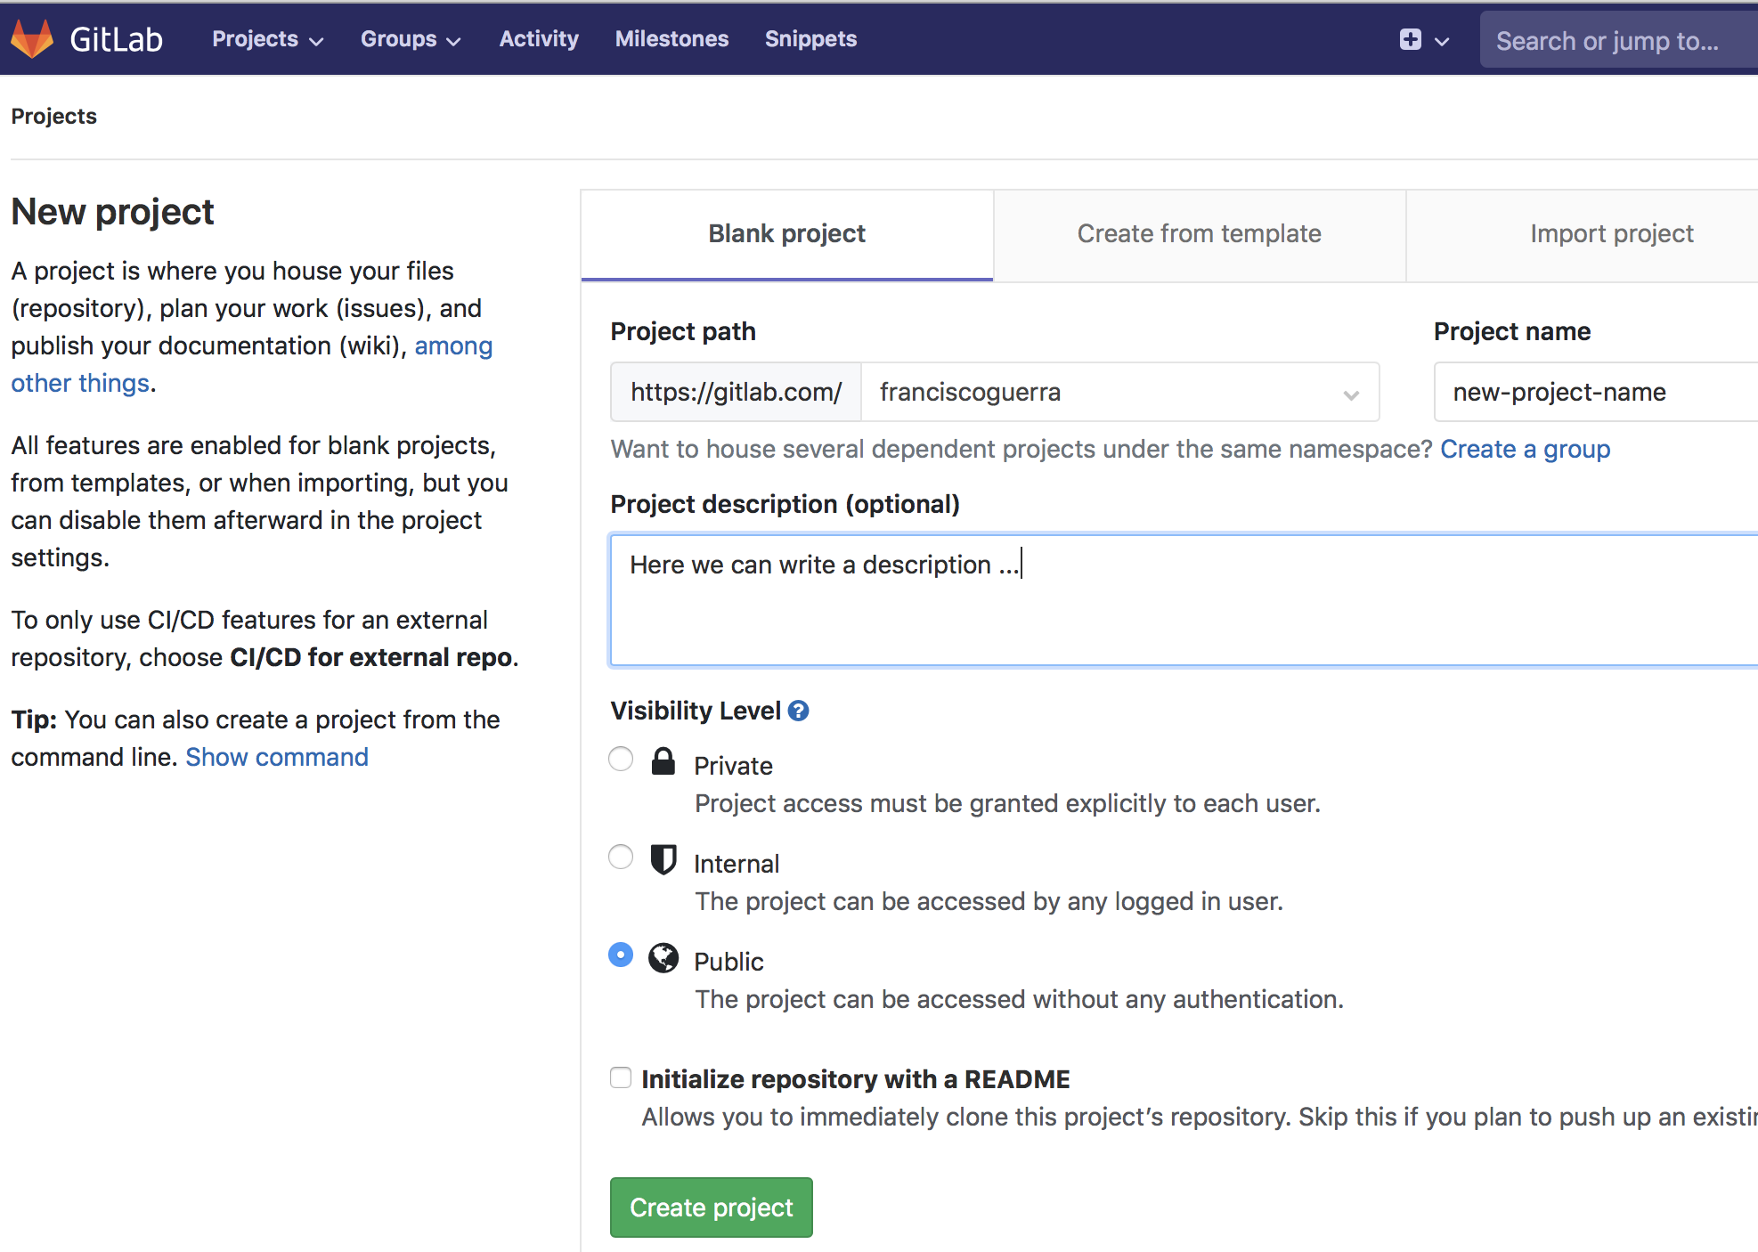
Let´s create a remote repository to new-project-name ...

Slide 54
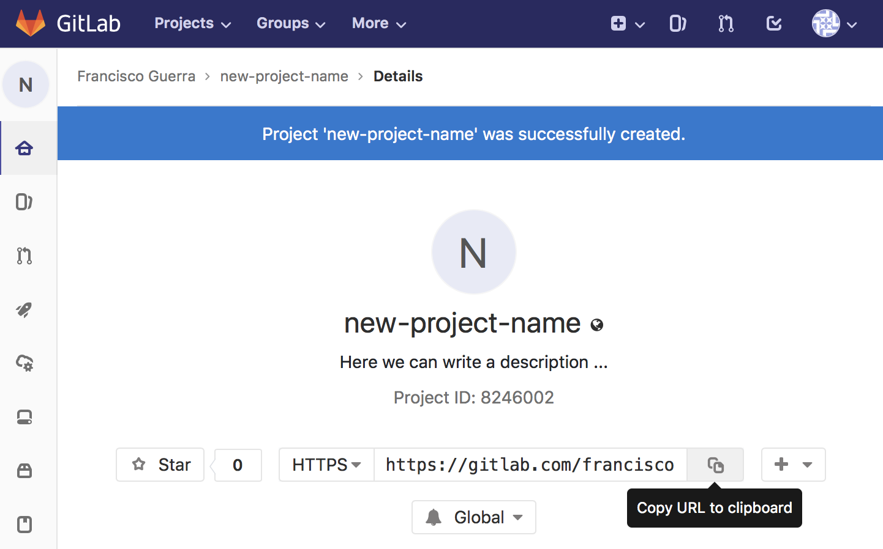
... and copy the URL of remote scenario ...

Slide 55
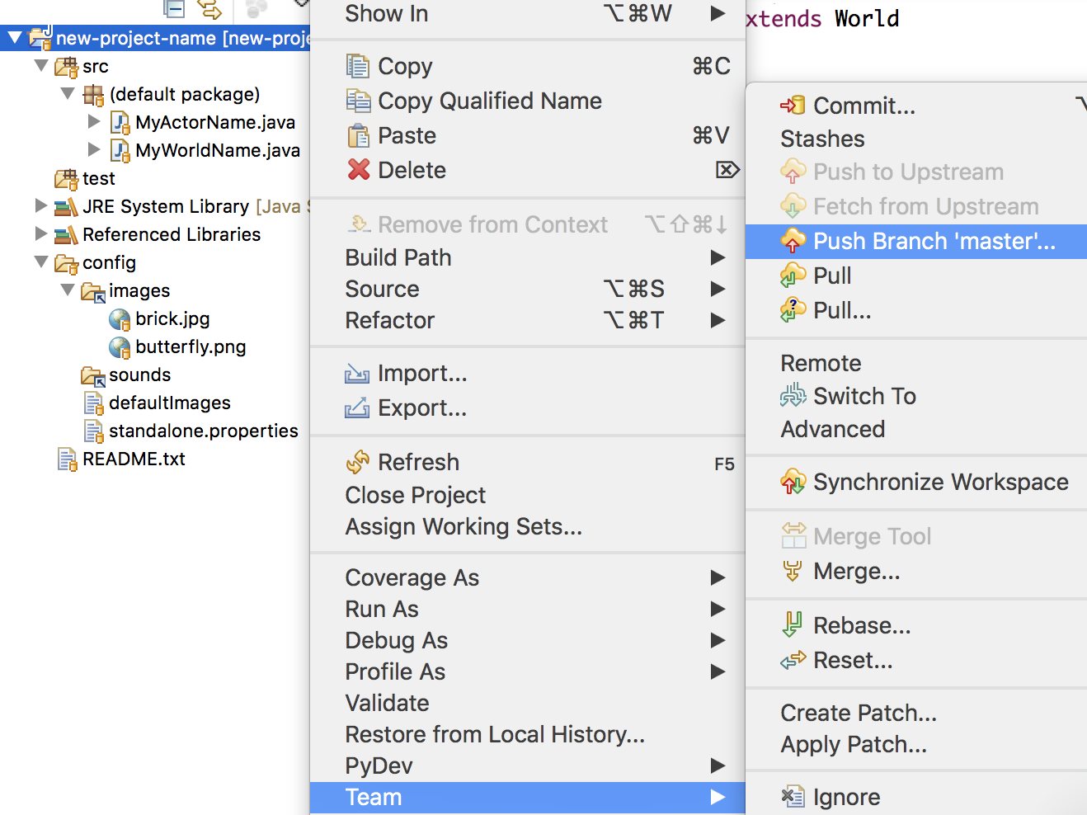
... ask Eclipse to push the local scenario into gitlab ...

Slide 56
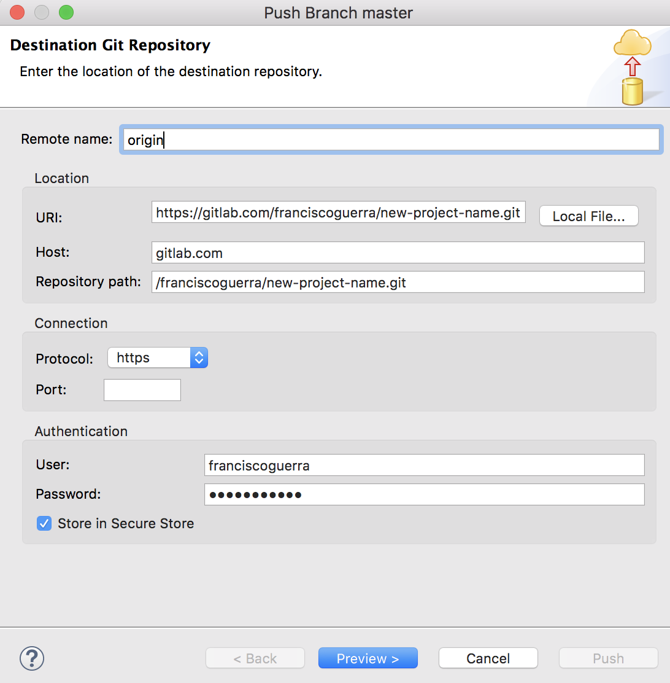
... paste URL of remote repository ...

Slide 57
... click on "Push" to confirm that it is uploaded in gitlab ...

Slide 58
... and finally, Eclipse confirms the push was done

Slide 59
Remote repository now has an identical copy to the local

Slide 60
As the scenario is in web, it can be took to another PC ...

Slide 61
... first, let´s select “Projects from Git” ...

Slide 62
... second, copy the repository URL ...

Slide 63
... third, select “Clone URI” ...

Slide 64
... fourth, paste the repository URL ...

Slide 65
... fifth, click “Next” ...

Slide 66
... sixth, browse to the Eclipse projects folder ...
The folder must be the current Eclipse Workspace

Slide 67
... seventh, select “Import existing Eclipse projects” ...

Slide 68
... we end up with “Finish”

Slide 69
We have the scenario again as we left it last time

Slide 70
“Export” is another way to take a project copy ...
Only the active version is copied (all versions of the “.git” folder are not copied)

Slide 71
... we choose “Archive File” and “Next” ...

Slide 72
... we removed the bin folder ...

Slide 73
... with “Browse”, we choose location and file name ...

Slide 74
... we end up with “Finish”

