Slide 1
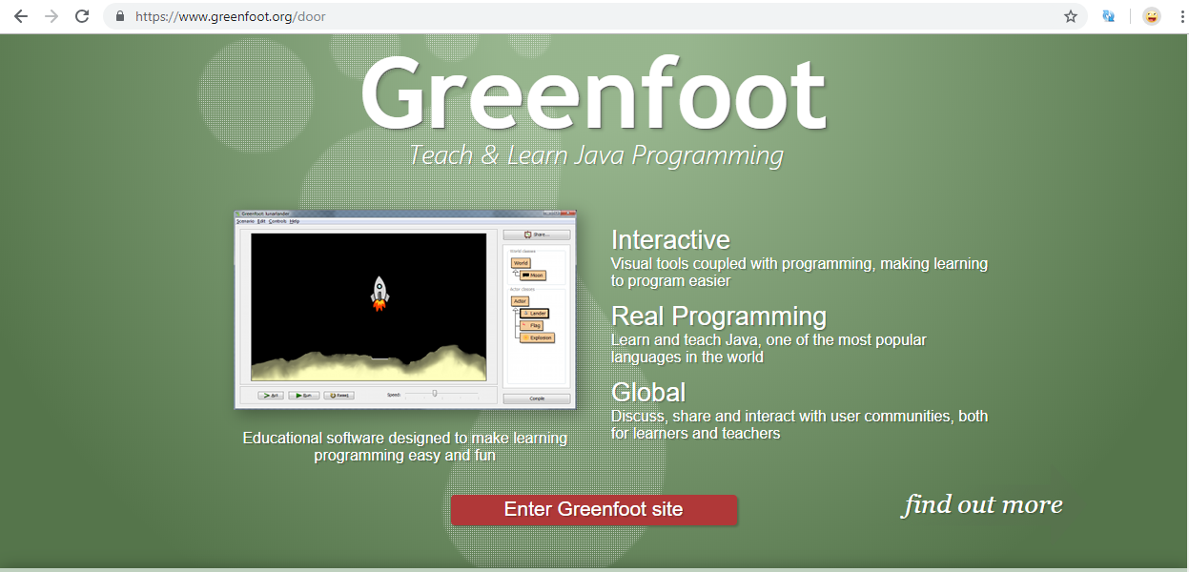
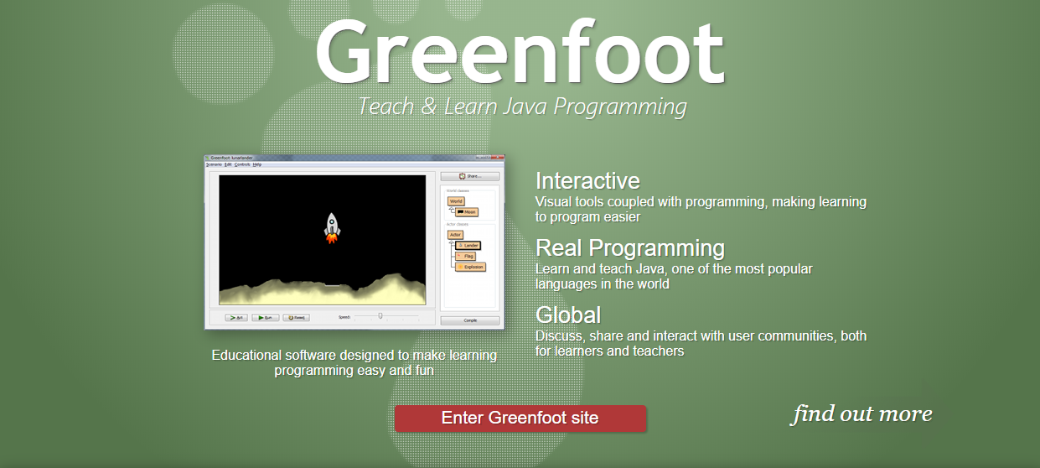
Why learn Java programming with Greenfoot?
Use true Java Programming syntax – Not Drag and Drop
Each class (thing you control and program) can easily have an image that can move around an interface. Allows for easy game and simulation design

Slide 3
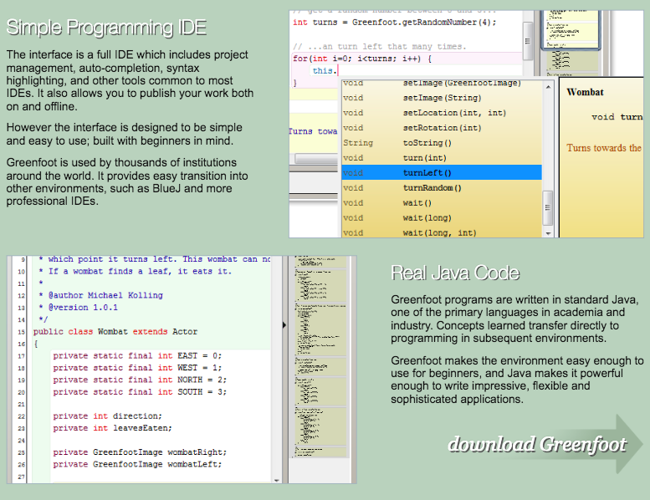

Slide 4
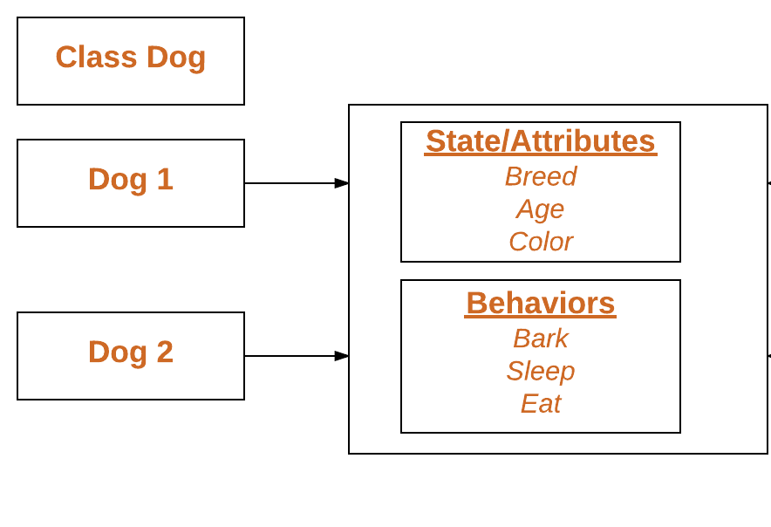
What is a class?
A class is a “blueprint” for creating objects.
The class holds the attributes and behaviors that we want our objects to have and do.
It defines a set of properties & methods that are common to all objects of one type.

Slide 5
Examples of writing a class
Attributes of Car(s)
class Car (String make, String model, double milesPerGallon, int mileage)
{
drive();
brake();
turn();
honk();
}
Behaviors of Car(s)

Slide 6
Block of Code {}
class ClassName()
{
statement(s)
}
if ( condition )
{
statement(s)
}
returnType methodName()
{
statement(s)
}
for (initialization condition; testing condition; increment/decrement)
{
statement(s)
}

Slide 7
What is an object?
An object refers to a particular instance of a class. Objects have states and behaviors that are set. Classes store the potential states an object may have.
Each object that is created is one “copy” or instance representation of the class.
Objects may have different parameters (States/attributes/characteristics) but all have the same options for behaviors and functions called methods that they can access from the class.

Slide 8
Example of an Object
Use keyword “new” to create an object or “instance” of a class.
Car myCar = new Car(”Toyota”, “Camry”, 32.2, 100,000);
Car sistersCar = new Car(“Ford”, ”Focus”, 28.5, 80,000);
Car momsCar = new Car (“Nissan”, “Murano”, 27.5, 120,000);
Notice each of these are cars, so they are of the same class, but all have certain states/attributes/characteristics given to each.
Most all of the behaviors/functions of these cars are the same, but the physical states and characteristics of each “instance” of the car class are different.

Slide 9
What is public and private?
public and private are Access Modifiers
They detail whether another class in your code can see the class, method, variables, etc.

Slide 10
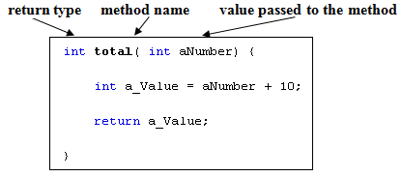
What is a method?
A method in object-oriented programming is a procedure associated with a class. A method defines the behavior of the objects that are created from the class.
Another way to say this is that a method is an action that an object is able to perform.

Slide 11
Example of a method
class Car (String make, String model, double milesPerGallon, int mileage)
public void act()
{
drive();
brake();
turn();
honk();
}
The main method in Greenfoot will be called the act() method.
These are all examples of methods being called into the main method. So there can be called methods within other methods.

Slide 12
Semicolon ends a statement ( ; )
Most, but not all, Java statements must end with a semicolon. The basic rule is that declaration and expression statements must end with a semicolon, but most other statement types do not.
When not to use semicolon
Class
Method
If-Statement
Loop

Slide 13
Block of Code {}
class ClassName()
{
statement(s);
}
if ( condition )
{
statement(s);
}
returnType methodName()
{
statement(s);
}
for (initialization condition; testing condition; increment/decrement)
{
statement(s);
}

Slide 14
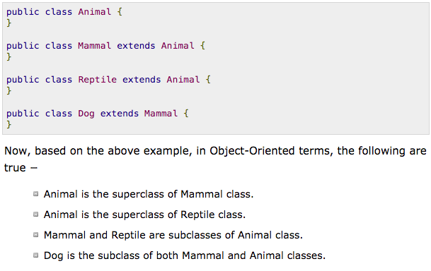
Inheritance (Subclasses and Superclasses)
Inheritance can be defined as the process where one class acquires the properties (methods and fields) of another. With the use of inheritance the information is made manageable in a hierarchical order.
Animal
Mammal
Reptile
Dog
Alligator

Slide 15
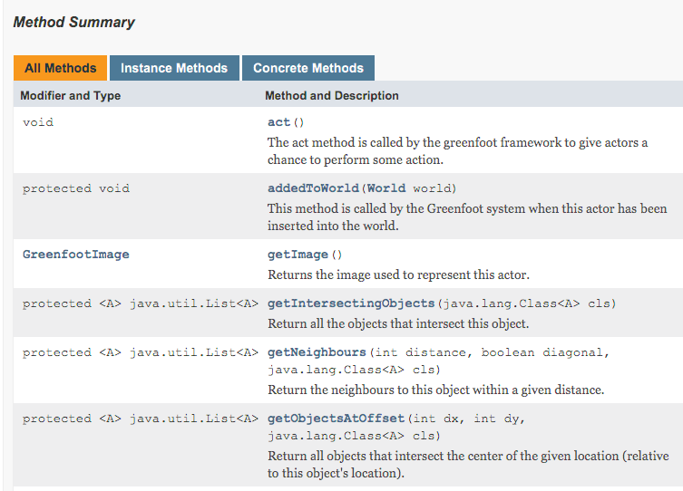
What is the Greenfoot API?
What does Application Programming Interface (API) mean?
a collection of prewritten packages, classes, and interfaces with their respective methods, fields and constructors.

Slide 16
What is a variable?
Variables are used to store information to be referenced and manipulated in a computer program.
They also provide a way of labeling data with a descriptive name, so our programs can be understood more clearly by the reader and ourselves.
It is helpful to think of variables as containers that hold information.
Their sole purpose is to label and store data in memory.
This data can then be used throughout your program.

Slide 17
Java provides three types of variables.
Class variables − Class variables also known as static variables are declared with the static keyword in a class, but outside a method, constructor or a block. There would only be one copy of each class variable per class, regardless of how many objects are created from it.
Instance variables − Instance variables are declared in a class, but outside a method. When space is allocated for an object in the heap, a slot for each instance variable value is created. Instance variables hold values that must be referenced by more than one method, constructor or block, or essential parts of an object's state that must be present throughout the class.
Local variables − Local variables are declared in methods, constructors, or blocks. Local variables are created when the method, constructor or block is entered and the variable will be destroyed once it exits the method, constructor, or block.

Slide 18
Class Variables vs. Instance Variables
Class Variables are defined using the “static” keyword.
static boolean isAnyObjectAtEdge = false;
static int score = 0;
static int speed = 3;
Instance Variables are defined outside any {} or blocks with just the data type in front.
int health = 5;
int count;

Slide 19
Local Variables Example
Local variables are declared in methods, constructors, or blocks.
public void act()
{
int a = 0;
System.out.println(a);
}
In this example the integer variable ”a” is only available inside of the act() method and would be destroyed/unavailable upon leaving the act() method

Slide 20
Example of Variables
Variable Declaration – How to declare a variables name and it’s value (sometimes)
String myName = “Mr. Crow”;
int myAge = 28;
double myHeight = 5.75;
boolean isOverSixFeet;

Slide 21
What is a data type?
In computer science and computer programming, a data type or simply type is an attribute of data which tells the compiler or interpreter how the programmer intends to use the data.
Most programming languages support common data types of real, integer and boolean.

Slide 22
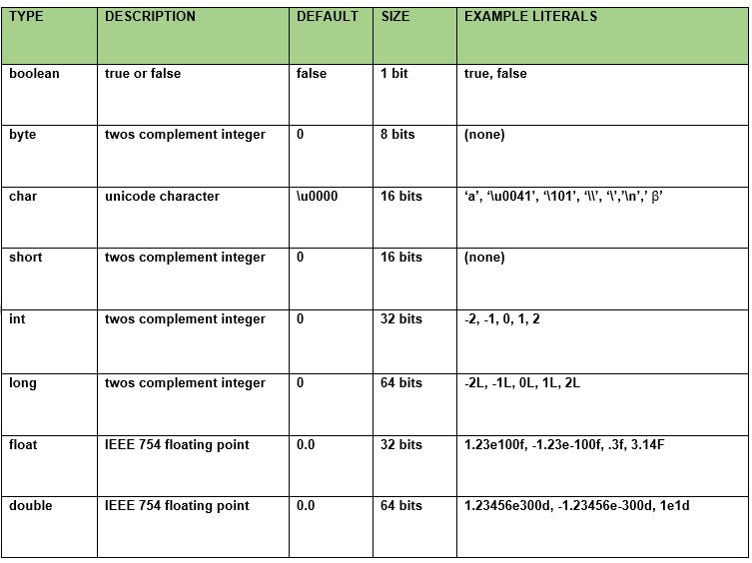
Example of primitive data types
Primitive data
Primitive data are only single values; they have no special capabilities. There are 8 primitive data types

Slide 23
What is an int? (integer)
int is a primitive type. Variables of type int store the actual binary value for the integer you want to represent. Integers (int) are whole numbers.
This is great for storing things that count.
int score;
int timer;
Ints will also come in to play when creating loops because they can count the number of times we want to do the loop.
for (int i = 0; i < 10; i++)
{
System.out.println(“This loop has happened “ + i + “ times”);
}

Slide 24
What is a String? (Array of “char” objects)
Strings are a sequence of characters (char). In Java programming language, strings are treated as objects. The Java platform provides the String class to create and manipulate strings.
This is why we capitalize the “S” in String, because when we declare our string, we are creating an array of “char” objects of the String class.

Slide 25
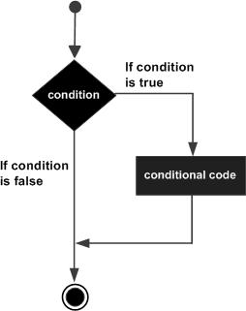
What is a boolean?
If the Boolean expression evaluates to true then the block of code inside the if statement will be executed. If not, the first set of code after the end of the if statement (after the closing curly brace) will be executed.
Flow Diagram
boolean data type represents one bit of information
There are only two possible values: true and false
This data type is used for simple flags that track true/false conditions
Default value is false
Example: boolean one = true

Slide 26
What is an if-statement?
If the Boolean expression evaluates to true then the block of code inside the if statement will be executed. If not, the first set of code after the end of the if statement (after the closing curly brace) will be executed.
Flow Diagram
An if statement consists of a Boolean (true or false) expression followed by one or more statements.
If the Boolean expression evaluates to true then the block of code inside the if statement will be executed. If not, the first set of code after the end of the if statement (after the closing curly brace) will be executed.

Slide 27
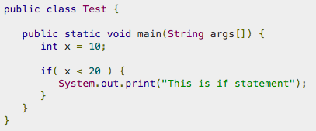
Example of an if-statement

Slide 28
Basic Java Operators
Arithmetic Operators ( + , - , / , * , %, ++, --)
Relational Operators (==, !=, <, >, <=, >= )
Logical Operators (&&, ||, !)
Assignment Operators (=, +=, -=, *=, /=, %=)

Slide 29
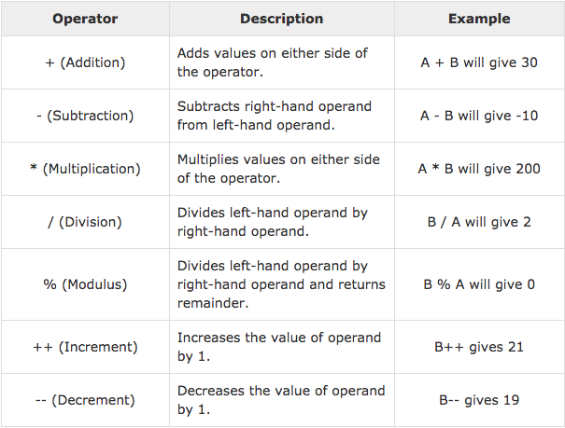
Arithmetic Operators
Arithmetic operators are used in mathematical expressions in the same way that they are used in algebra. The following table lists the arithmetic operators −
Assume integer variable A holds 10 and variable B holds 20, then −

Slide 30
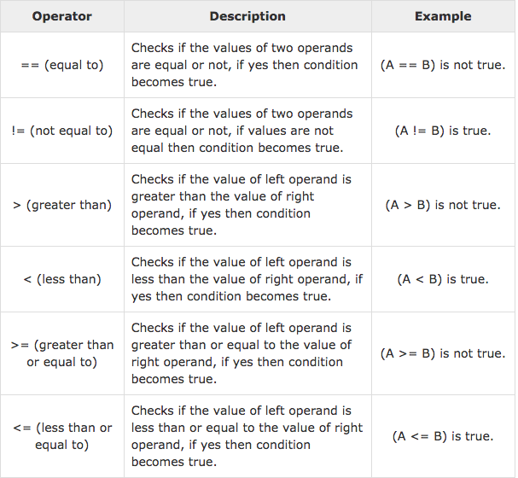
Relational Operators
The following are relational operators supported by Java language.
Assume variable A holds 10 and variable B holds 20, then −

Slide 31
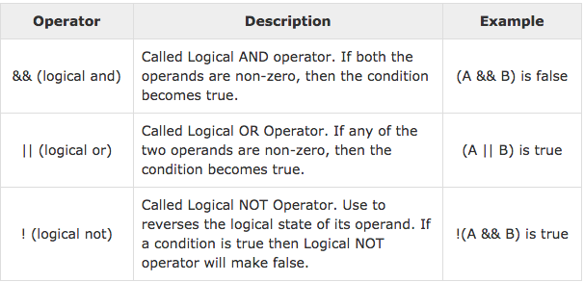
Logical Operators
The following table lists the logical operators −
Assume Boolean variables A holds true and variable B holds false, then −

Slide 32
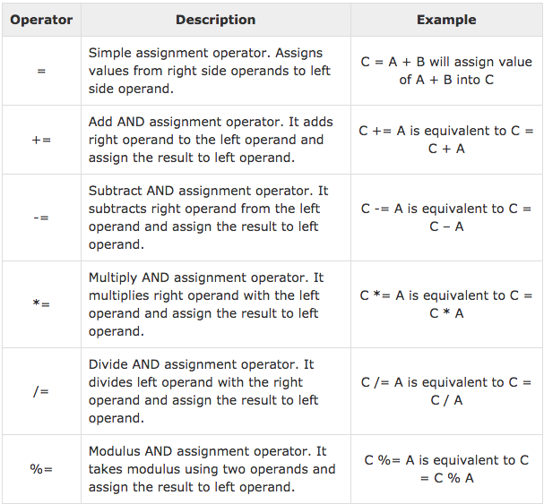
Assignment Operators
The following are the assignment operators supported by Java language −

Slide 33
What is a Return Type?
In computer programming, the return type (or result type) defines and constrains the data type of the value returned from a subroutine or method.
In many programming languages (especially statically-typed programming languages such as C, C++, Java) the return type must be explicitly specified when declaring a function.
public void methodName() – (void) does not return anything. Simply instruction or command.
public int getScore(int score) –(int) returns an int

Slide 34
Void Return Type
(void) does not return anything. Simply an instruction or command.
public void move(){
setLocation(getX() + 5, getY());
}
public void turn()
{
setRotation(getRotation() + 10);
}

Slide 35
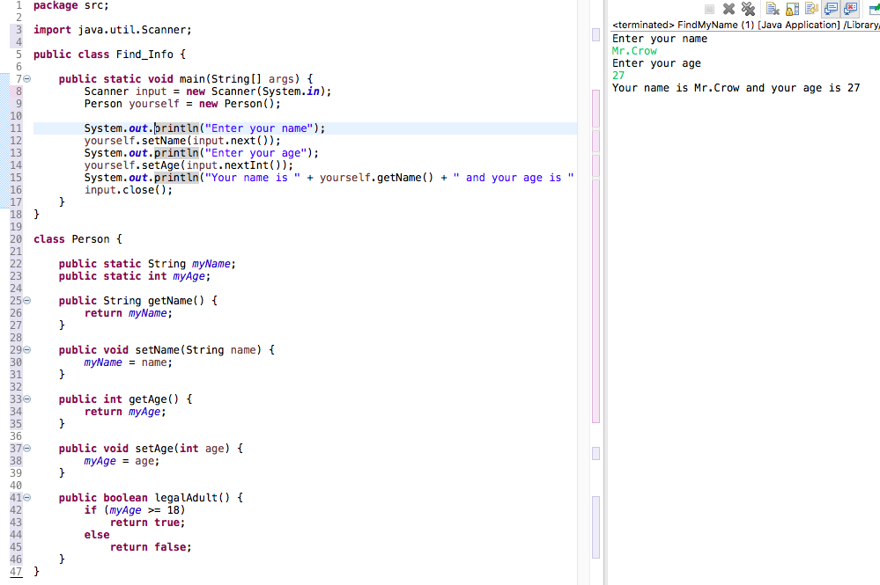
Non-Void Return Type – String , int, boolean

Slide 36
What is a parameter? What are the ()?
In Java, parameters sent to methods are passed-by-value.
What is passed "to" a method is referred to as an "argument".
The "type" of data that a method can receive is referred to as a "parameter".

Slide 37
Example of using parameters

Slide 38
What is a constructor? What is a class field?
A constructor in Java is a block of code similar to a method that’s called when an instance of an object is created.
A constructor allows you to provide initial values for class fields when you create the object.
These class fields represent different states/traits/characteristics such as, for a class Person, might be things like name, age, height, weight, hairColor. A class Car might have make, model, year, mileage, mpg, color, suv, etc.

Slide 39
Example of Constructor and class fields

