Slide 1
Adding sound in Greenfoot
Best Practices for Music and Sound Effects

Slide 2
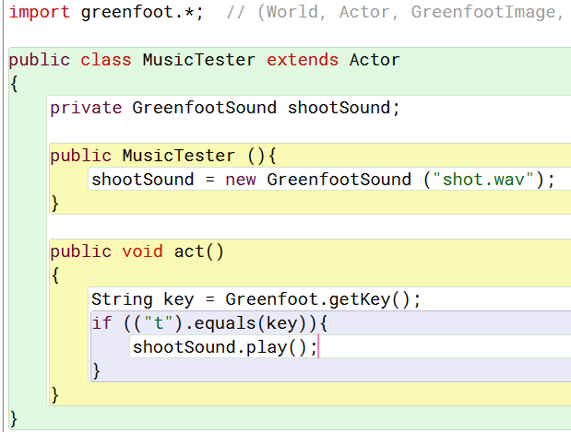
Adding sound
Greenfoot makes it easy to add sound
Before this code can work, a file called “shot.wav” must be saved in the sounds folder within your project
The basic process is simple, but there are many best-practices that will result in a better audio experience for your users

Slide 3
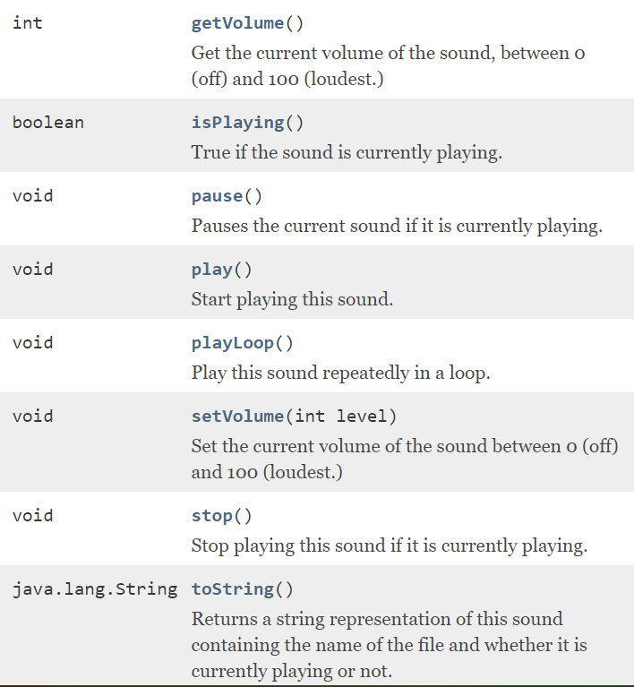
Greenfootsound
Greenfoot provides a GreenfootSound class to help easily manage audio.
The API gives you an idea of how to use this class – similar to how you use a GreenfootImage

Slide 4
Choose .wav files for sound effects
MP3 files, which most students are more familiar with, are intended for music with the primary goal creating small, manageable files.
However, MP3s sacrifice quality, as well as requiring a computer to decompress them in order to play them (this happens automatically with any MP3 player, even if you never thought about it before).
WAV files are uncompressed. This means they take up significantly more space. But it also means that they are easy to process, and high quality. In general, they are a better choice for sound effects

Slide 5
Choose .MP3 for music, Usually
Consider that most sound effects range from less than a second to a few seconds long – so these files are always fairly small
Music can be stored in the same file types, but songs are usually 2+ minutes, so the files can start to be a lot larger
A 5 min. song as an MP3 file = ~5 MB
A 5 min. song as a .WAV file = ~60 MB

Slide 6
Warning!
The sound processor that Greenfoot uses does not like all MP3s equally
If you have found a sound file that you like, but you keep getting an error when opening it (and you’re sure you’ve got the file name correct, and the file is saved in the “Sounds” folder) but it just wont work! If this happens, you have two options:
You may simply find another sound file
You may open up the file in Audacity or another audio editor, and do a “Save As” to re-encode the music. This also lets you change things like the file type (I.e. open an MP3, save it as a WAV) or change the compression ratio on MP3s (quality vs file size)

Slide 7
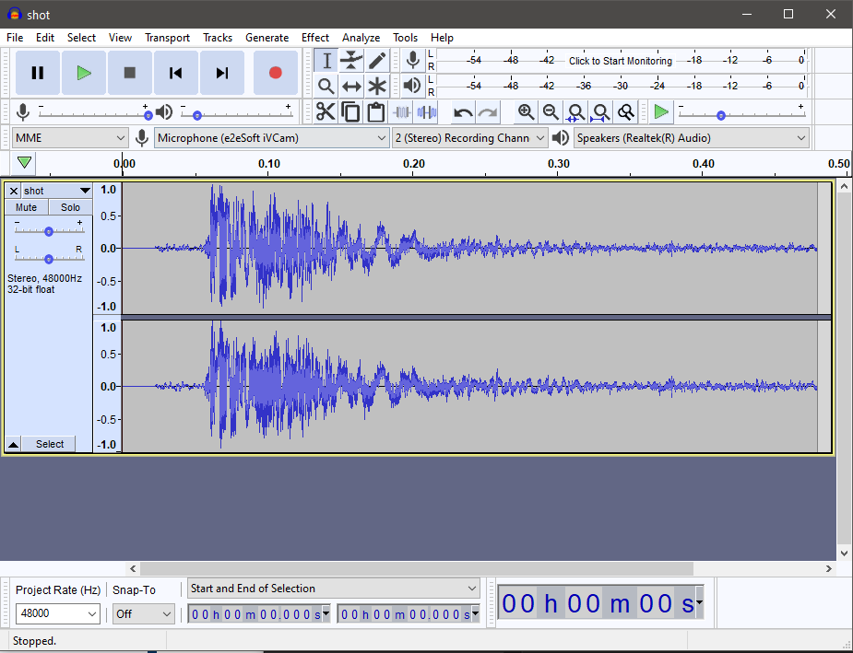
Audacity
Audacity is FREE!
Audacity is easy to use to make simple tweaks to your sound
Audacity includes dozens of free “effects” that can be applied to a sound file
Audacity is a powerful music recording tool for musicians on a budget

Slide 8
Not so … fast
The simple method on the previous slide has an issue
If you try to play sounds quickly in succession, the sound won’t start playing again until the original “play” is finished. (Instead of pop-pop-pop, you get pop…wait…pop… wait…pop. Or just nothing.)
This is a weakness in the sound engine – a sound object cannot be played simultaneously with itself, meaning you can’t start it again while letting the previous sound “ring out”
See the next slide for a creative workaround by Mr. Cohen

Slide 9
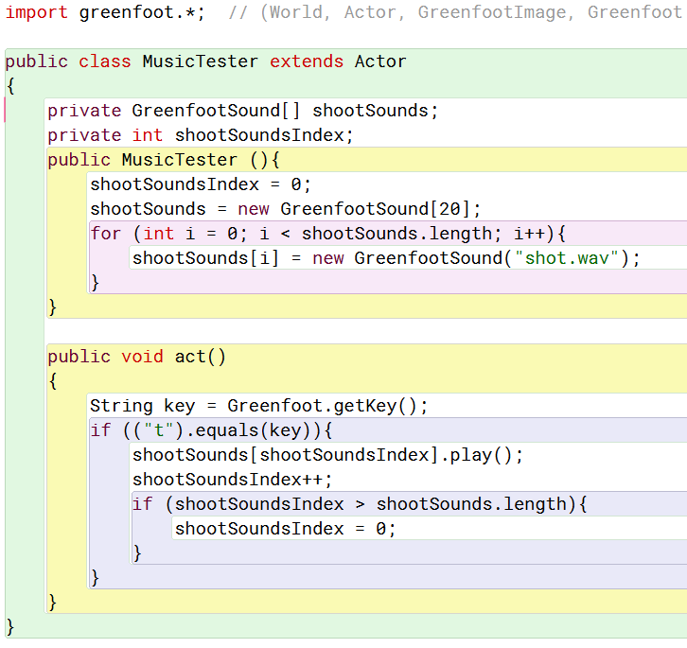
Using array
My “trick” involves using a simple array to store 20 copies of the same sound
These are unique copies, each opened from the sound file separately (during the constructor).
20 is an arbitrary number. You could probably get away with fewer. This should be minimized to make this admittedly inefficient method be as light as possible
-1){

Slide 10
music
When adding Music, it’s important to pre-load the music file
However, you want to ensure that your music does not start playing when the World loads – otherwise you won’t be able to stop it from loading when you aren’t ready for it to play.
Unbeknownst to most Greenfoot programmers, there is a fun and useful method called started() that is automatically called when the World starts running (via the user clicking the “Run” button).
For scenarios with multiple worlds: Put the play() command in the started() method for the first World loaded (I.e. WelcomeWorld) but put the play() command in the constructor for each world started by the setWorld() command

Slide 11
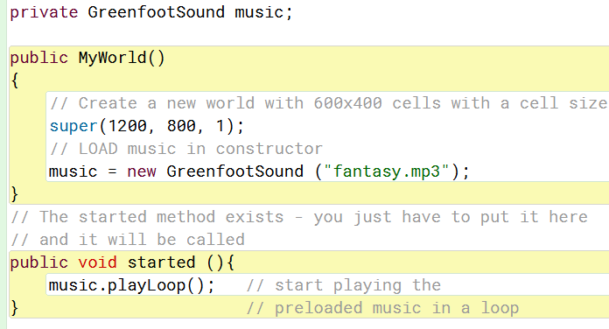
Playing in the started method

Slide 12
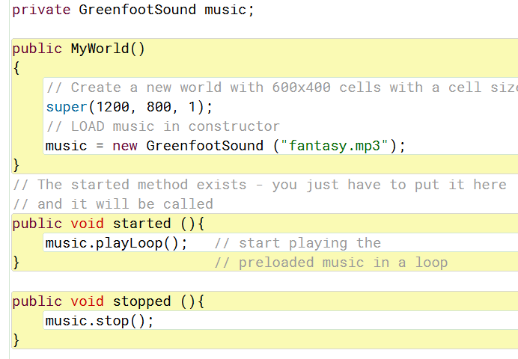
Stopping the music
Each music piece that is started in the started() method should be stopped in the stopped() method.
This way, when you pause or stop your game, it won’t continue to play unwanted music.
Also ensures sounds stop before switching Worlds

Slide 13
Setting the volume
Greenfoot allows you to set the volume of each sound independently
This allows you to make sure that all sounds are played at an appropriate sound level, at the same volume, and that sounds can still be heard over the music
You can use the .setVolume(int) method for creative touches, too, such as
Allowing the user to specify sound effects and music volumes
Making the music quieter or louder for cutscenes, etc.
Making something slowly quieter or louder for emphasis

Slide 14
attribution
When using sound files for your project, please keep track of where you acquired each file, as well as the musician/creator if one is listed
You may not use commercial music in commercial projects. You may use commercial music within projects for my course (assuming of course you won’t try to profit off of your creation), but commercial music is often not a great choice for background music in a game as it is distracting
Search for “royalty free game music” and you will find plenty! Just keep track of where you got it from – artists / musicians / creators deserve credit!

Slide 15
General best practices
Choose high quality music (MP3 or WAV) and sound effects (WAV)
01
Use arrays of identical sound objects if you want to play the same sound repeatedly without interrupting the first sound
02
Use the started() and stopped() method of class World to make sure music plays at the correct time
03
Attribute your music to its creators
04

