Slide 1
Eclipse Projects of Greenfoot Book Scenarios

Slide 2
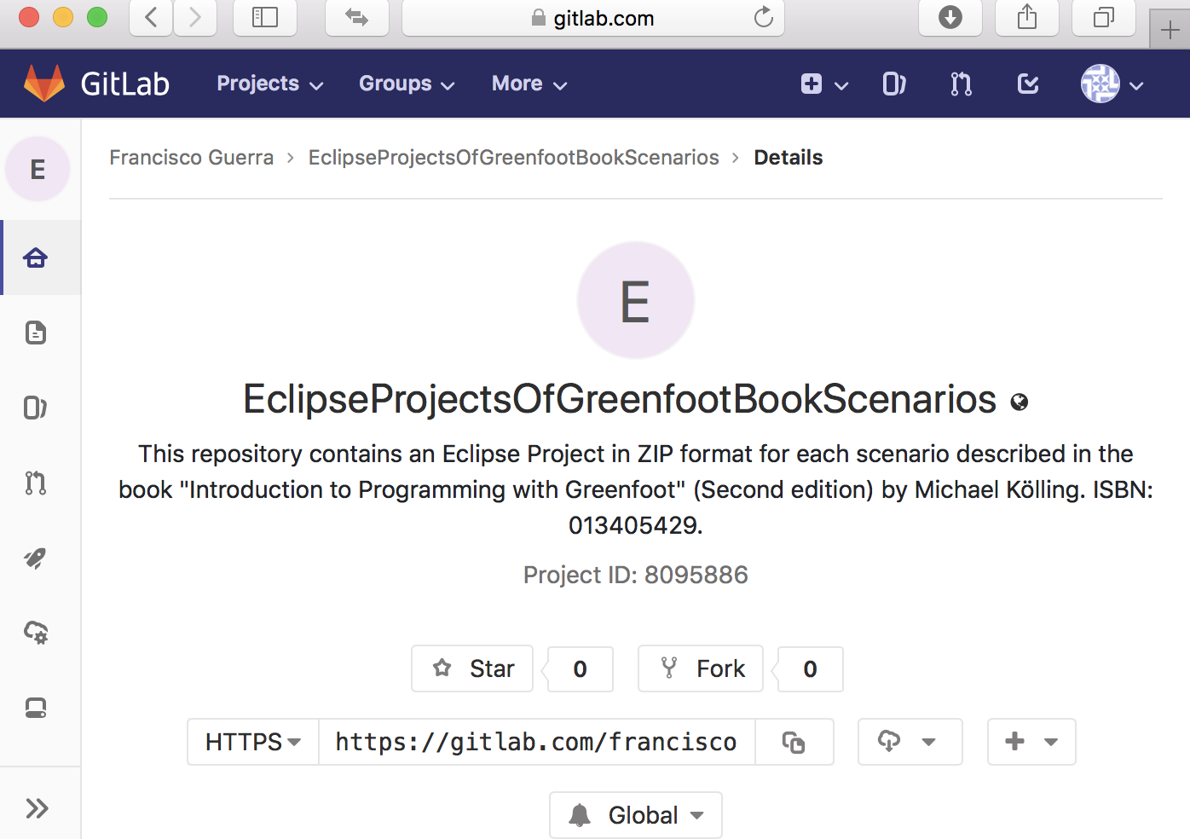
Greenfoot book scenarios for Eclipse are on the WEB
https://gitlab.com/franciscoguerra/EclipseProjectsOfGreenfootBookScenarios.git

Slide 3
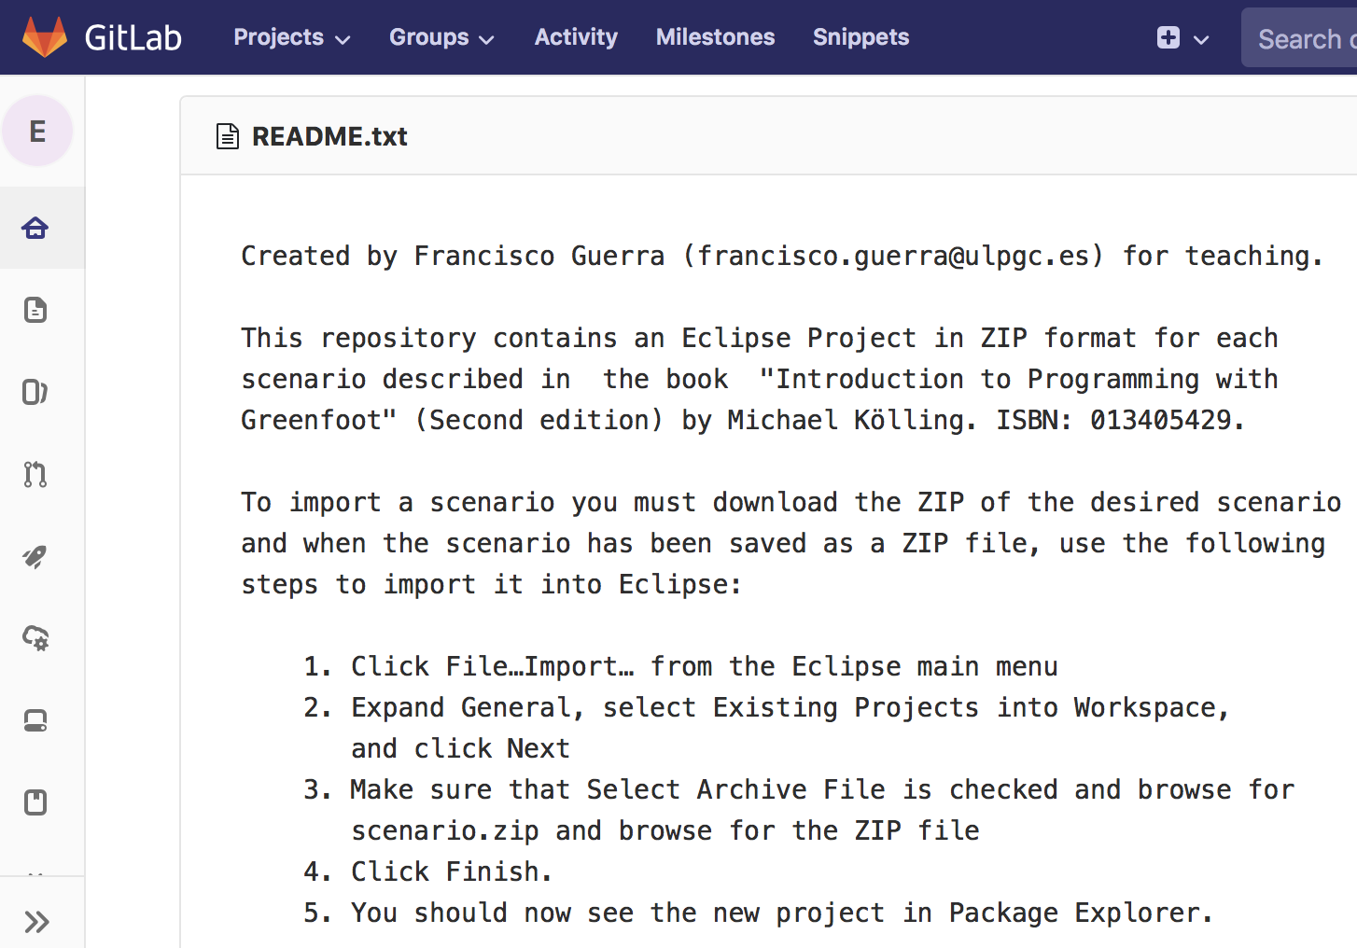
README explains how to import any scenario

Slide 4
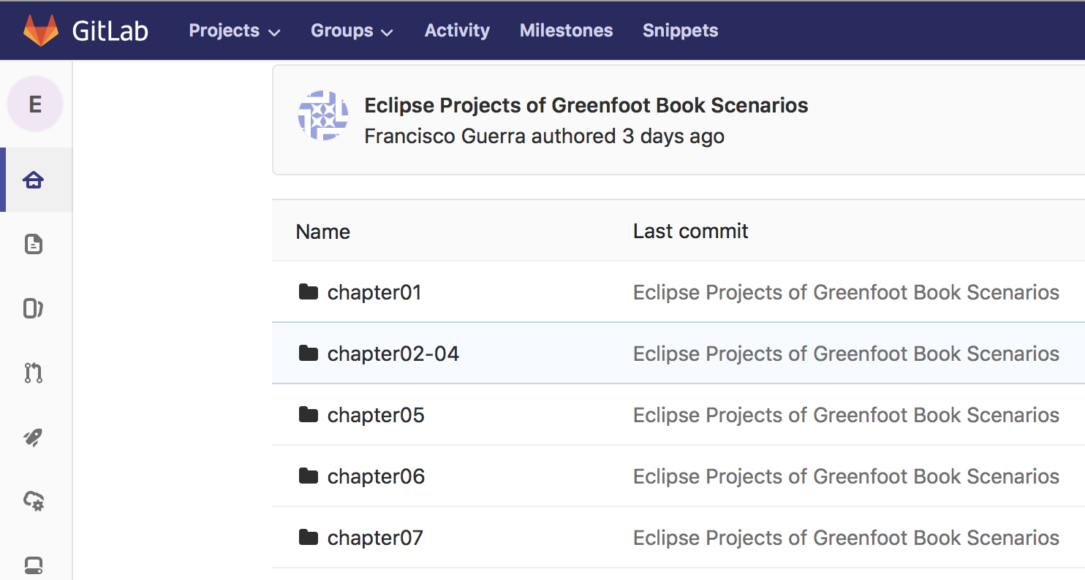
Let's choose from the chapter02-04 folder ...

Slide 5
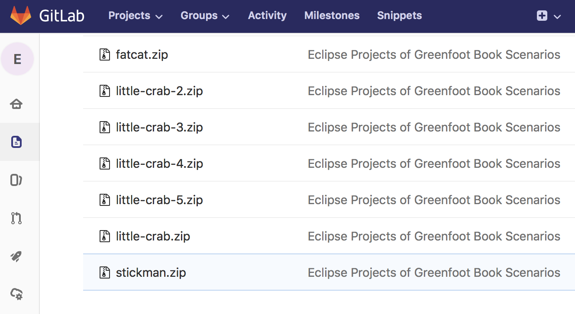
... the stickman scenario ...

Slide 6
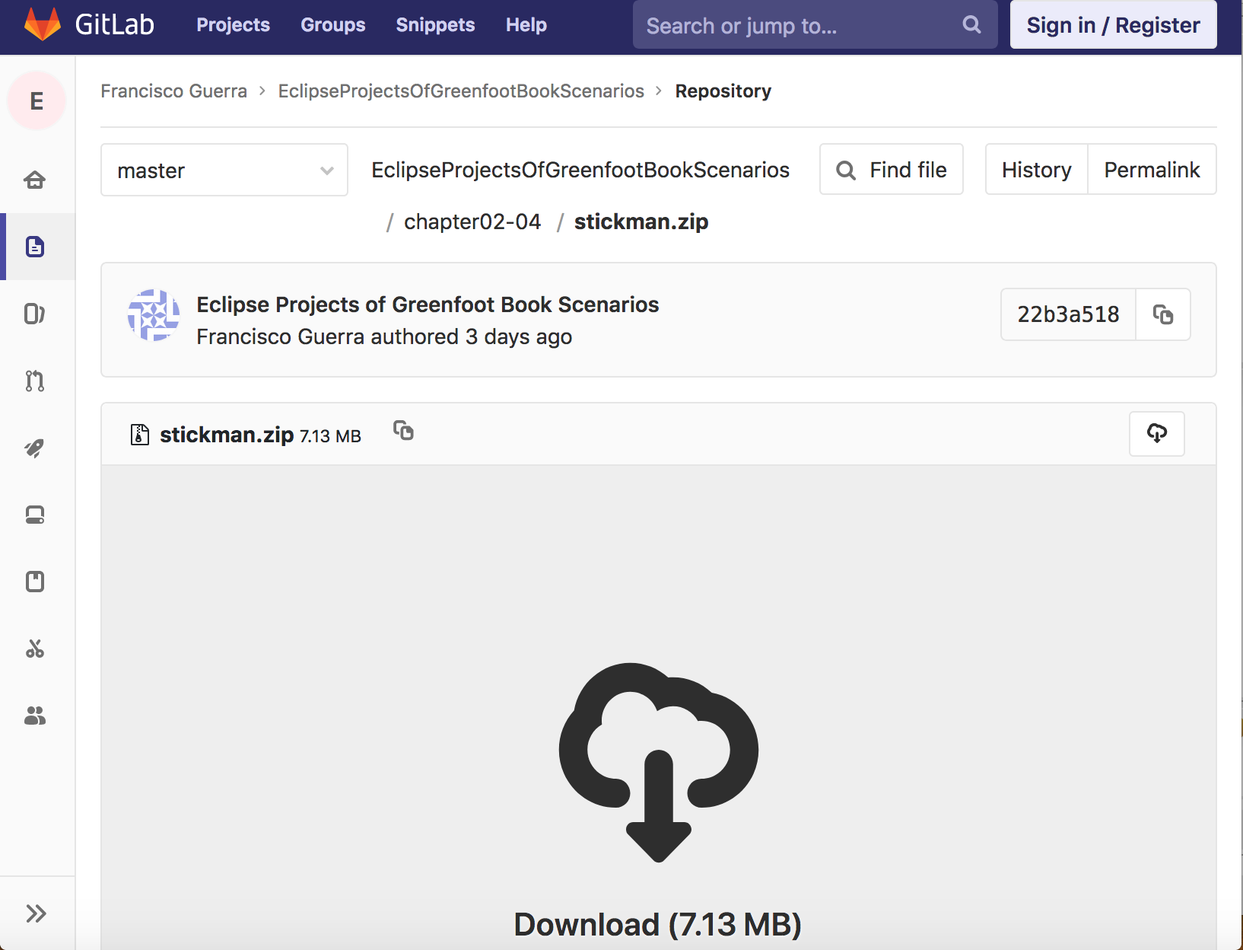
... and download stickman.zip file to local folder

Slide 7
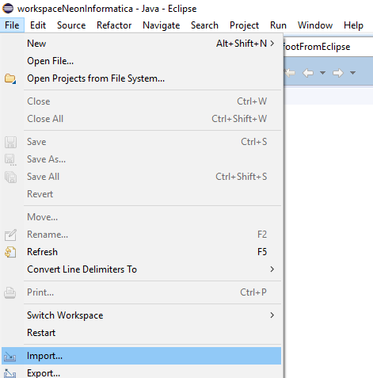
Now, we can import the zip from download folder …

Slide 8
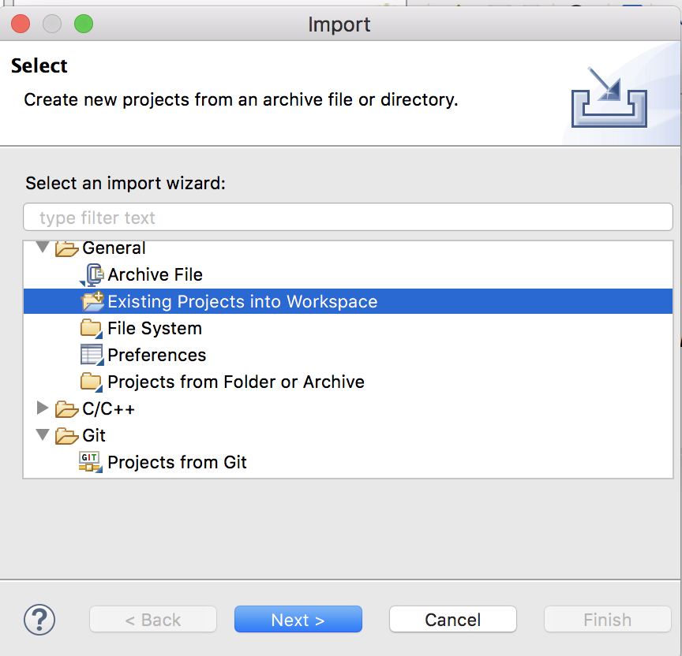
… first, click “Existing projects into Workspace” ...

Slide 9
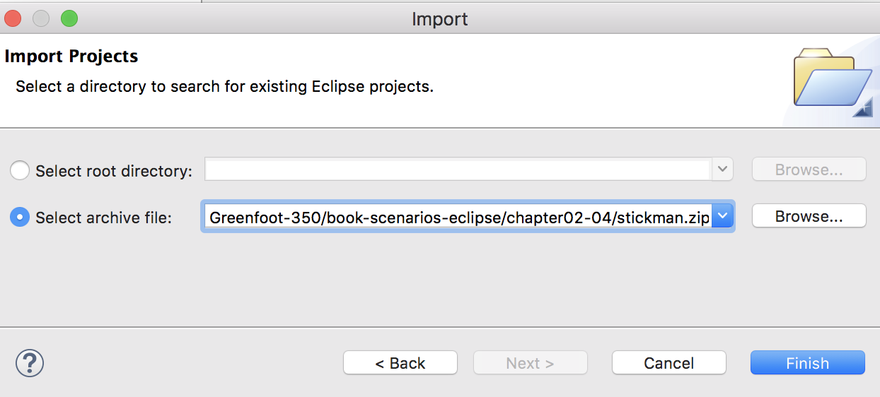
… second, browse up to the zip file …

Slide 10
… and third, click “Finish”

Slide 11
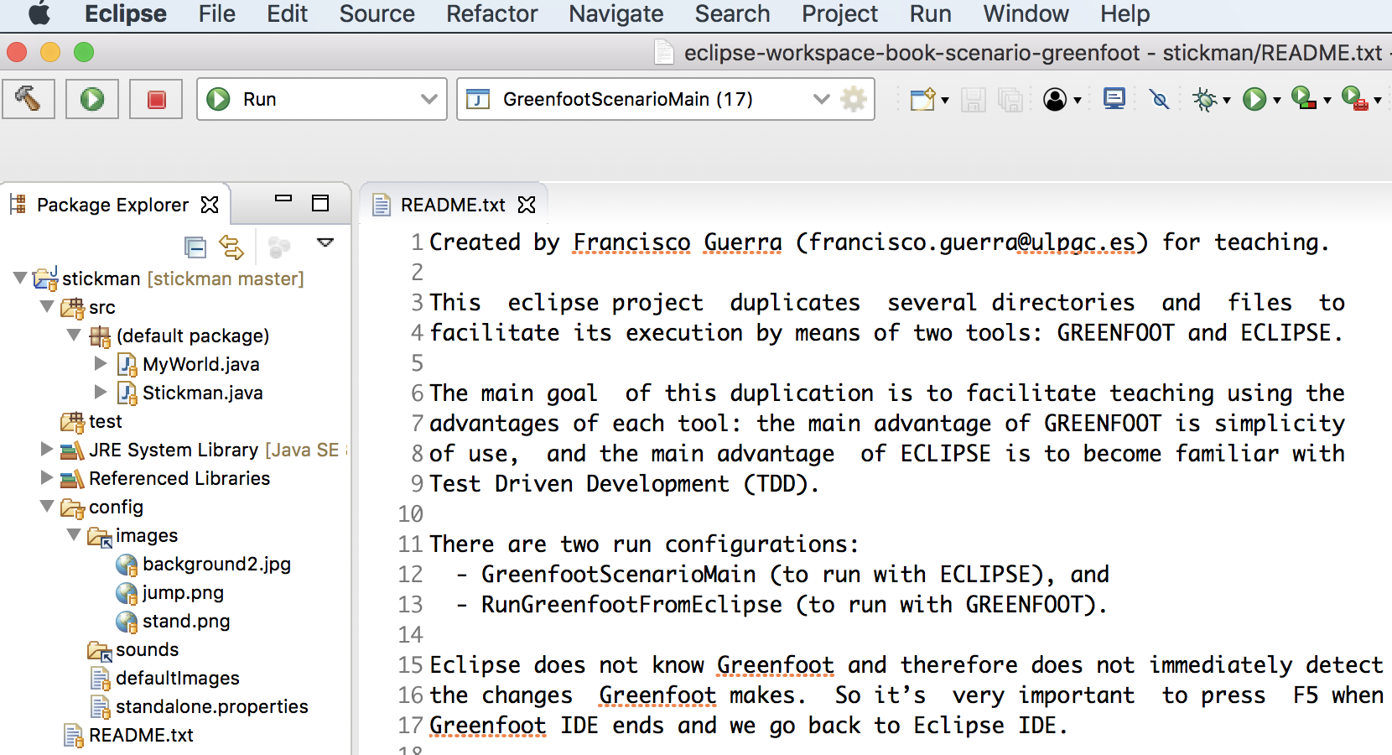
README helps to understand and use the scenario

Slide 12
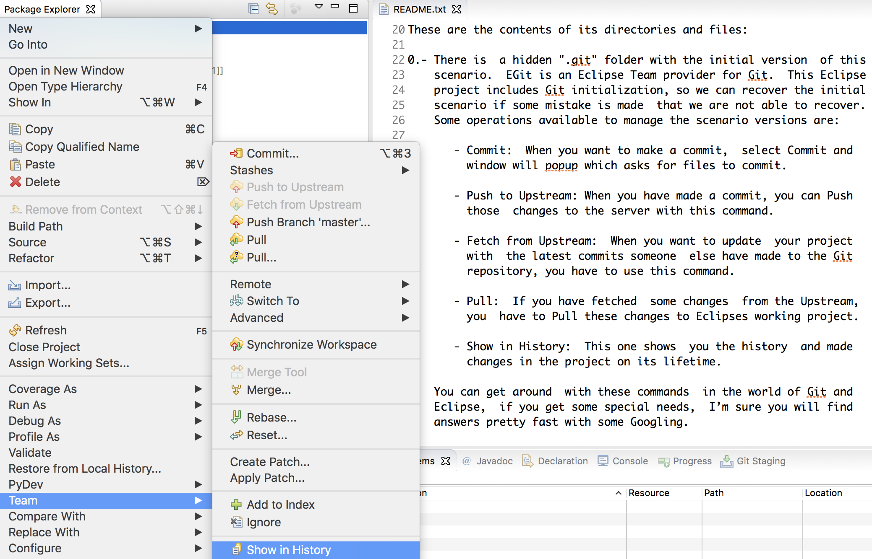
All scenarios of zip files includes local repository

Slide 13
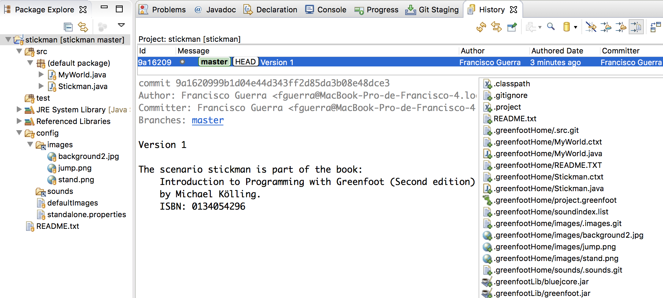
Git history of stickman shows the local commit Version 1
stickman.zip includes git init + git add . + git commit –m “Version 1”

Slide 14
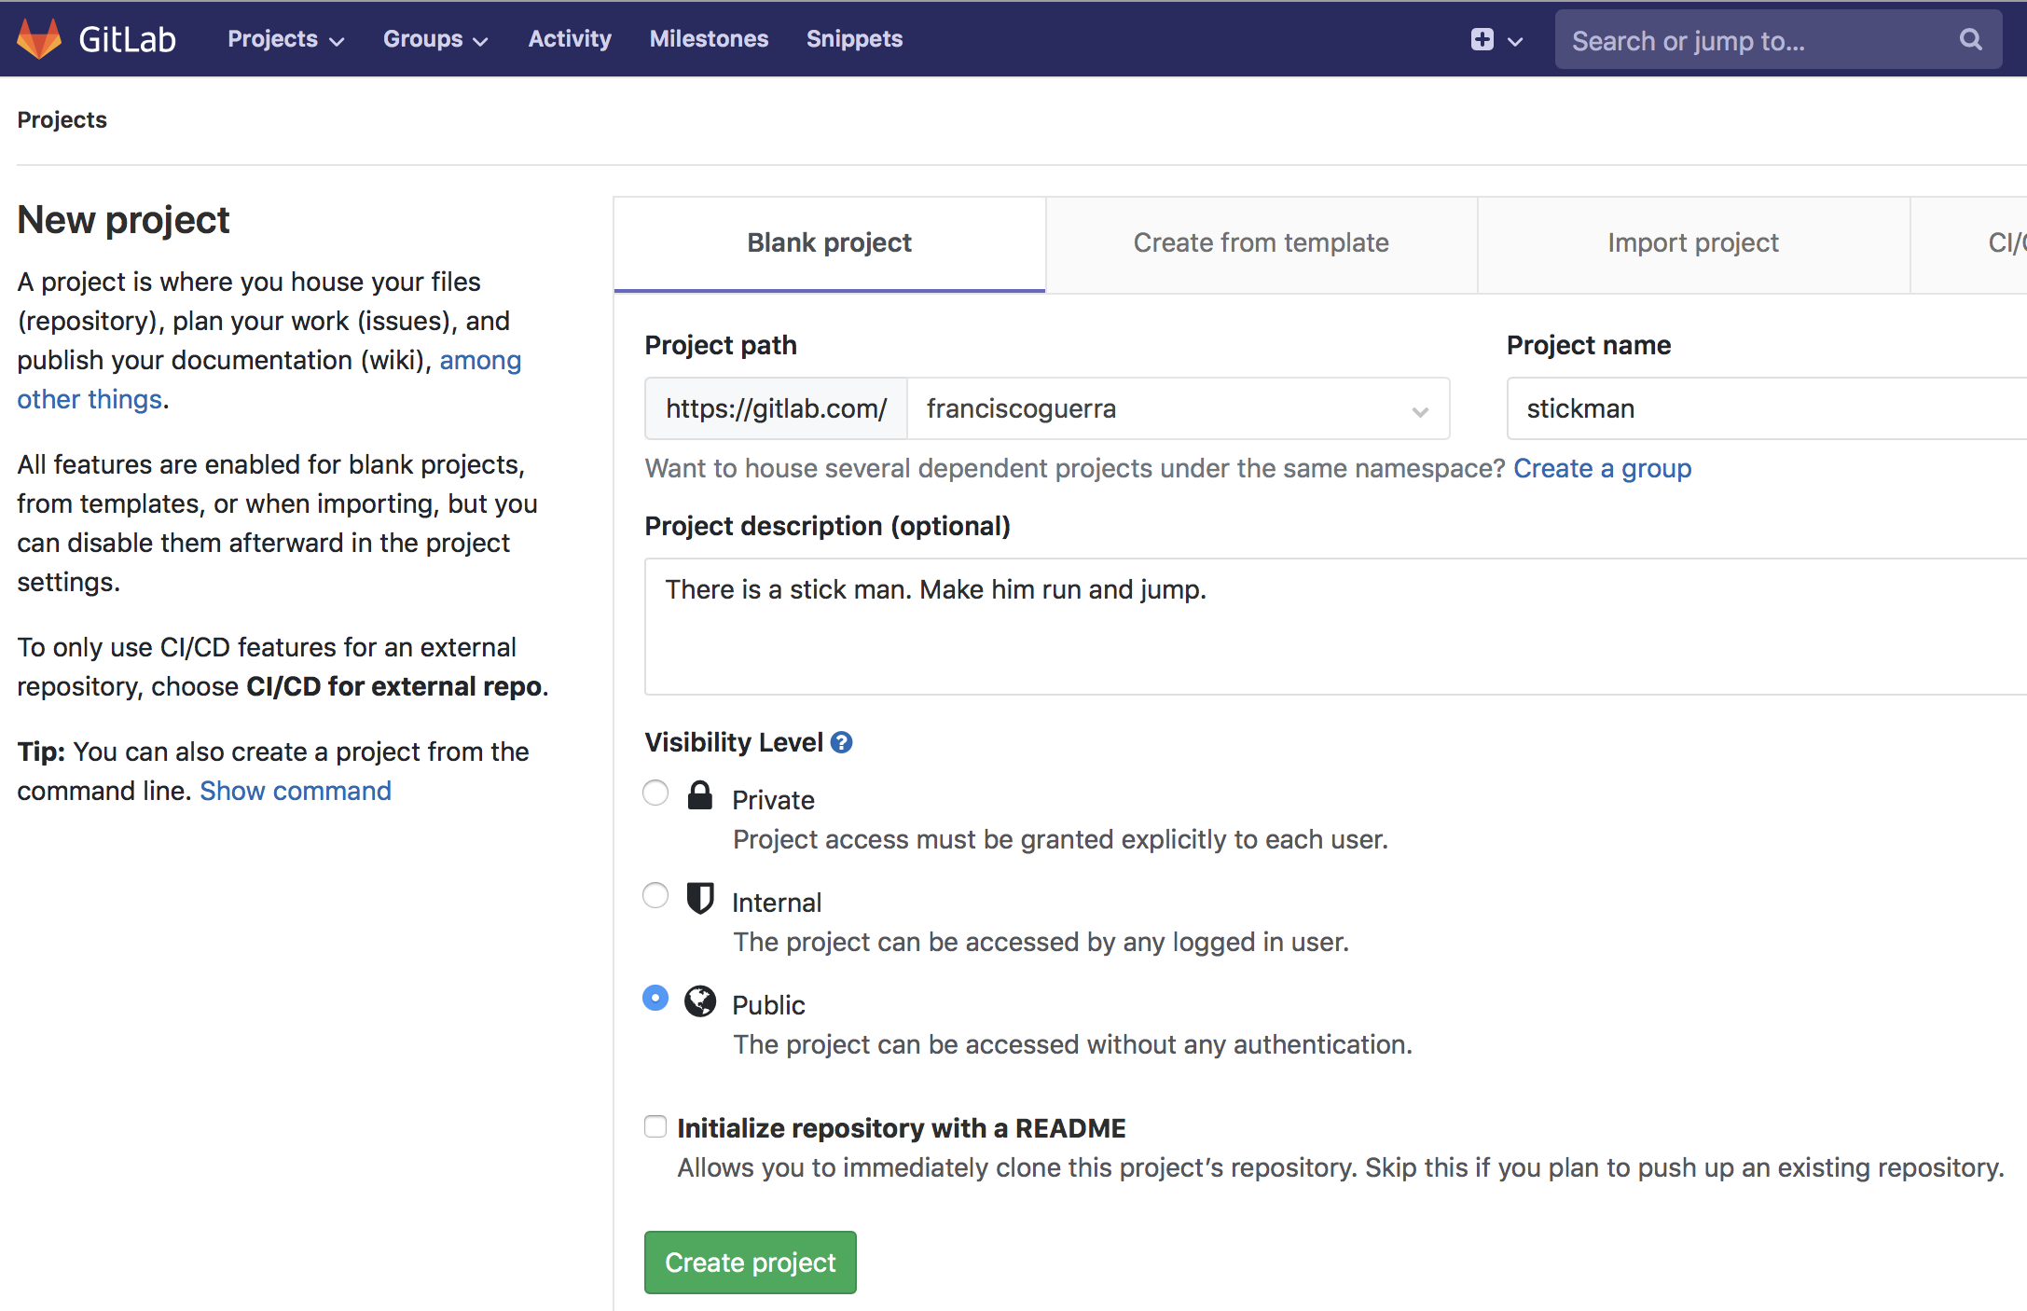
Let´s create a remote repository to stickman ...

Slide 15
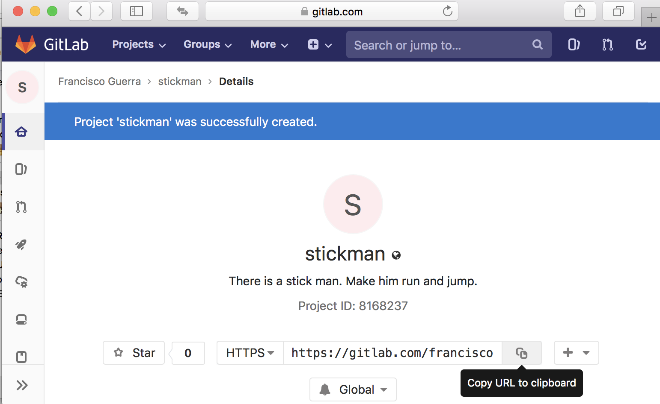
... and copy the URL of remote stickman scenario ...

Slide 16
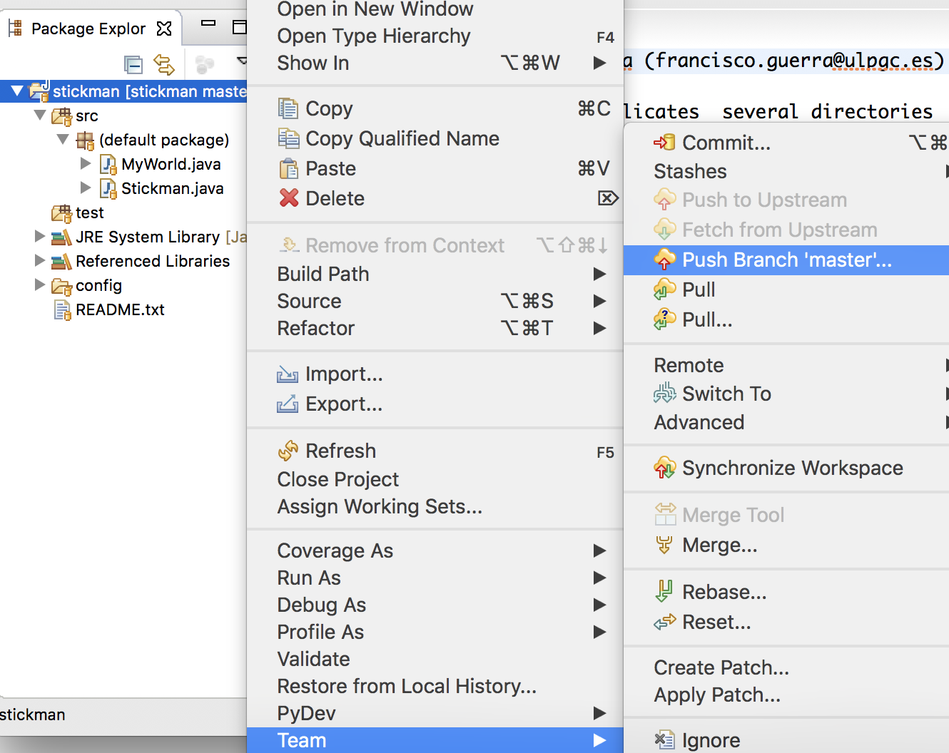
... ask Eclipse to push the local scenario into gitlab ...

Slide 17
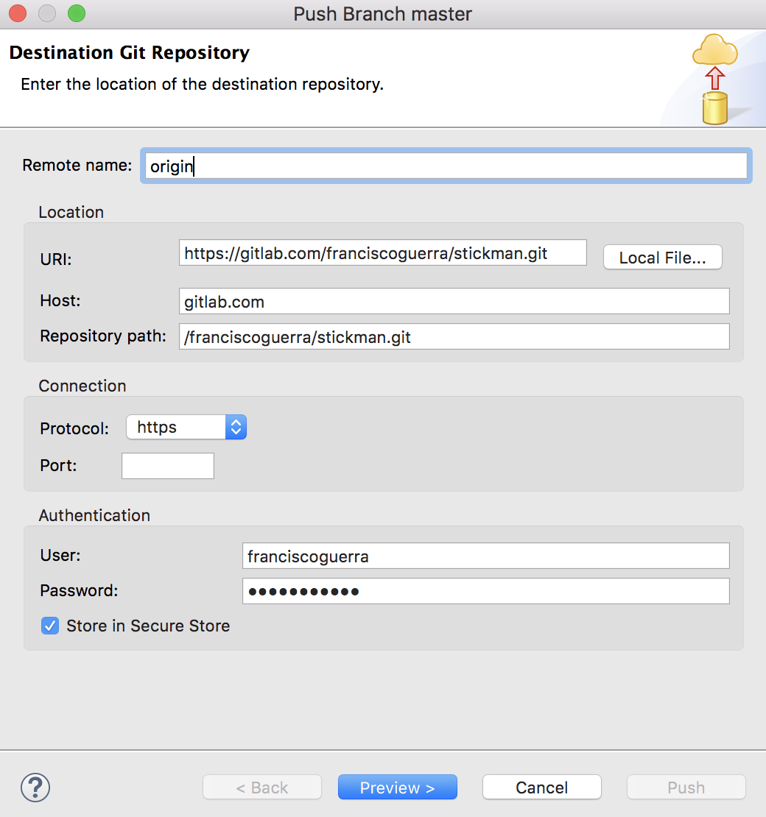
... paste URL of remote repository ...

Slide 18
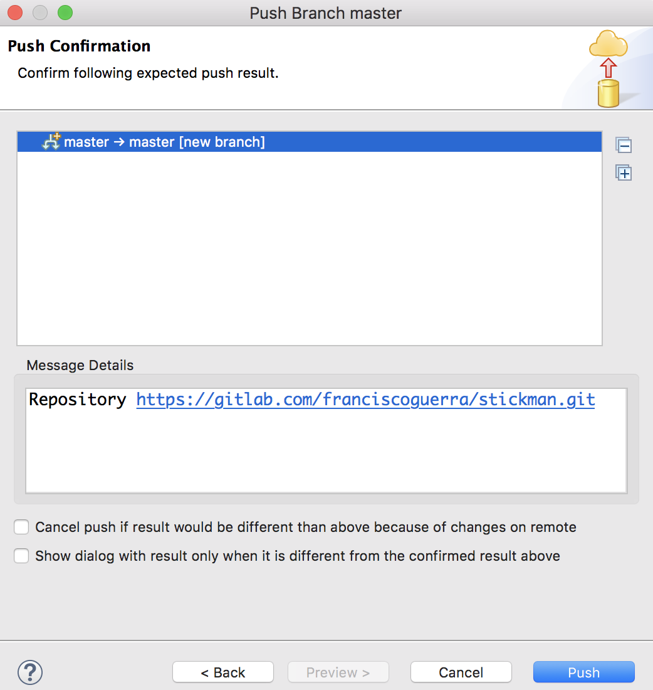
... click on "Push" to confirm that it is uploaded in gitlab ...

Slide 19
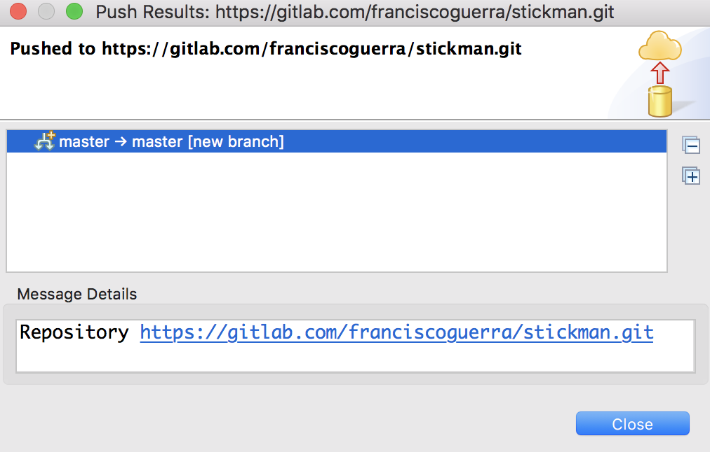
... and finally, Eclipse confirms the push was done

Slide 20
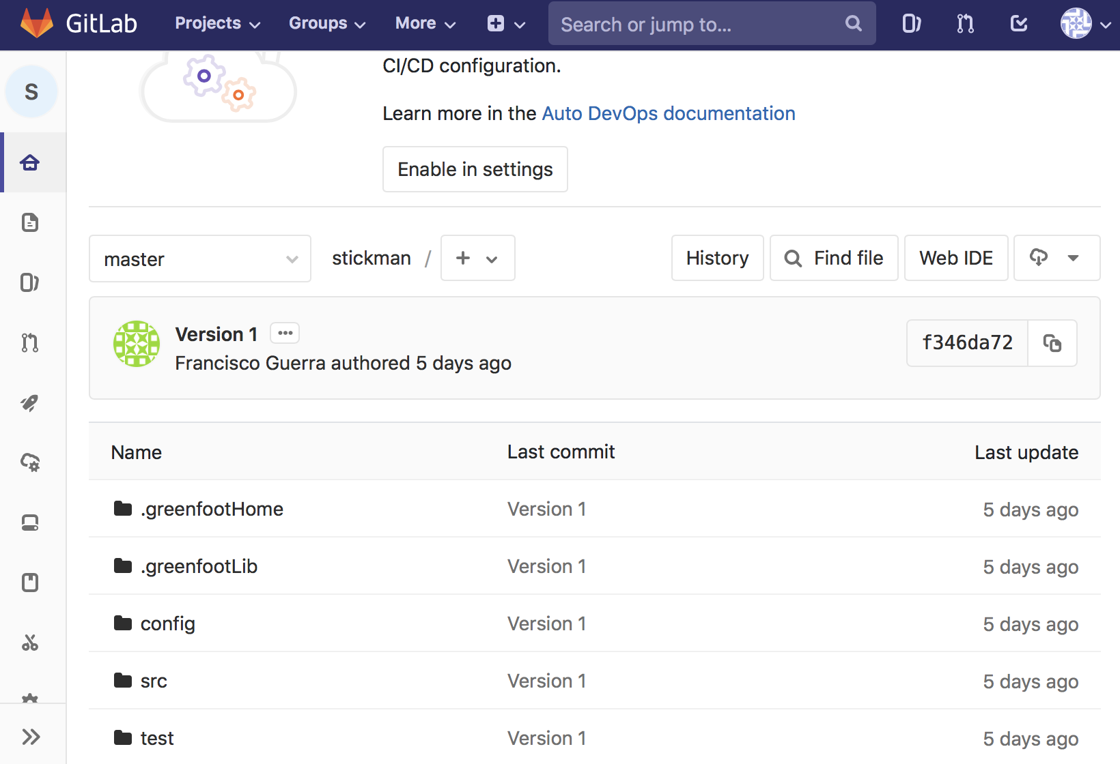
Remote repository now has an identical copy to the local

Slide 21
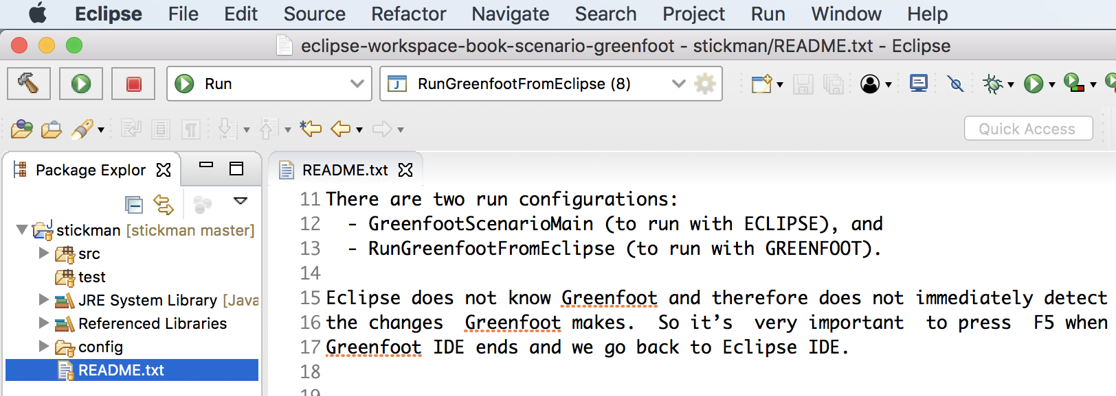
README lists the execution modes

Slide 22
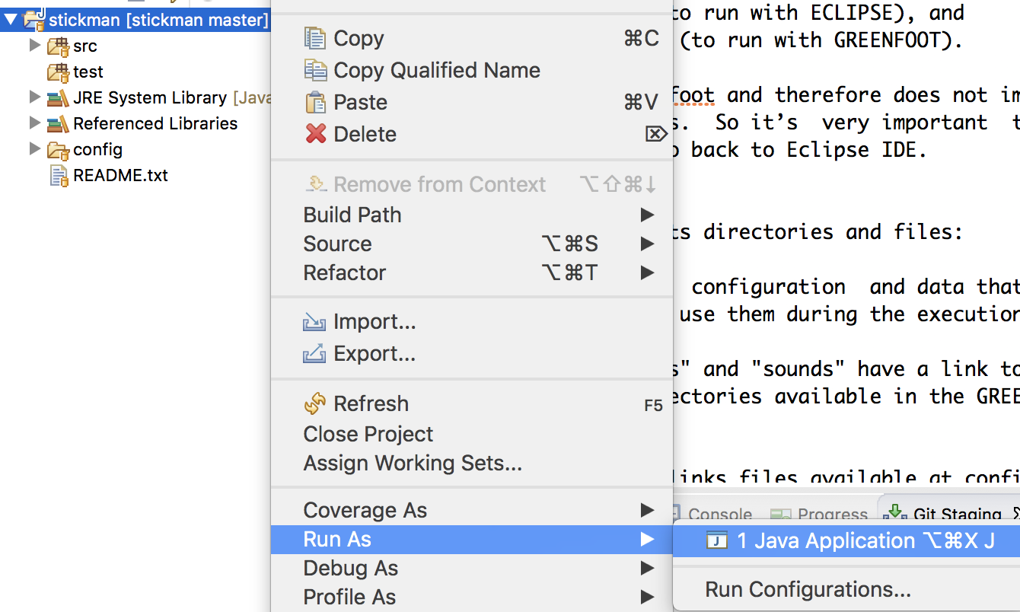
Let`s select “Run AS” and “Java Application” ...

Slide 23
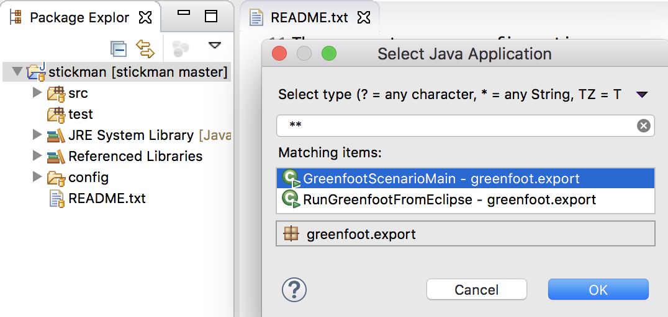
... and first let´s choose Eclipse mode execution

Slide 24
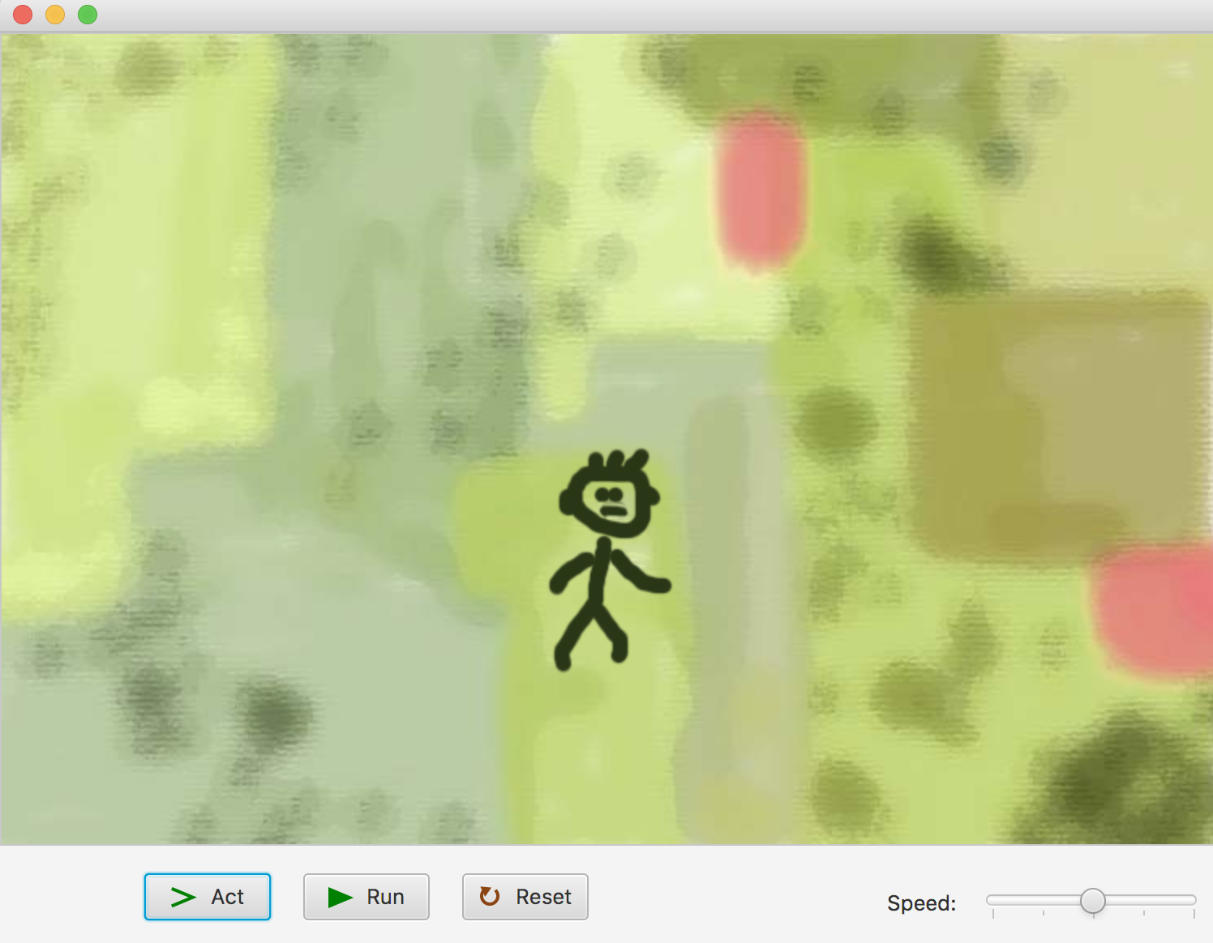
We can control the execution, without forgetting ...

Slide 25
... to close the window before re-editing with Eclipse

Slide 26
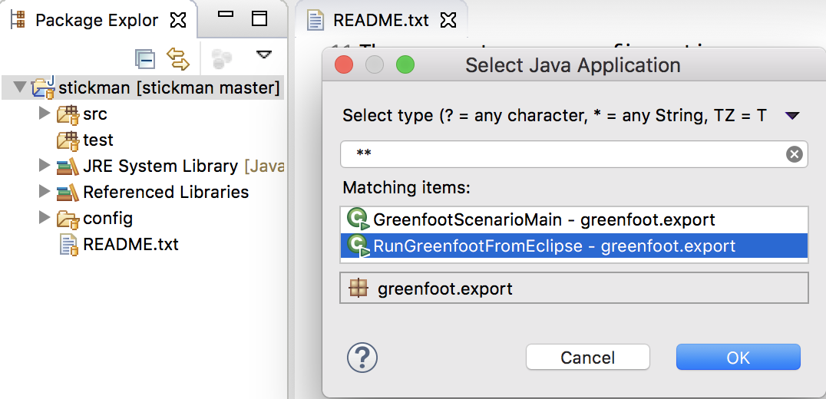
Now let´s can choose Greenfoot mode execution

Slide 27
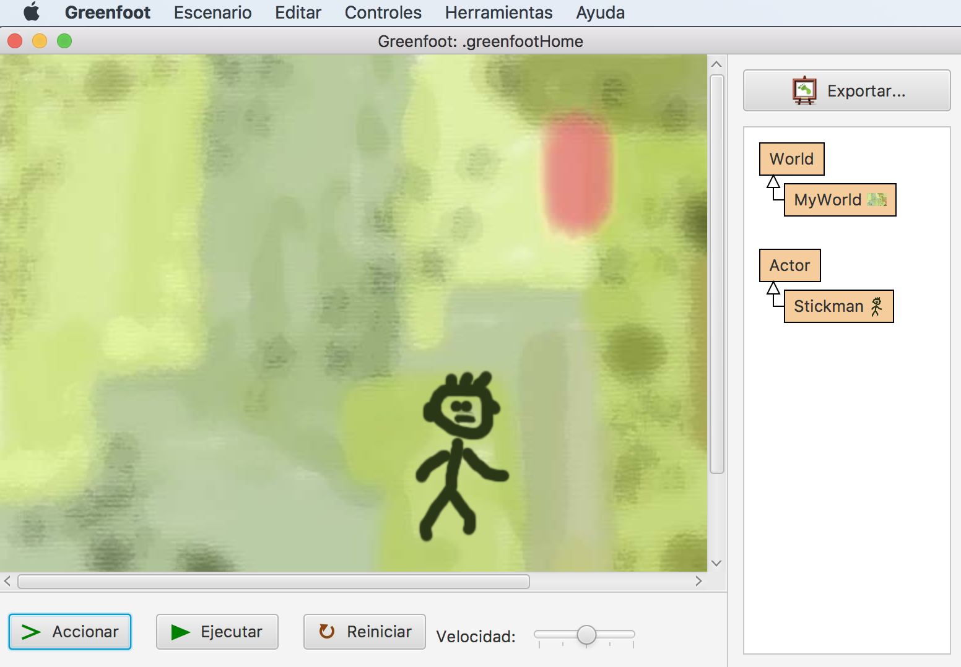
We can run or edit the scenario, without forgetting ...

Slide 28
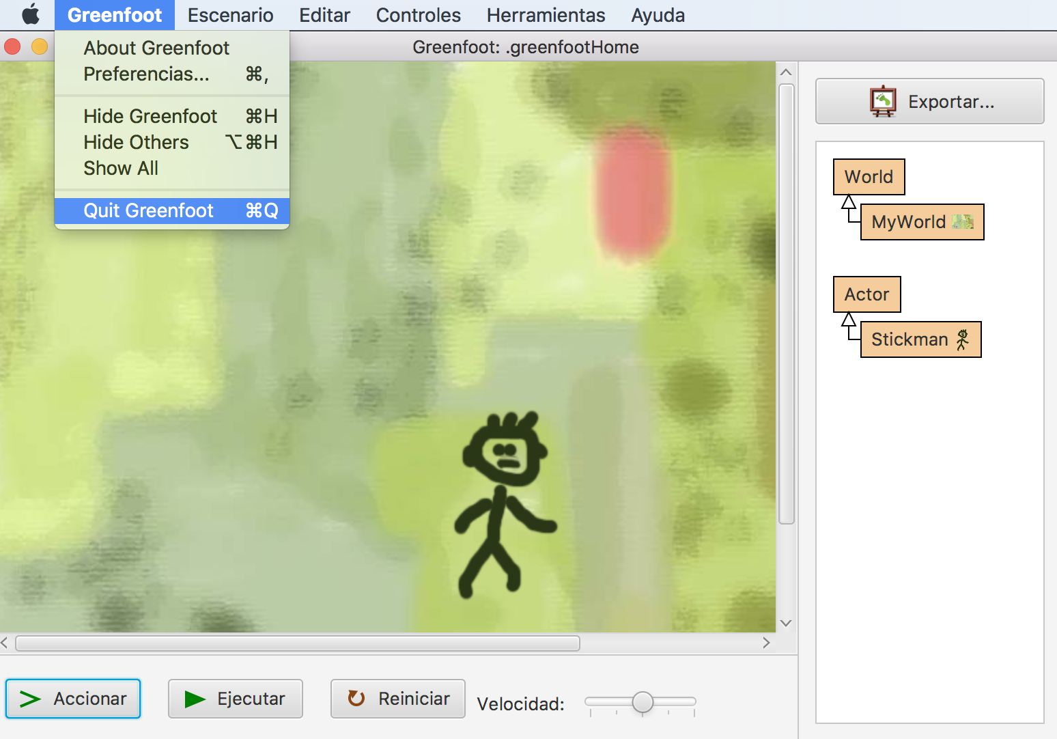
... quit + F5 before going back to edit with Eclipse

Slide 29
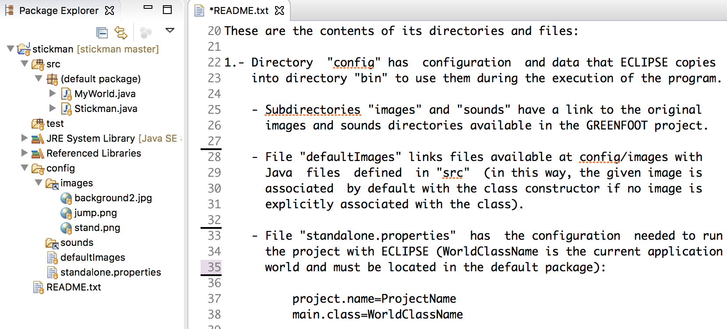
config folder contains configuration, images and sounds

Slide 30
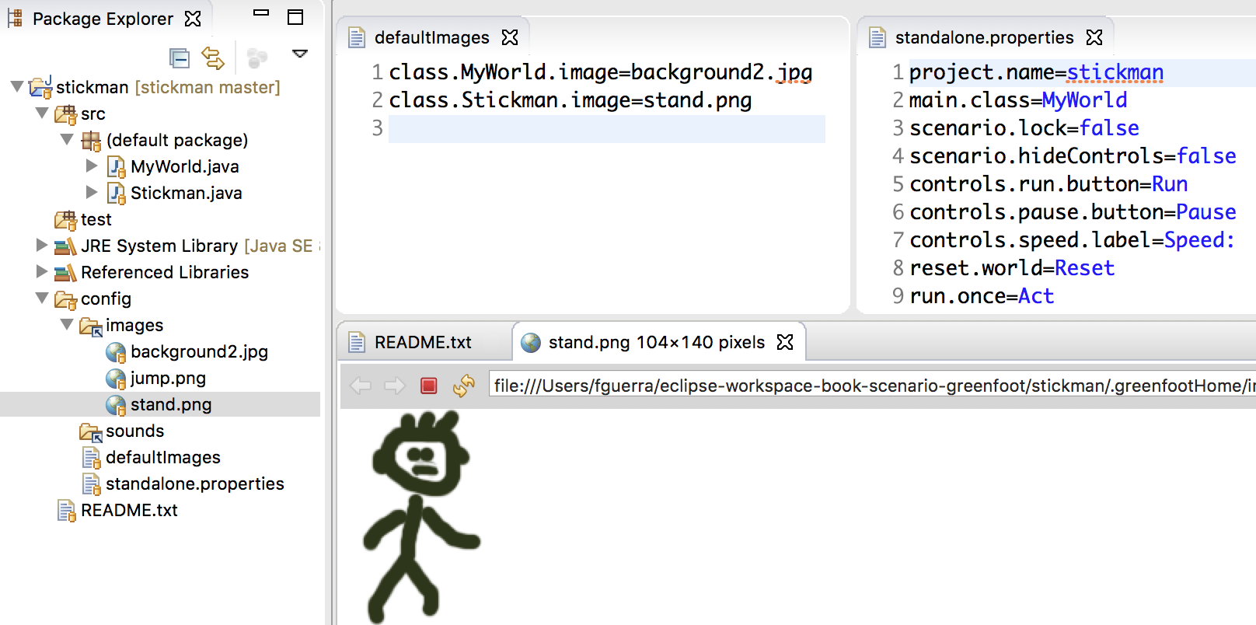
In this scenario, stickman has a default image

Slide 31
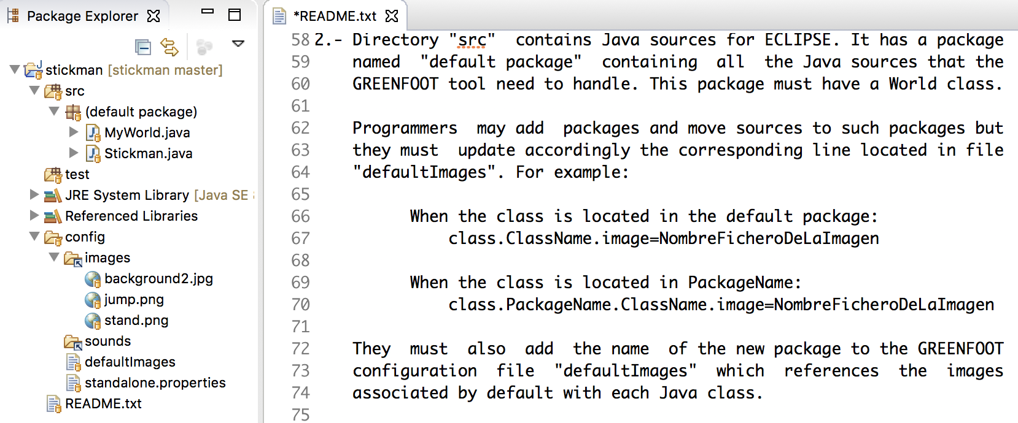
src folder contains java sources

Slide 32
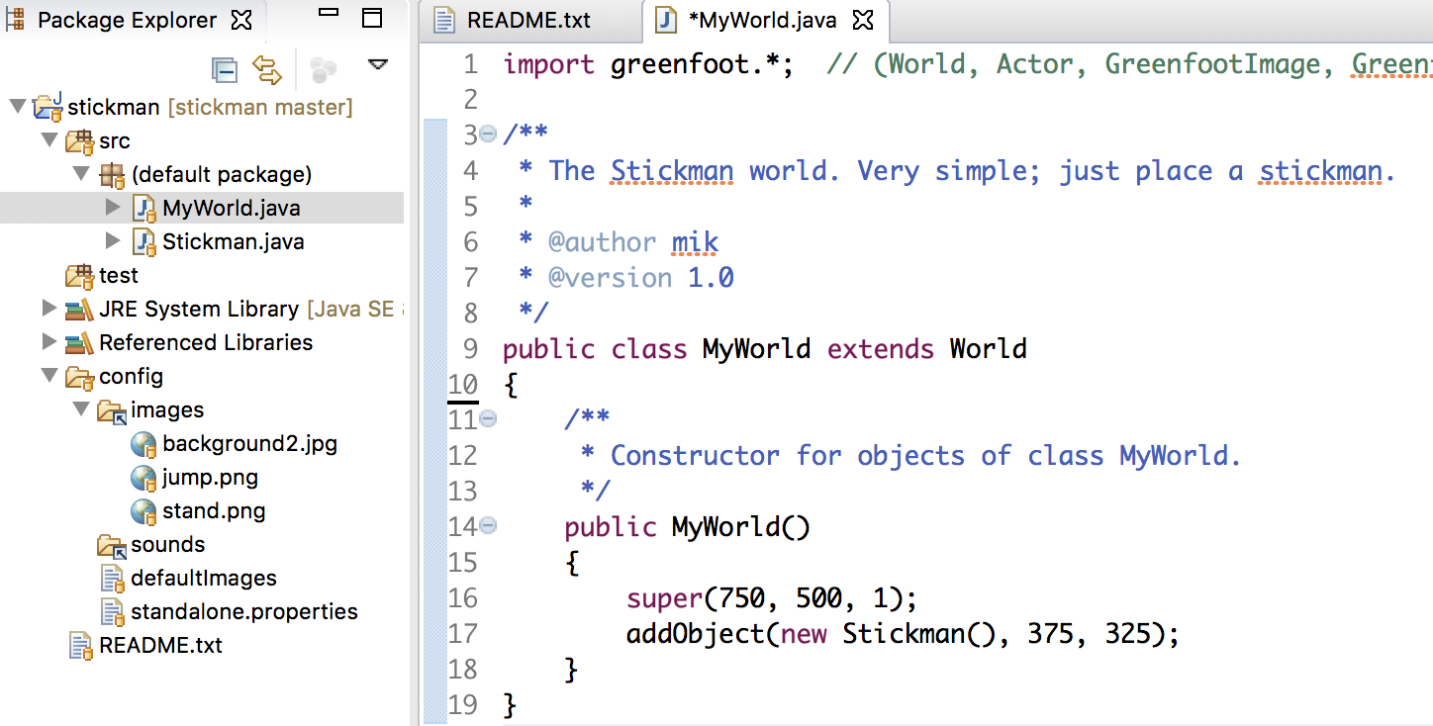
MyWorld class sets its size and adds a Stickman object

Slide 33
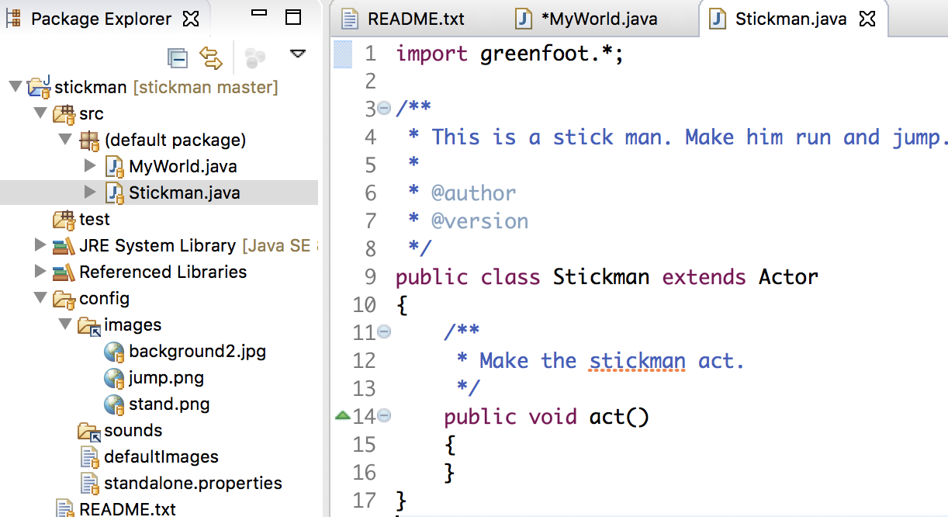
Stickman class still does not define any behavior

Slide 34
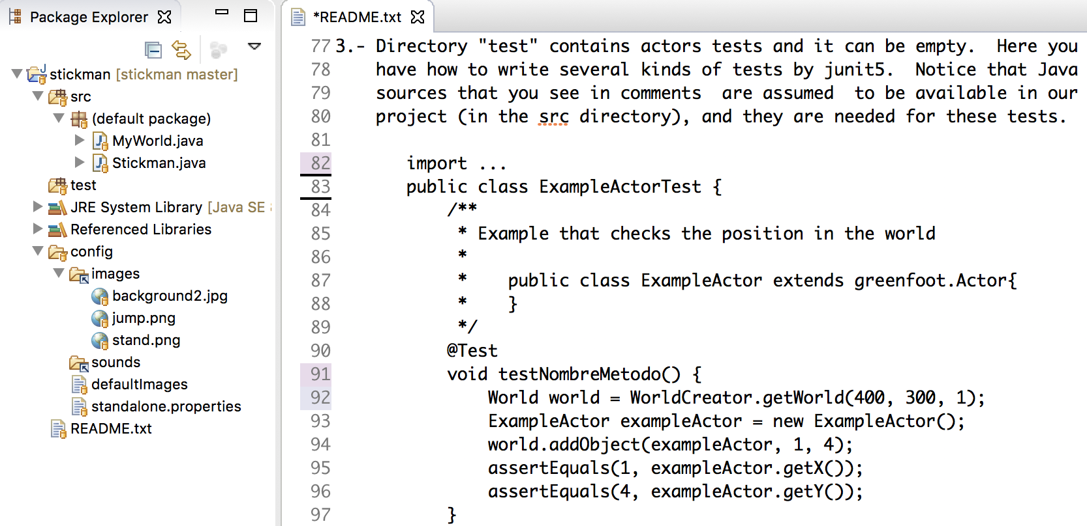
test folder can contain world tests and actors tests

Slide 35
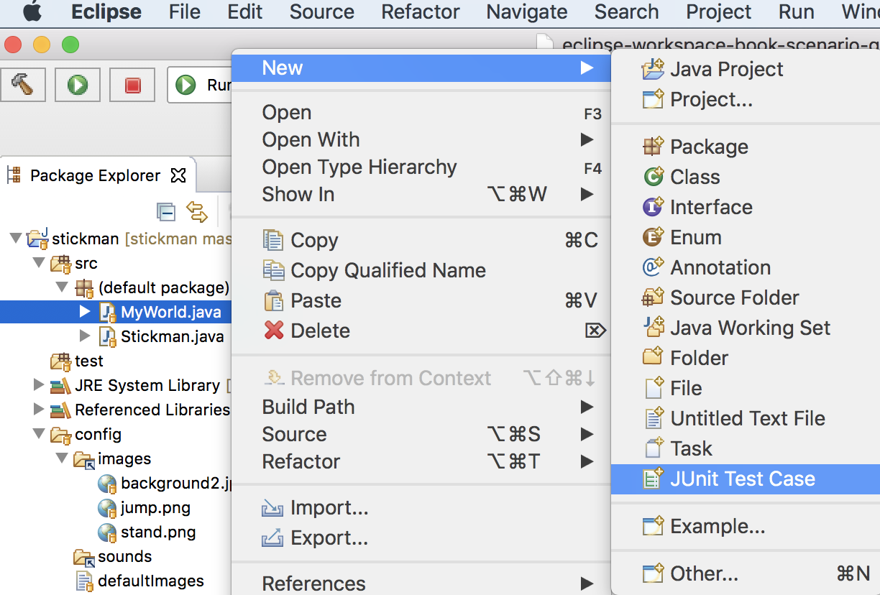
Let's go to add tests to MyWorld class ...

Slide 36
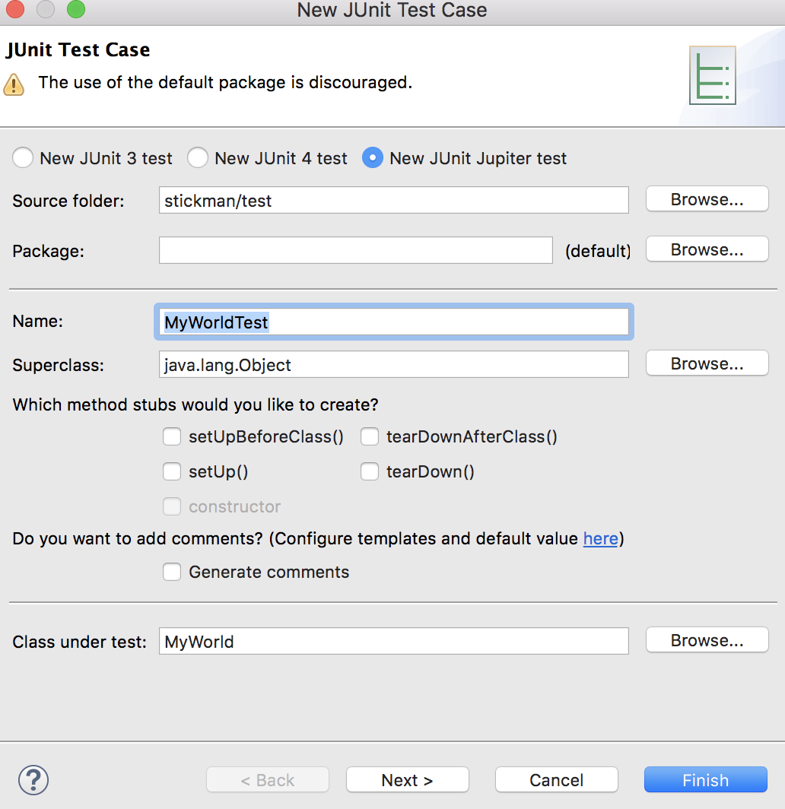
... select the test folder and click “Finish”

Slide 37
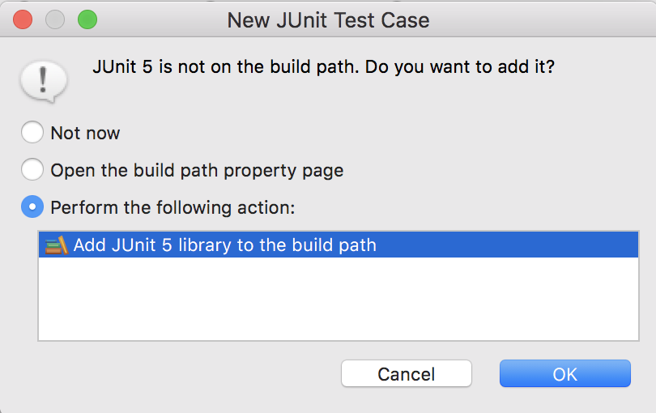
The first time the junit library should be added

Slide 38
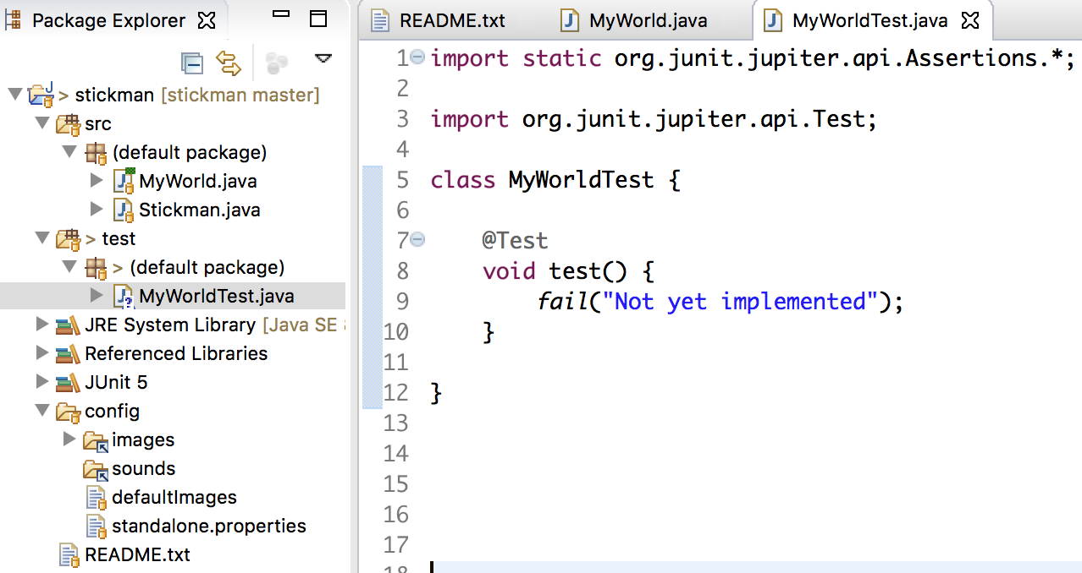
Eclipse creates an empty test template

Slide 39
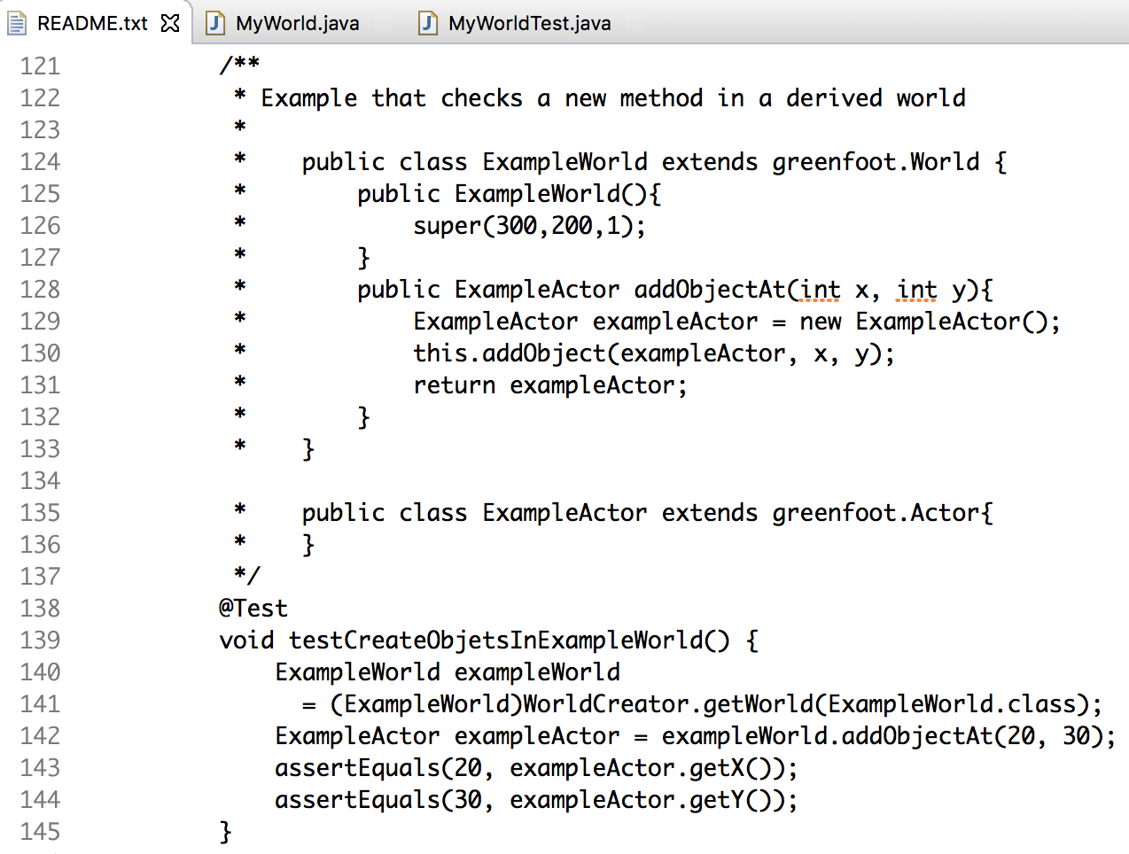
README has examples of how to do tests

Slide 40
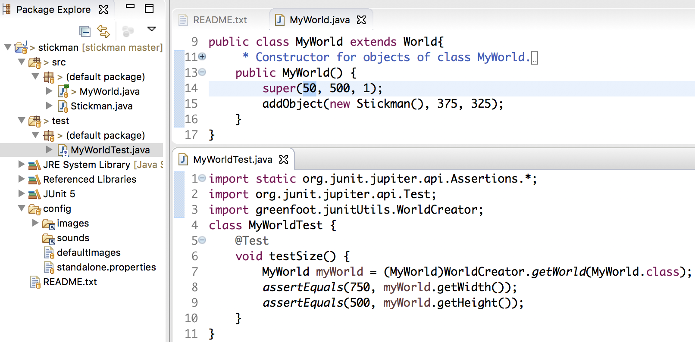
Let's check that the size of the world is correct

Slide 41
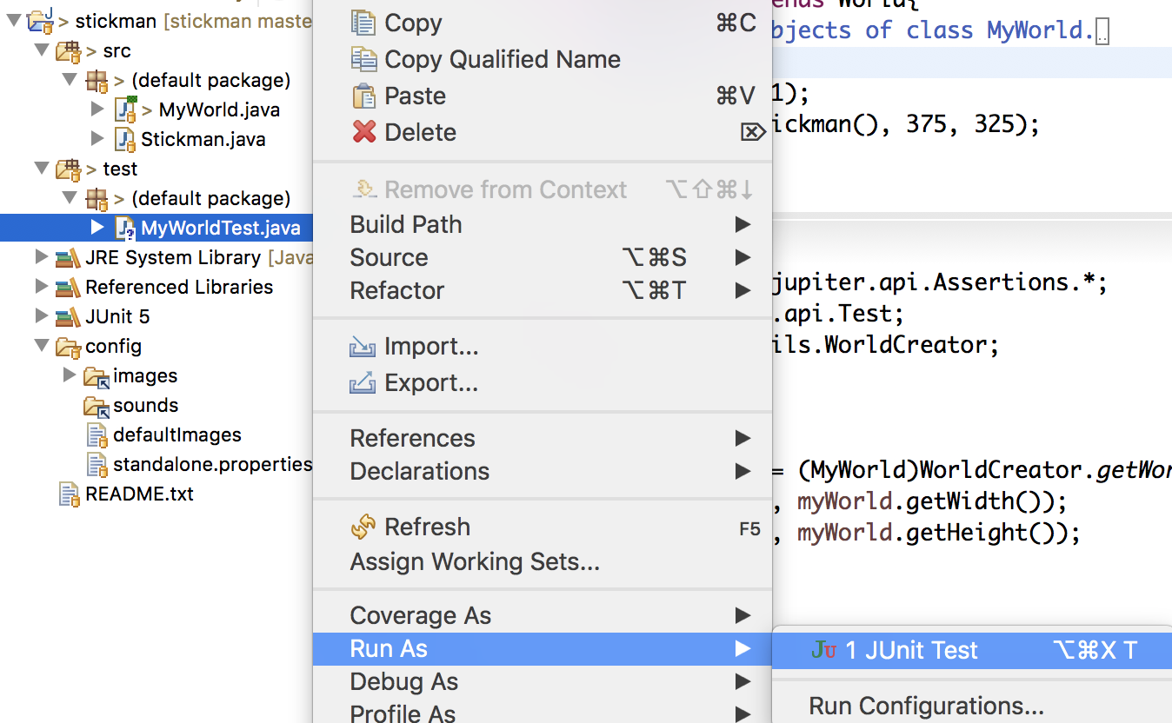
Let´s ask Eclipse to run MyWorldTest ...

Slide 42
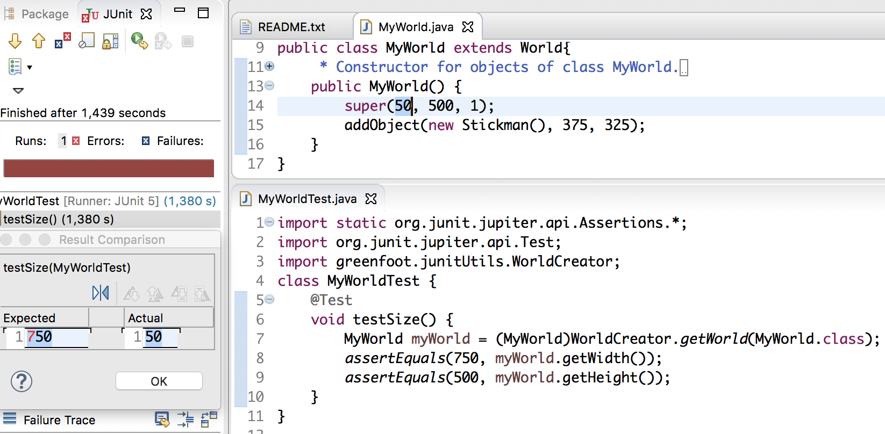
... and when it fails it gives RED

Slide 43
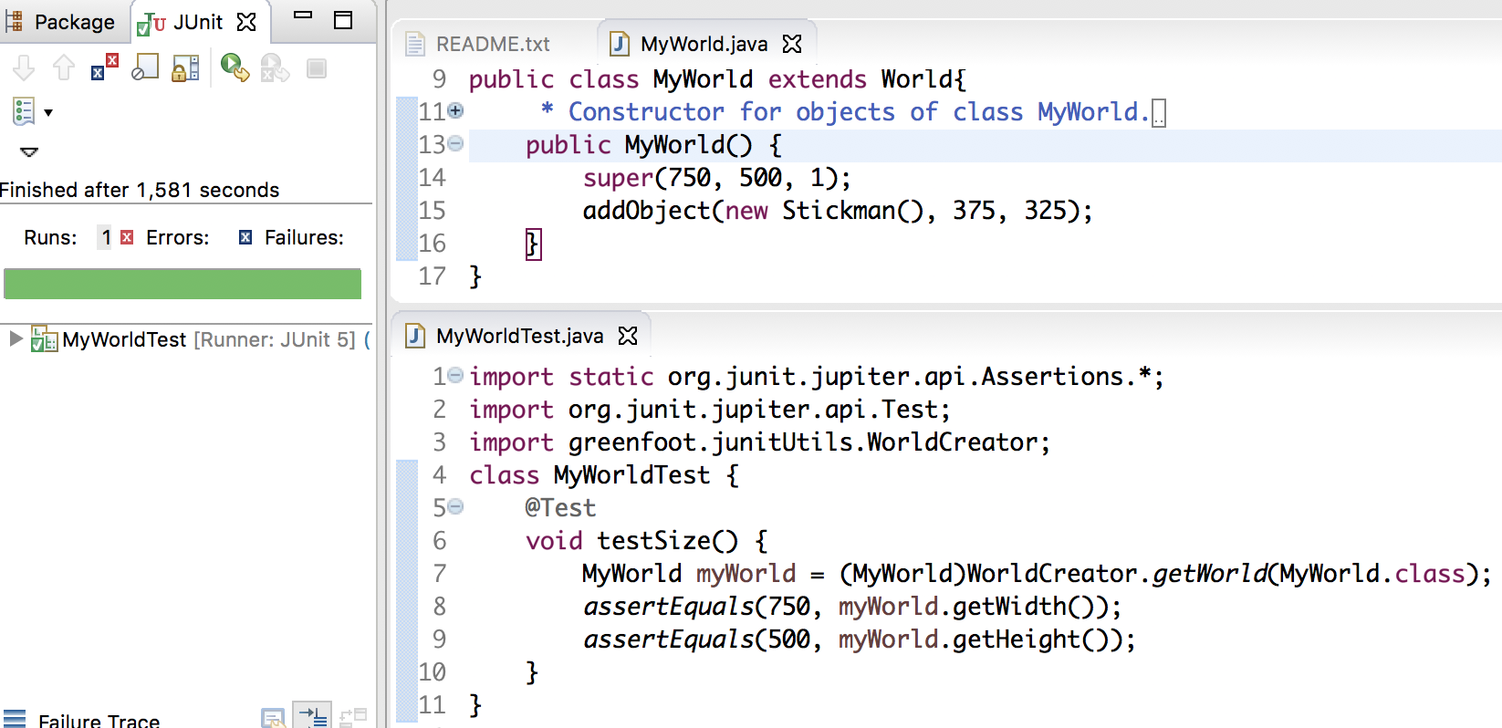
... and as it is right, it gives GREEN

Slide 44
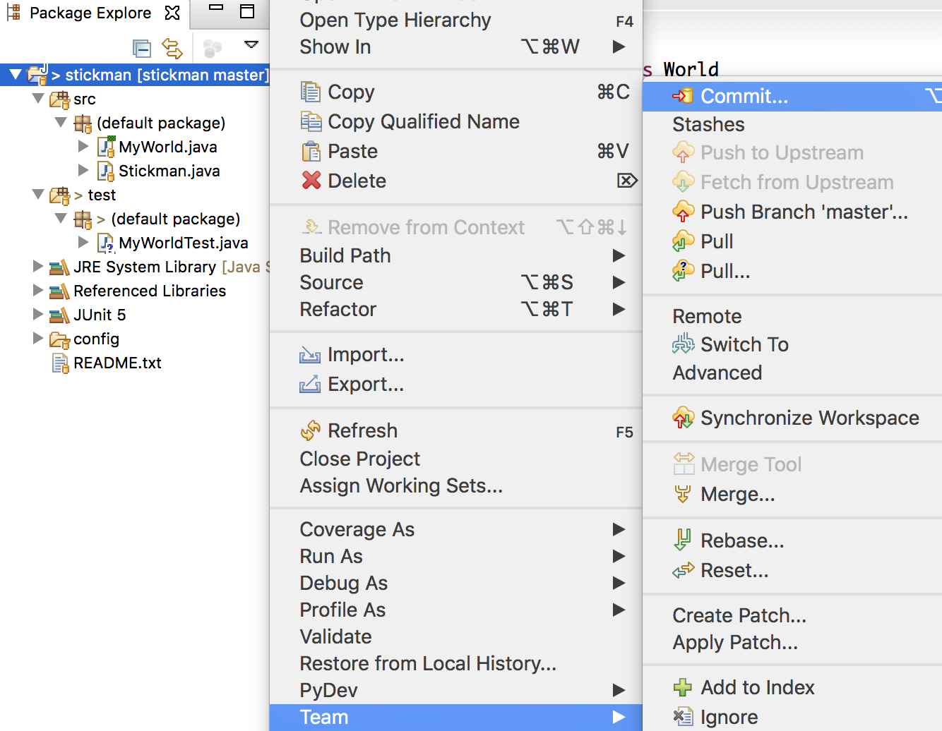
Eclipse can register the scenario changes with git ...

Slide 45
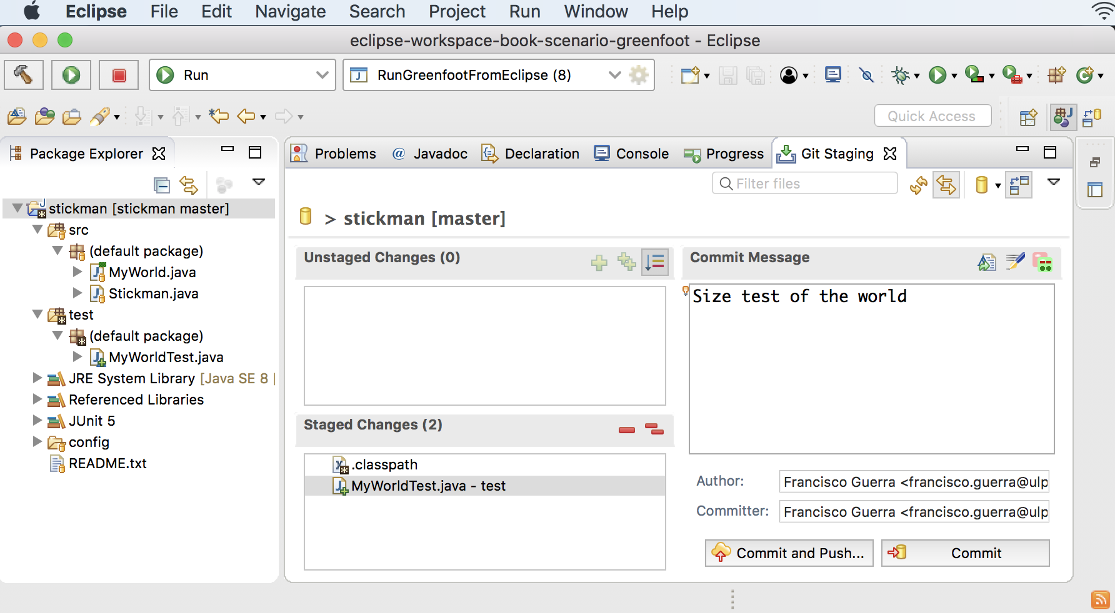
... so let´s register junit library included and test created ...

Slide 46
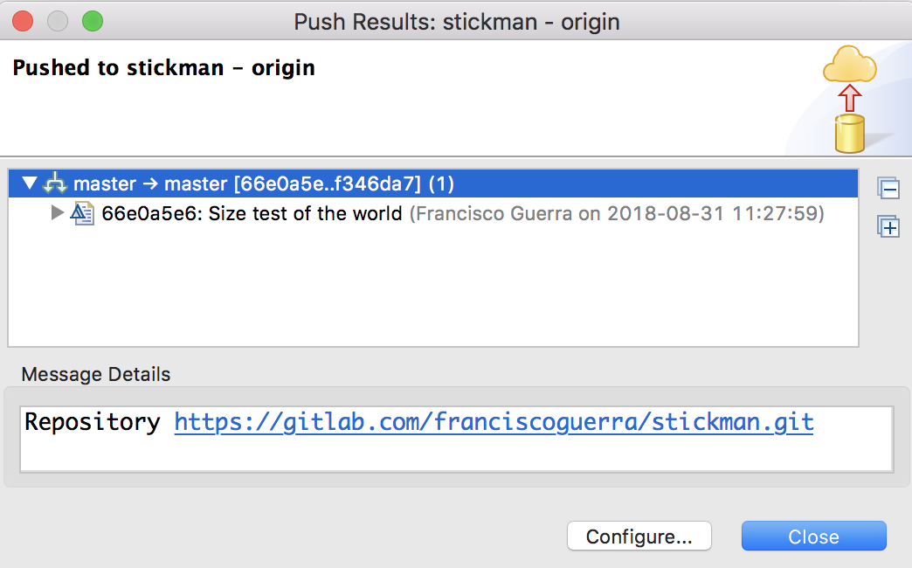
... Eclipse notifies when the commit has been pushed

Slide 47
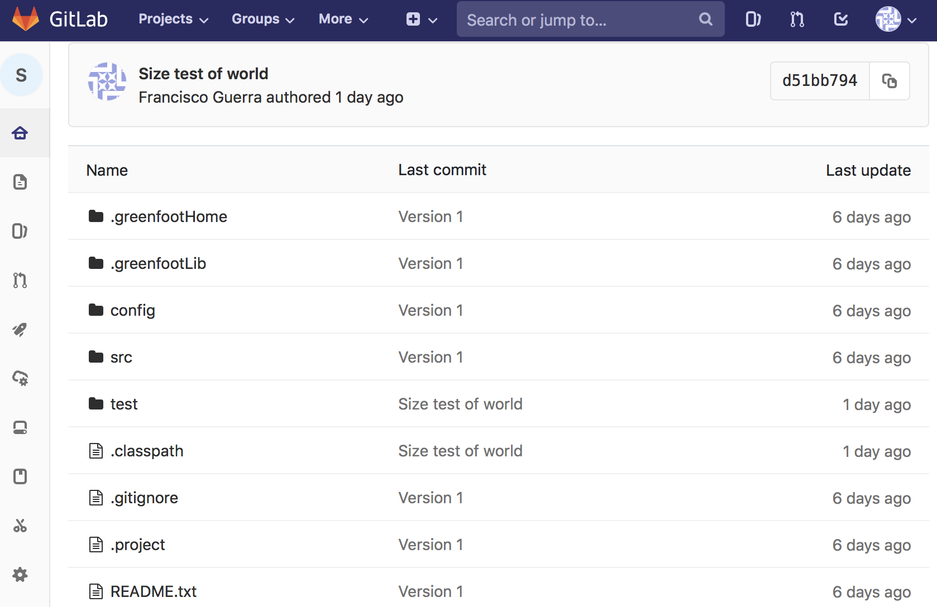
test folder on the remote now marks the new commit ...

Slide 48
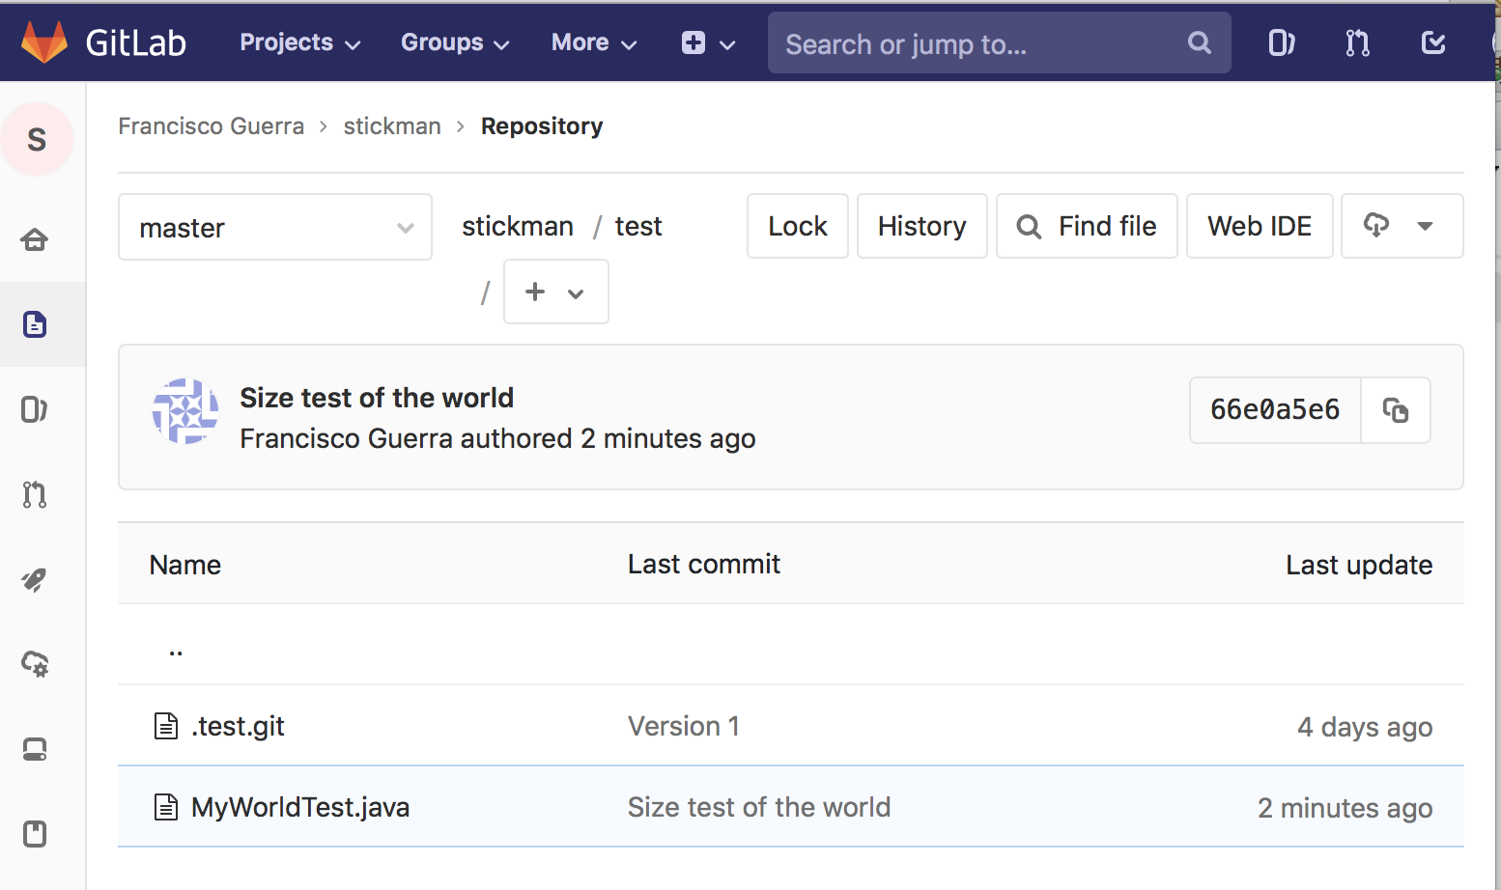
... and in the remote test folder you can see the new file ...

Slide 49
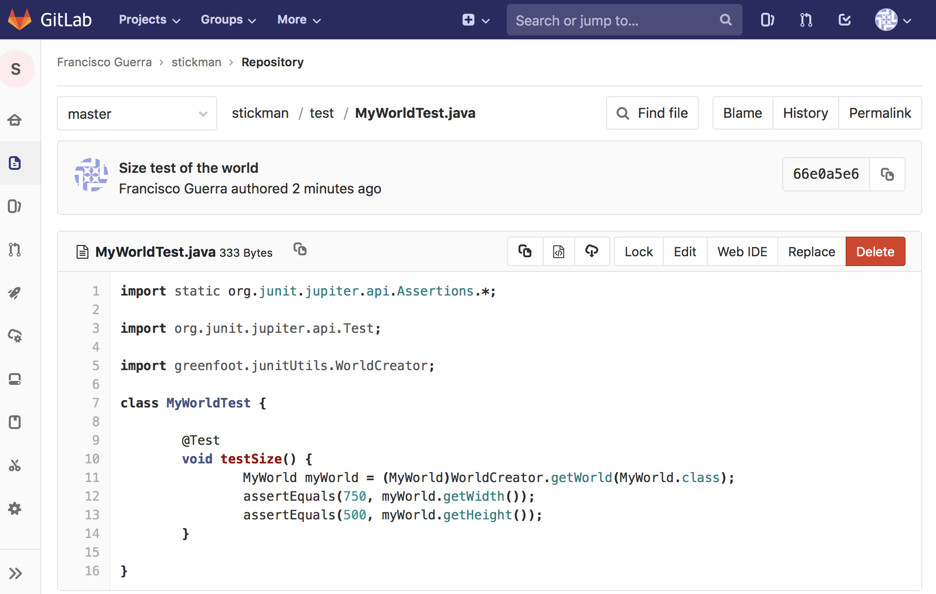
... that we can even analyze in the browser ...

Slide 50
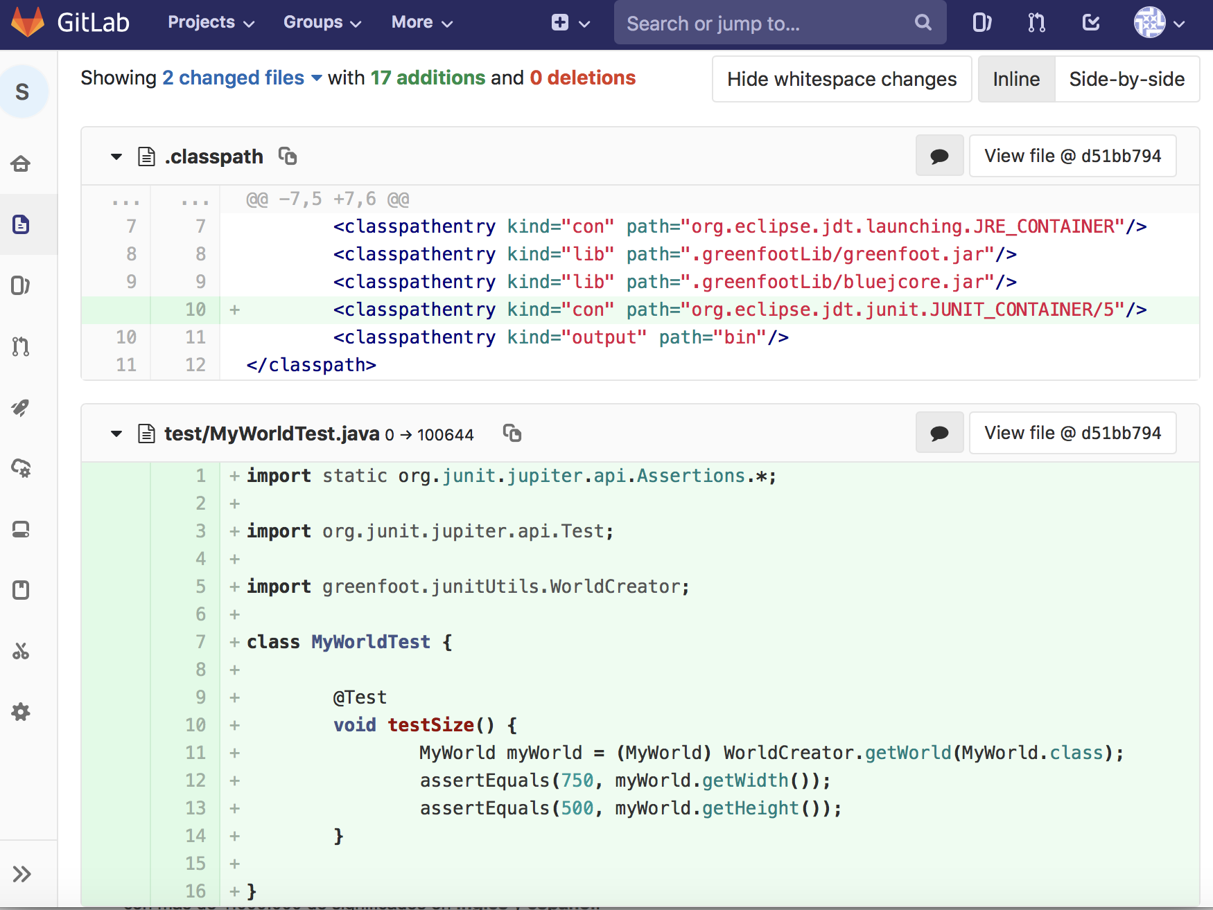
... and also see all the changes included in any commit

Slide 51
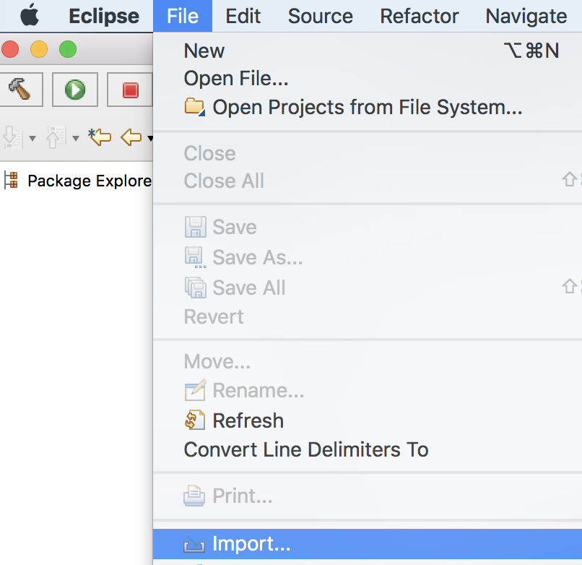
As the scenario is in web, it can be took to another PC ...

Slide 52
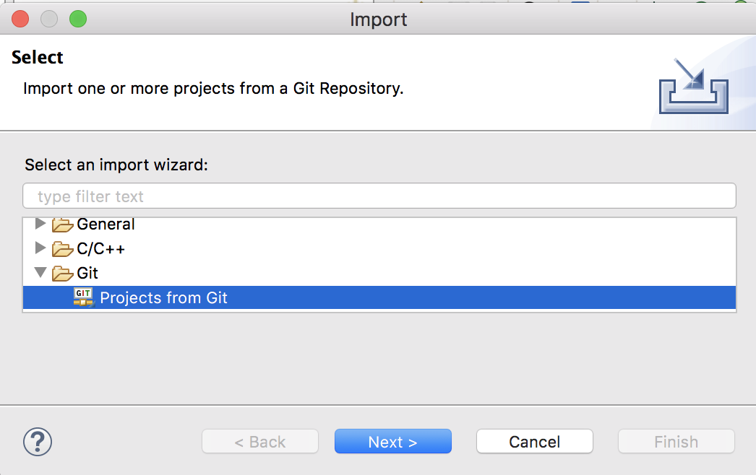
... first, let´s select “Projects from Git” ...

Slide 53
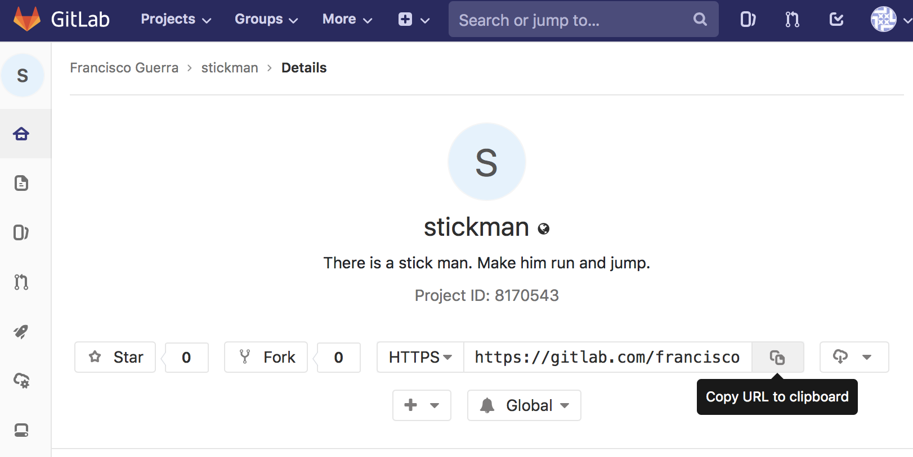
... second, copy the repository URL ...

Slide 54
... third, select “Clone URI” ...

Slide 55
... fourth, paste the repository URL ...

Slide 56
... fifth, click “Next” ...

Slide 57
... sixth, browse to the Eclipse projects folder ...
The folder must be the current Eclipse Workspace

Slide 58
... seventh, select “Import existing Eclipse projects” ...

Slide 59
... we end up with “Finish”

Slide 60
We have the scenario again as we left it last time

Slide 61
“Export” is another way to take a project copy ...
Only the active version is copied (all versions of the “.git” folder are not copied)

Slide 62
... we choose “Archive File” and “Next” ...

Slide 63
... we removed bin folder ...

Slide 64
... with “Browse”, we choose location and file name ...

Slide 65
... we end up with “Finish”

Slide 66
Now, you can select any scenario and practice
https://gitlab.com/franciscoguerra/EclipseProjectsOfGreenfootBookScenarios.git

