Slide 1
Importing Litte-Crab Versions From Git

Slide 2
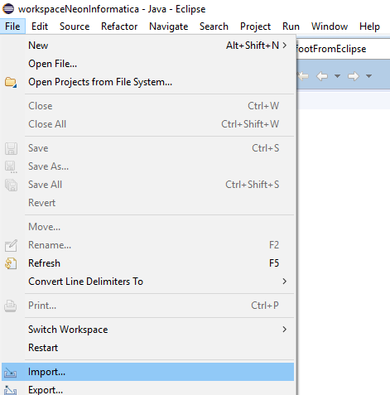
Let´s import an Eclipse Project from remote repository

Slide 3
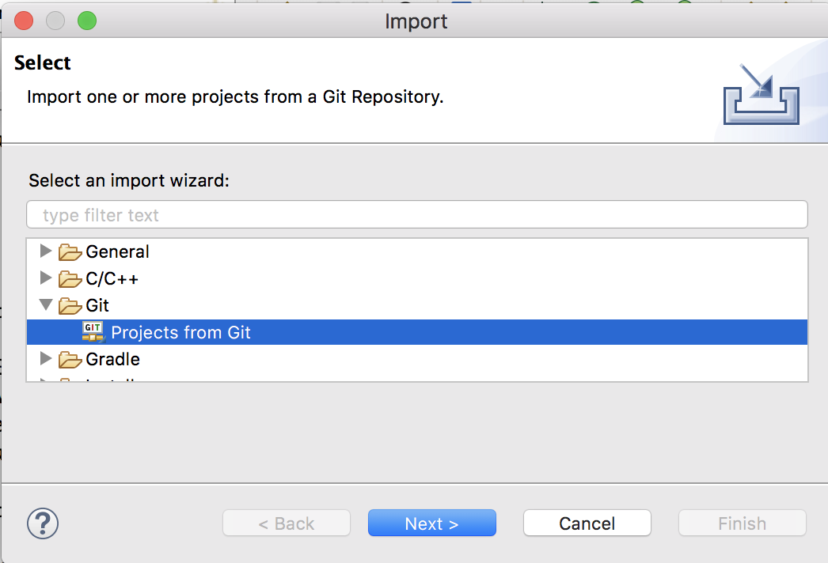
First, let´s select “Projects from Git” ...

Slide 4
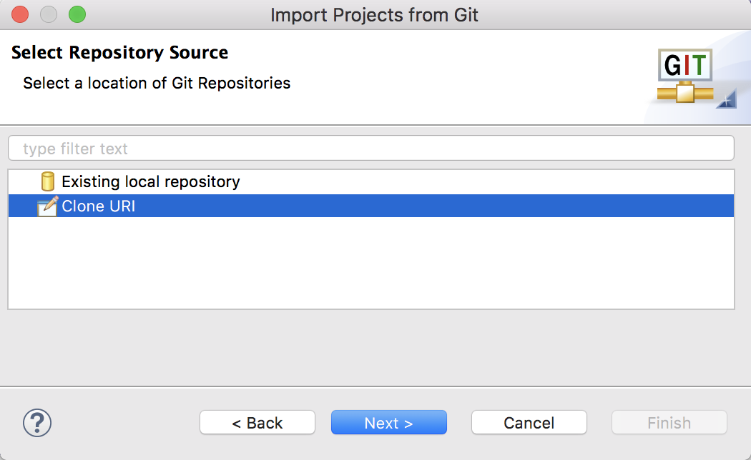
... second, we select “Clone URI” ...

Slide 5
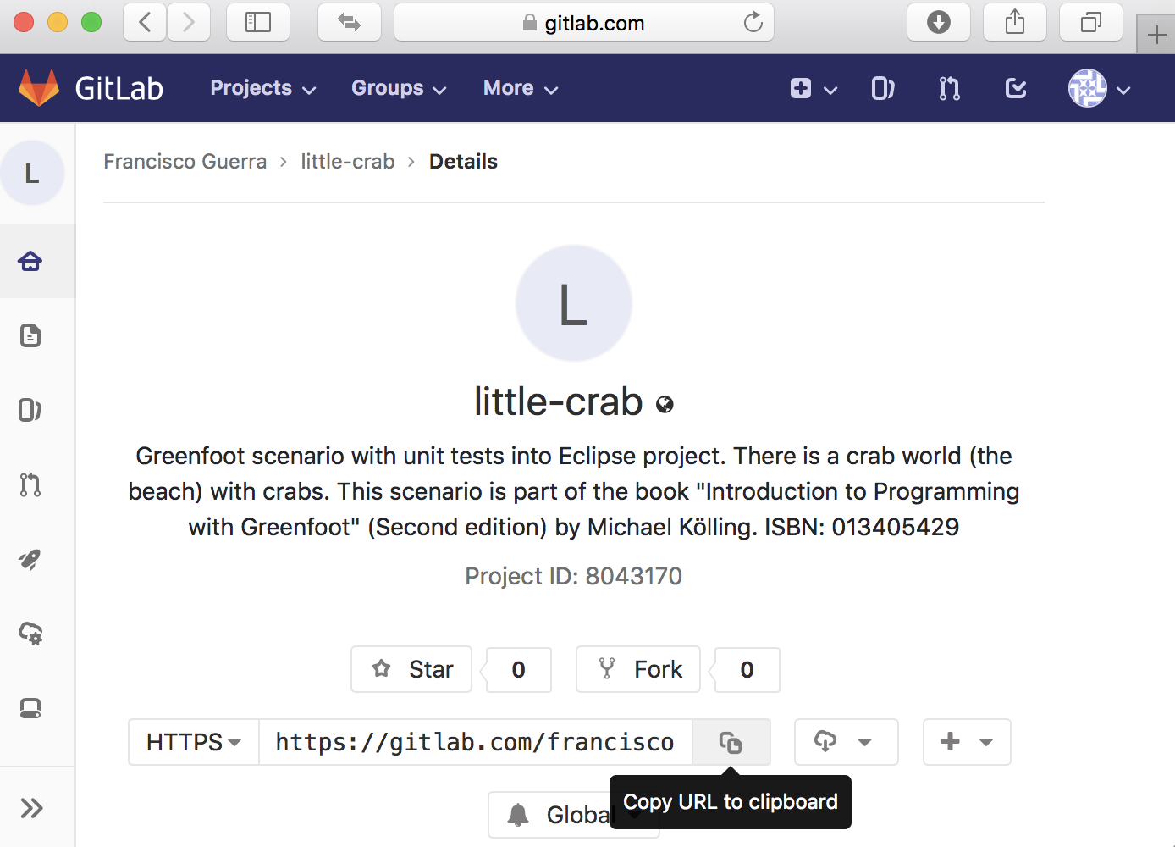
... third, we copy URL to clipboard ...
https://gitlab.com/franciscoguerra/little-crab.git

Slide 6
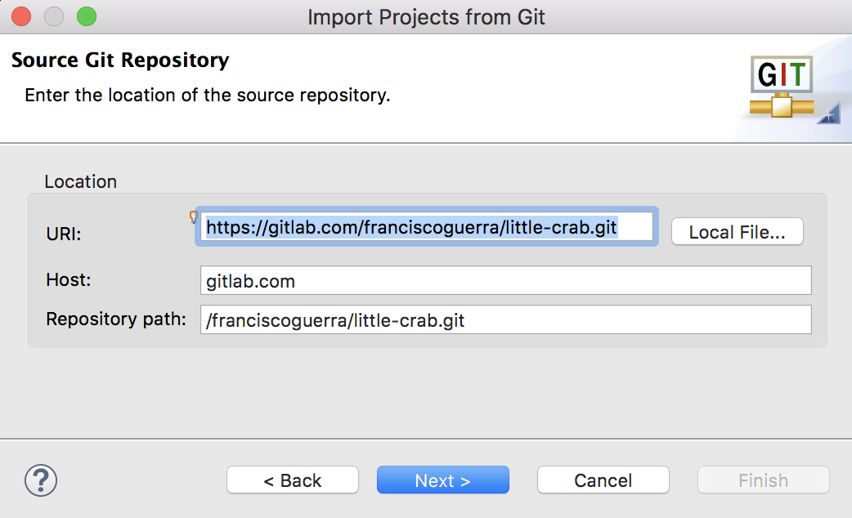
... fourth, we paste the URL ...

Slide 7
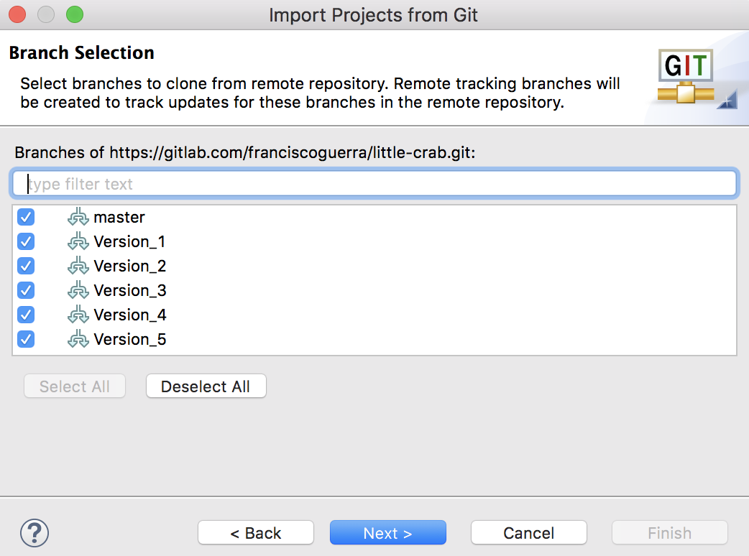
... fifth, we select the five versions described in the book ...

Slide 8
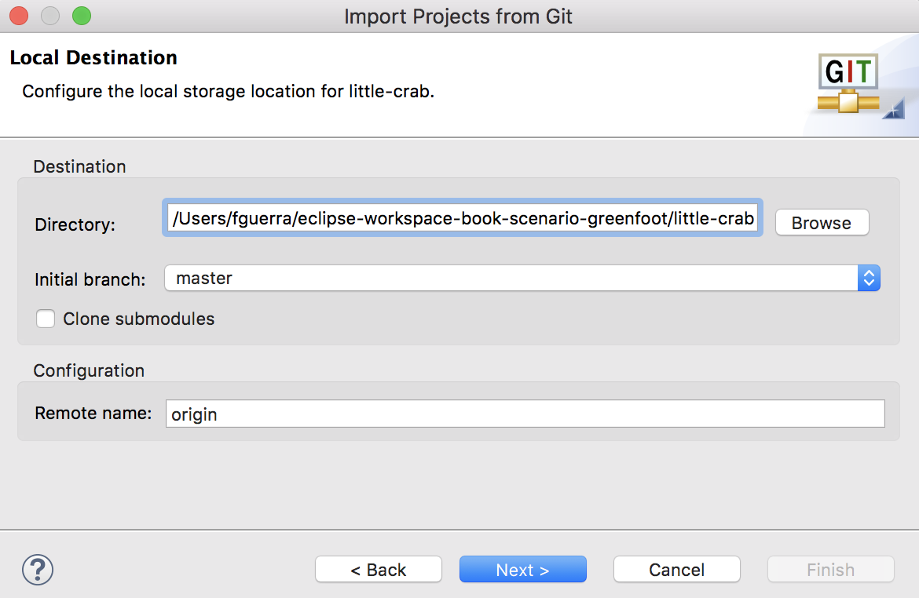
... sixth, we select the project folder by “Browse” ...
The folder must be the current Eclipse Workspace

Slide 9
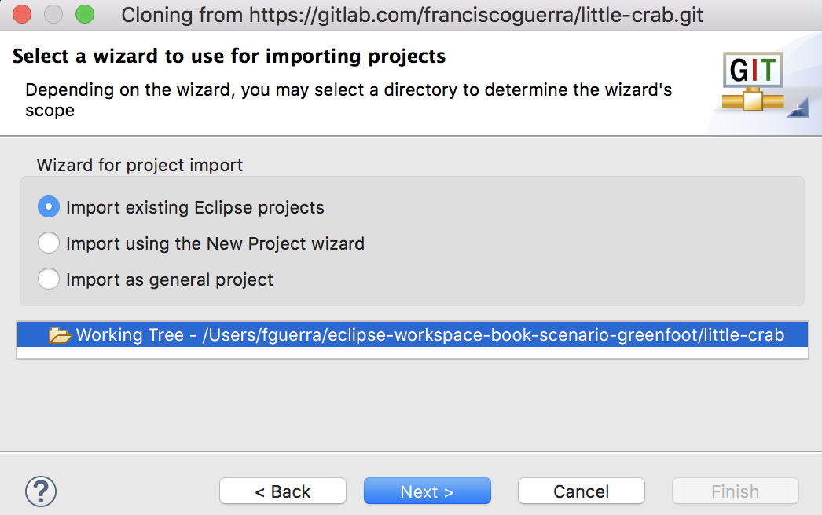
... seventh, we select “Import existing Eclipse Project” ...

Slide 10
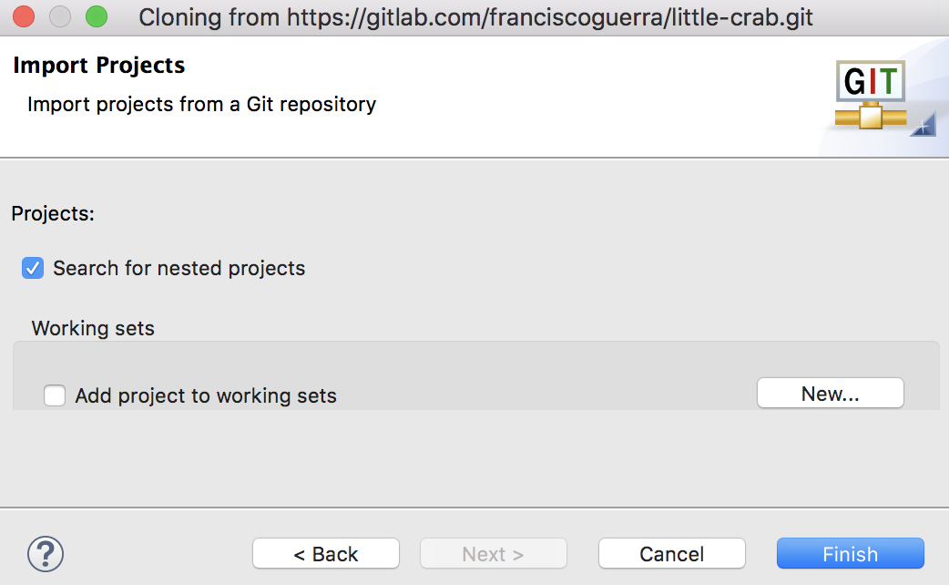
... we end up with “Finish”

Slide 11
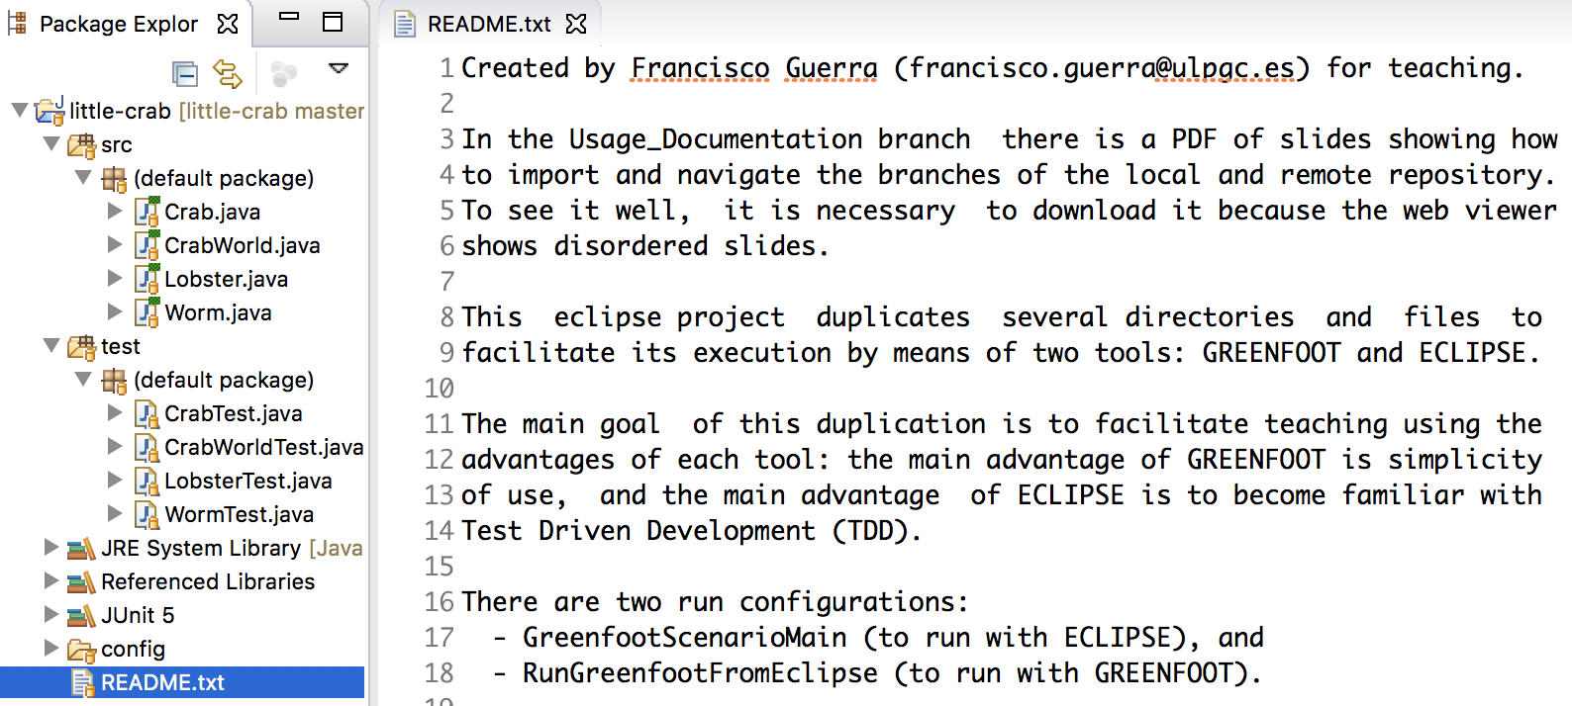
README.txt: Eclipse + Greenfoot + Junit + Git

Slide 12
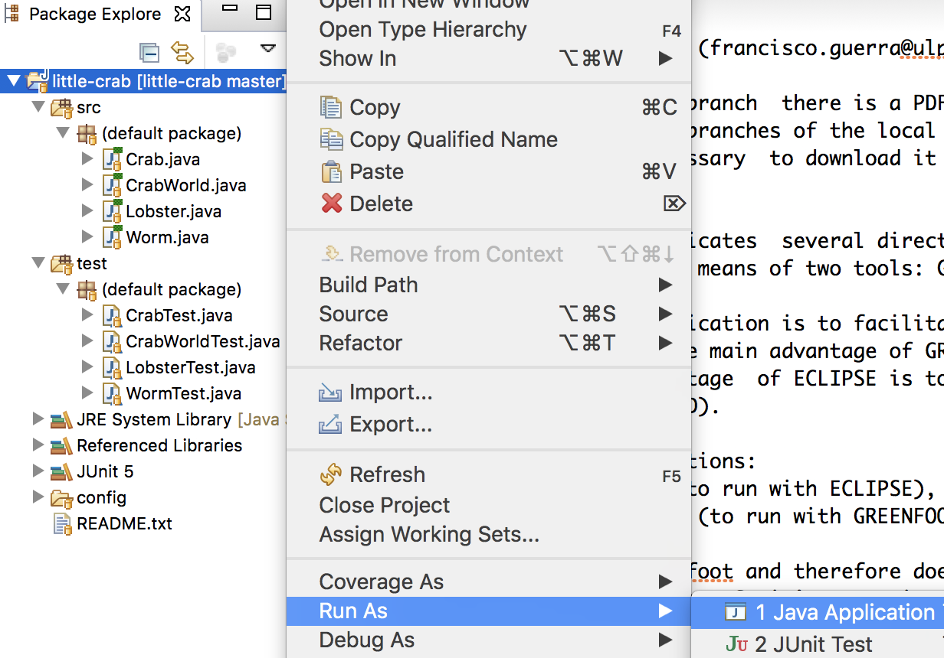
Let`s select “Run AS” and “Java Application” ...

Slide 13
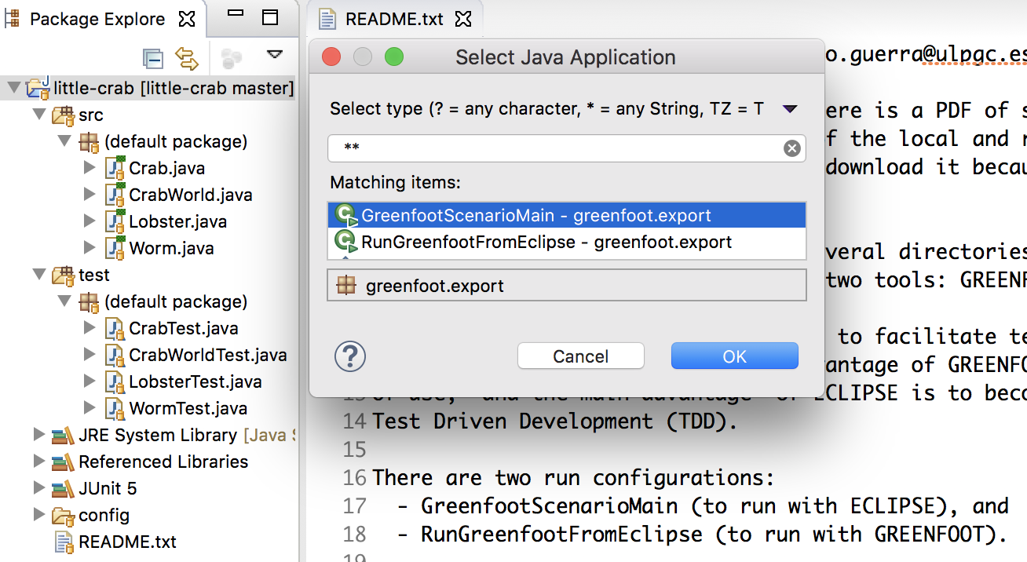
... and first let´s choose Eclipse mode execution

Slide 14
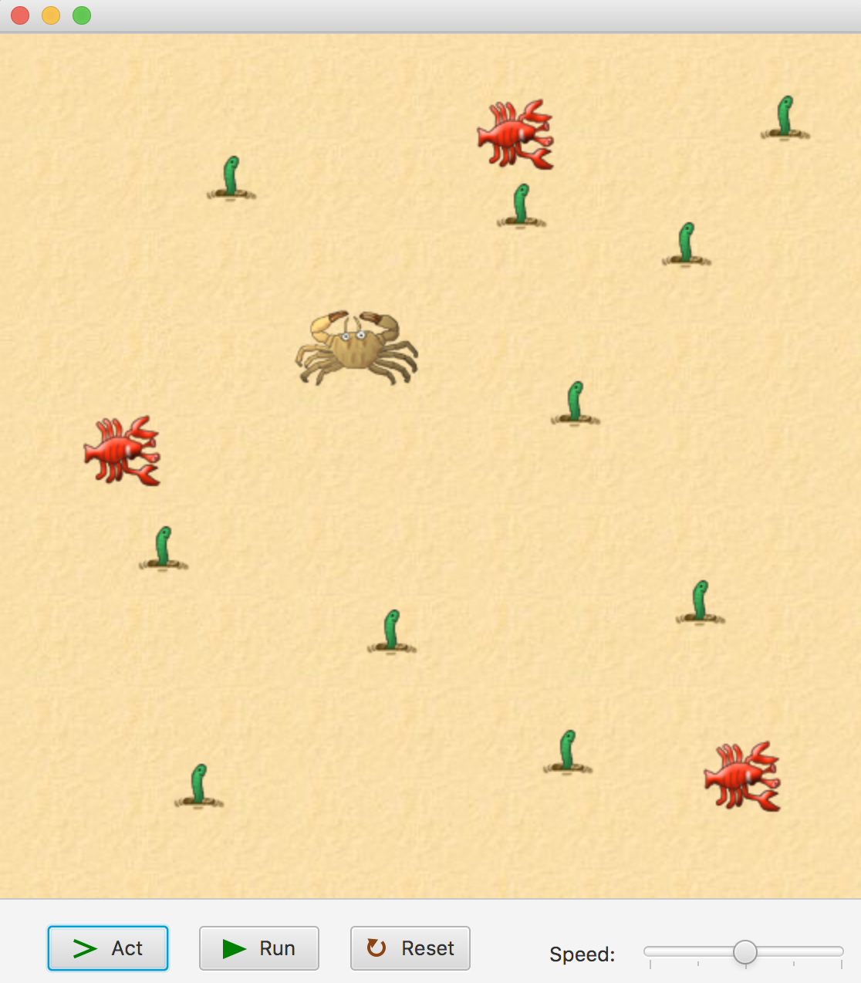
We can control the execution, without forgetting ...

Slide 15
... to close the window before re-editing with Eclipse

Slide 16
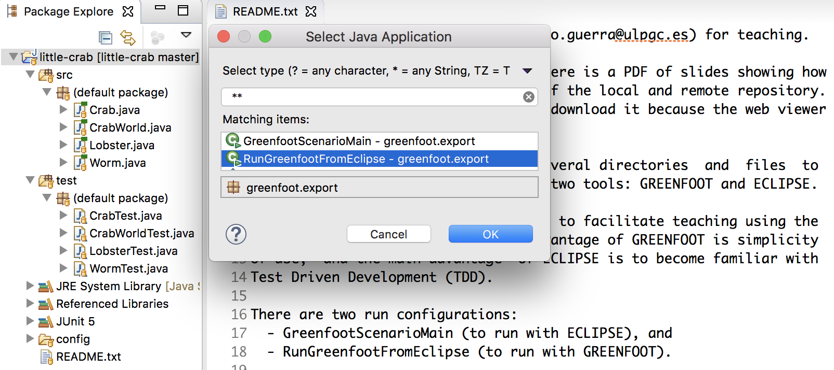
Now let´s can choose Greenfoot mode execution

Slide 17
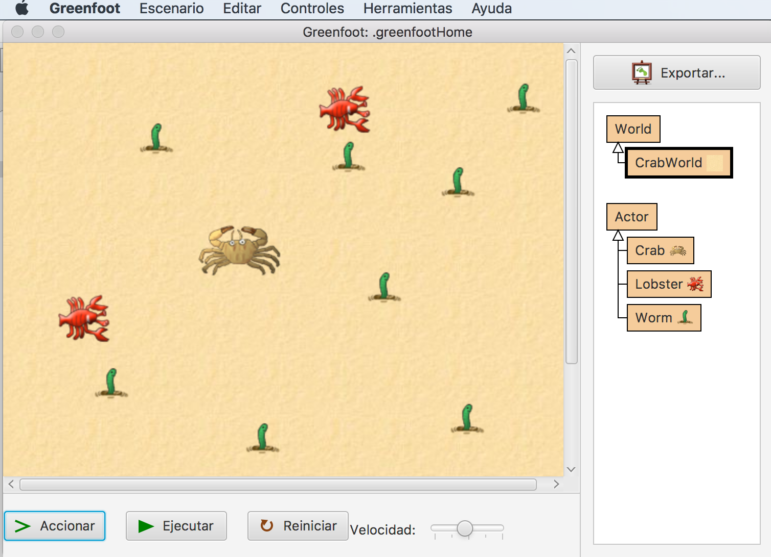
We can run or edit the scenario, without forgetting ...

Slide 18
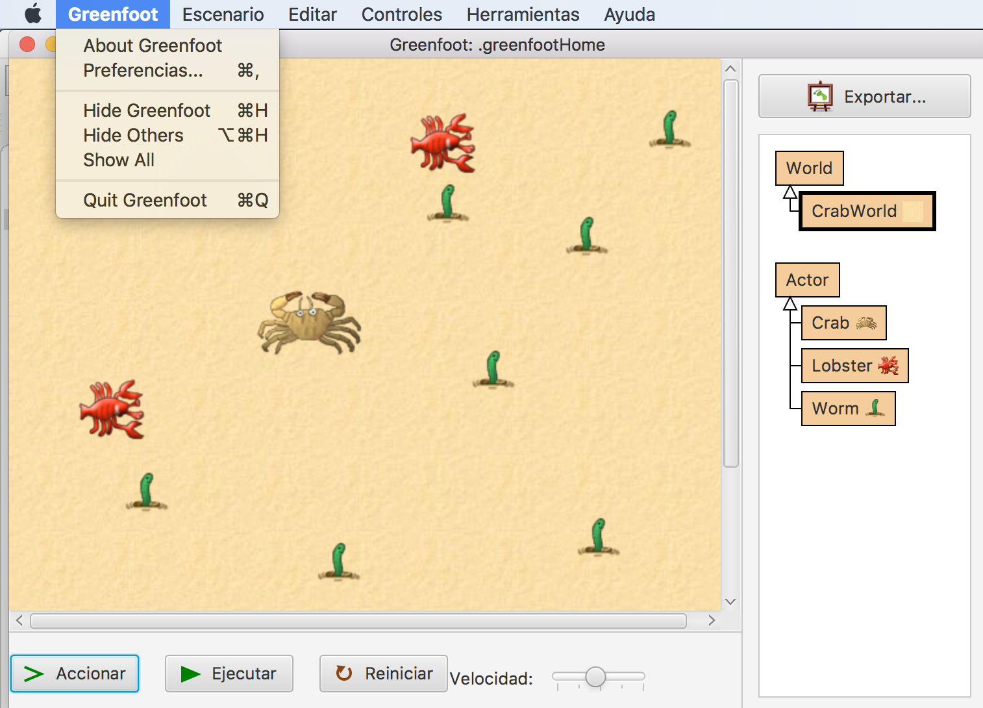
... quit + F5 before going back to edit with Eclipse

Slide 19
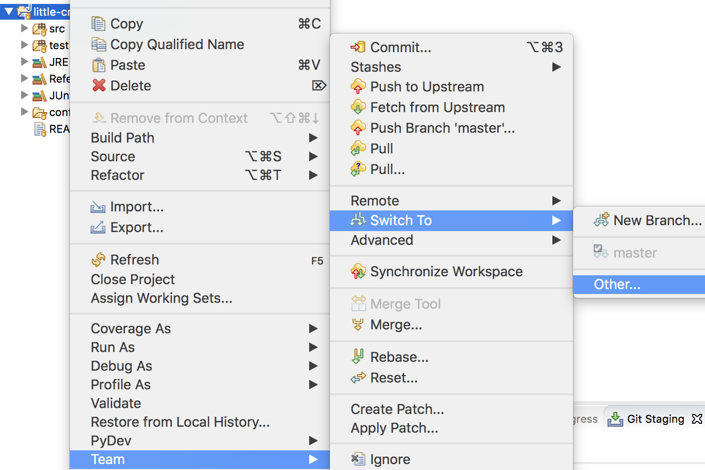
Switch to Version_1 branch

Slide 20
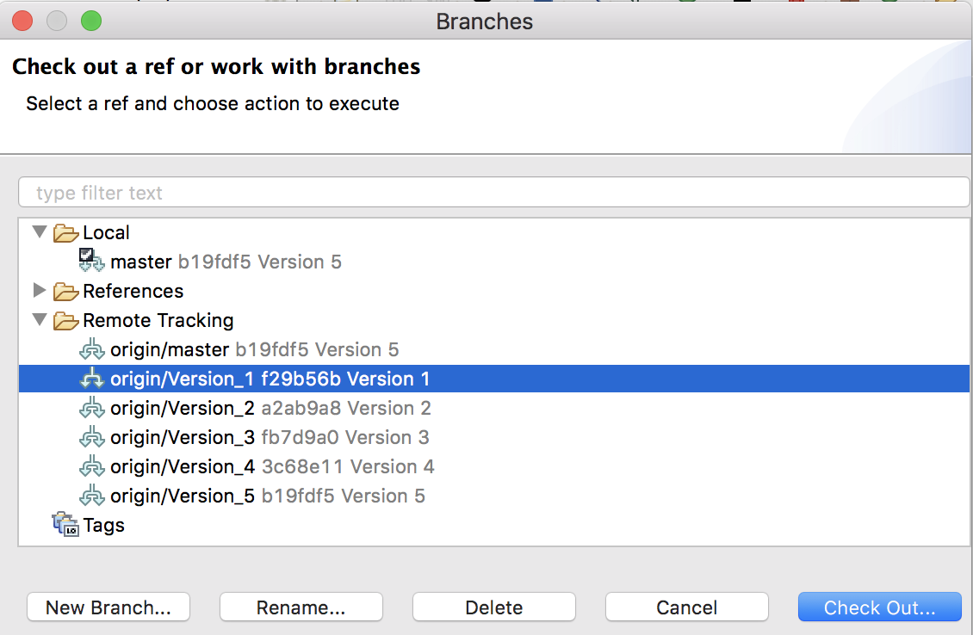
Version_1 must be selected

Slide 21
Version_1 is checked out as new local branch

Slide 22
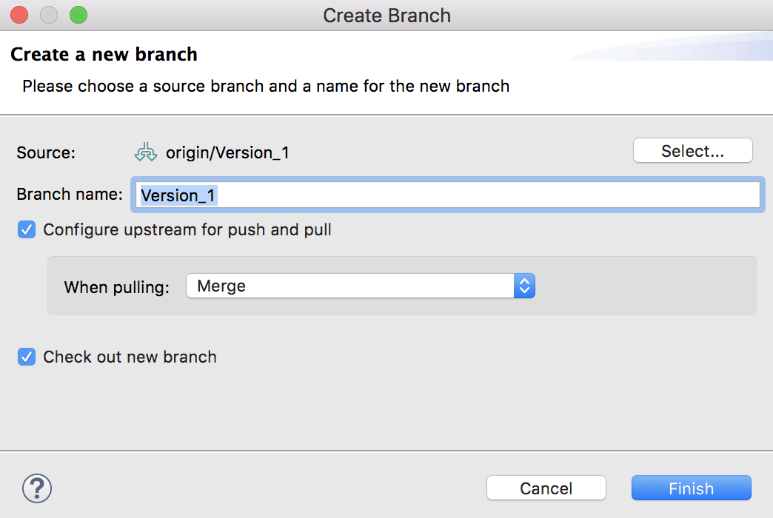
We end up with “Finish”

Slide 23
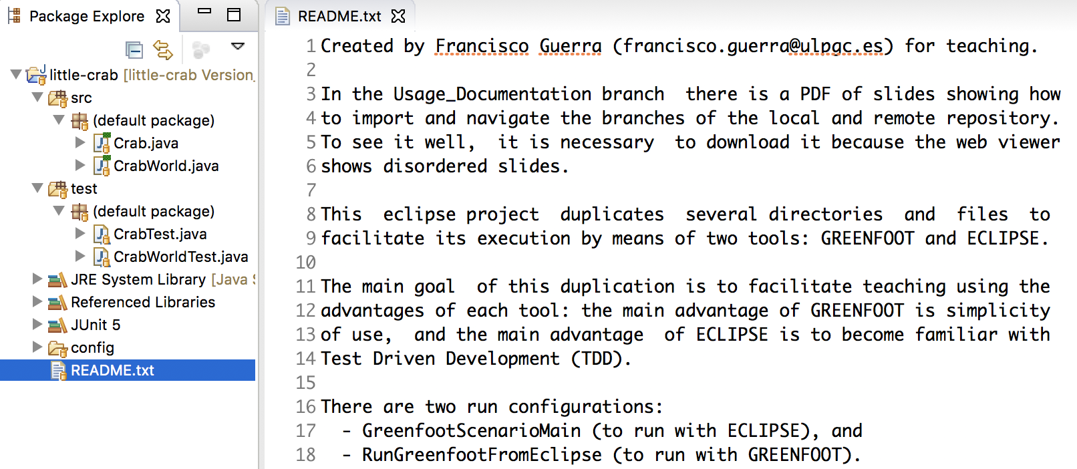
The versión 1 only has two clases and two tests ...

Slide 24
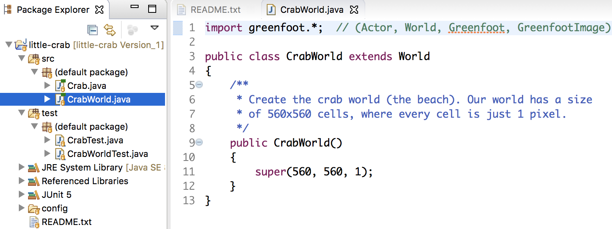
Class that defines the world: CrabWorld

Slide 25
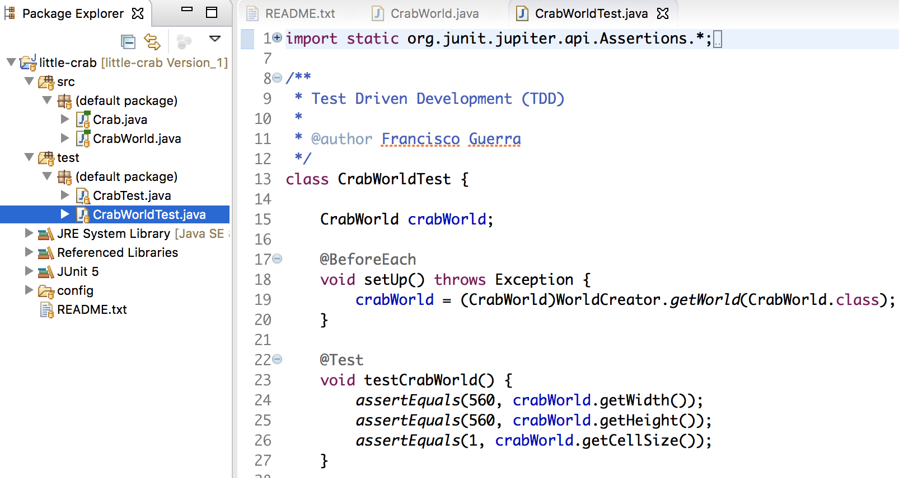
The world behavior is verified by CrabWorldTest
CrabWorld only defines its size: 560, 560, 1

Slide 26
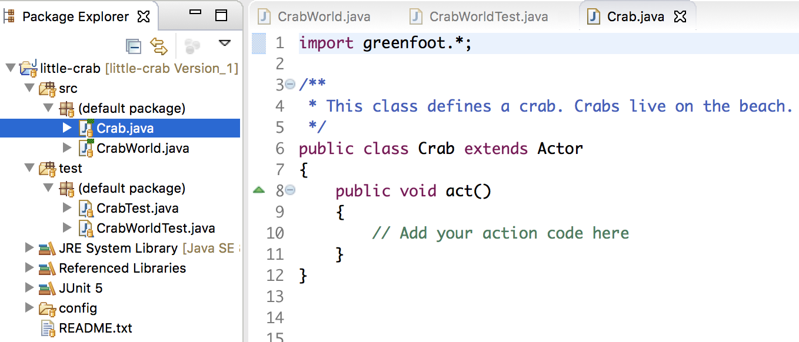
Class of actors for the world: Crab

Slide 27
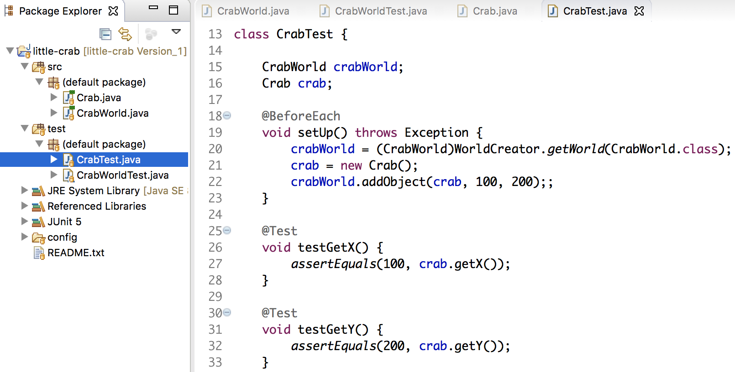
The crab behavior is verified by CrabTest
Crab is placed in a position within CrabWorld: 100, 200

Slide 28
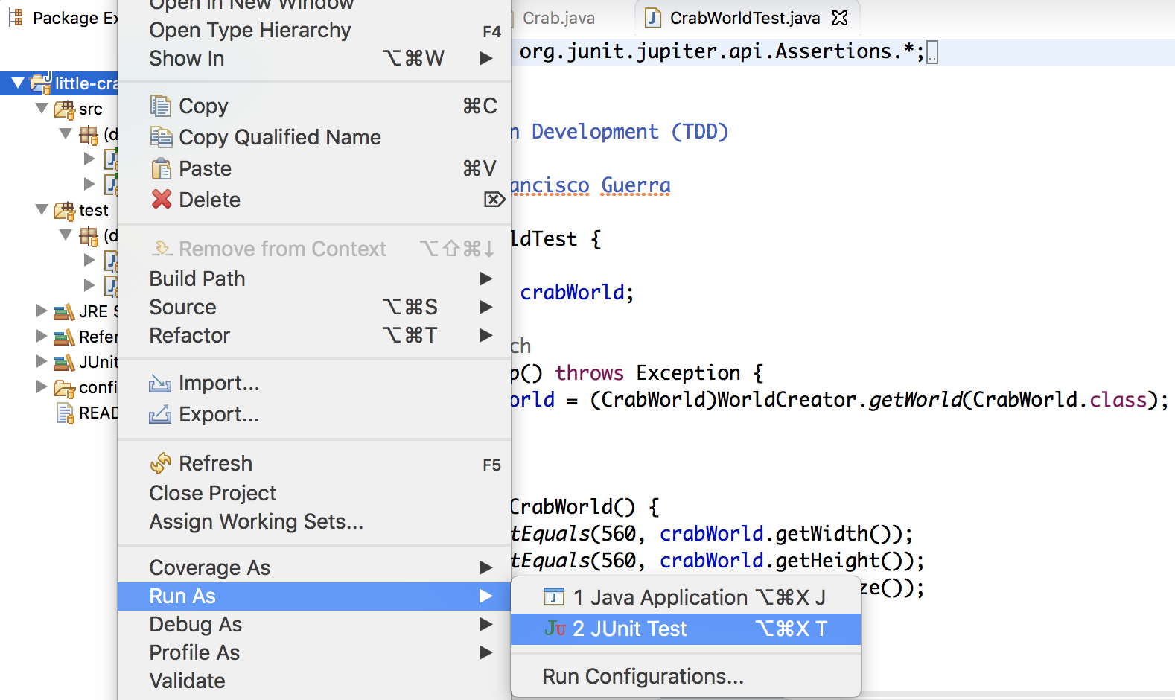
Let´s go to run the tests with JUnit

Slide 29
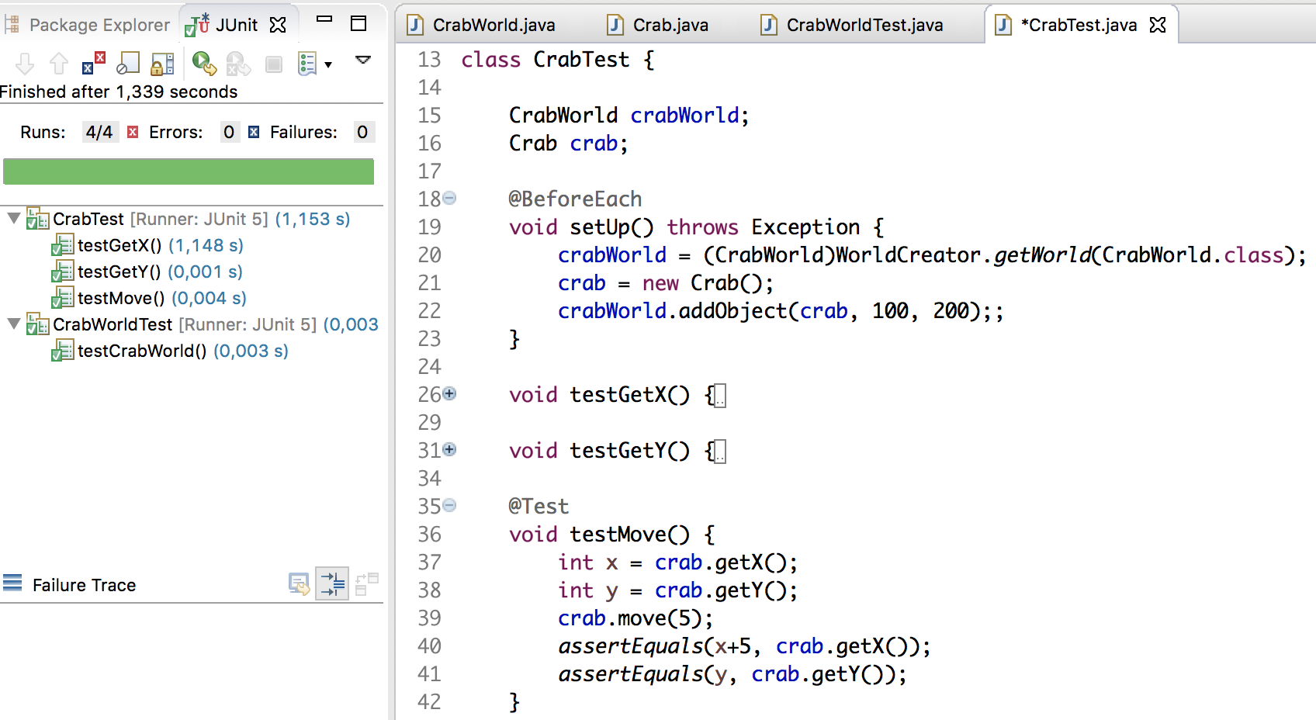
Green if the tests are verified

Slide 30
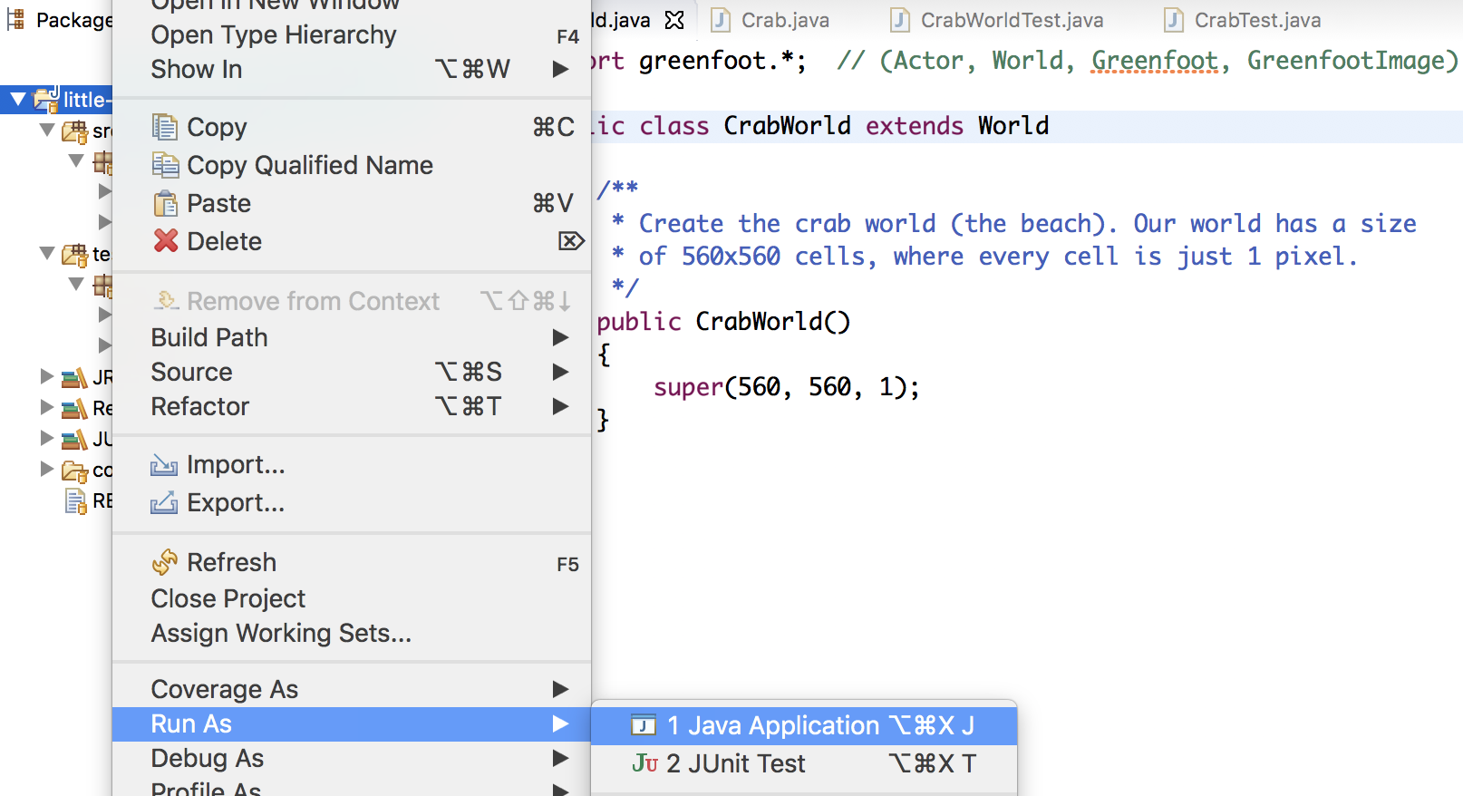
Let´t go to run the world (Eclipse)

Slide 31
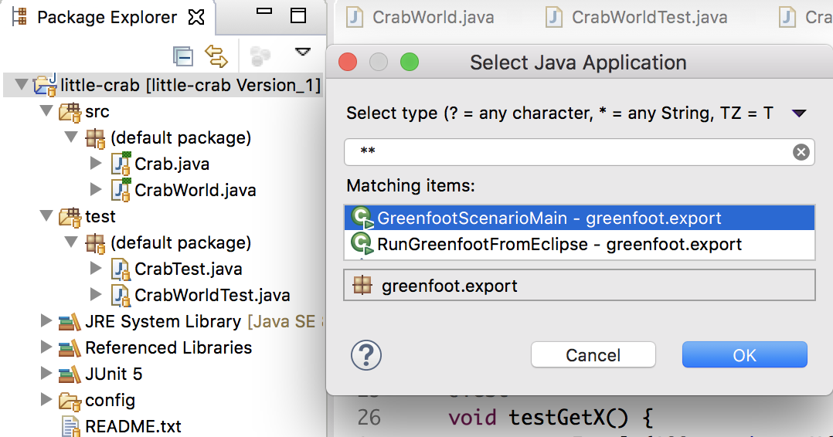
GreenfootScenarioMain must be selected

Slide 32
Execution in Eclipse mode
This scenario initially only defines its size

Slide 33
Let´t go to run the world (Greenfoot)

Slide 34
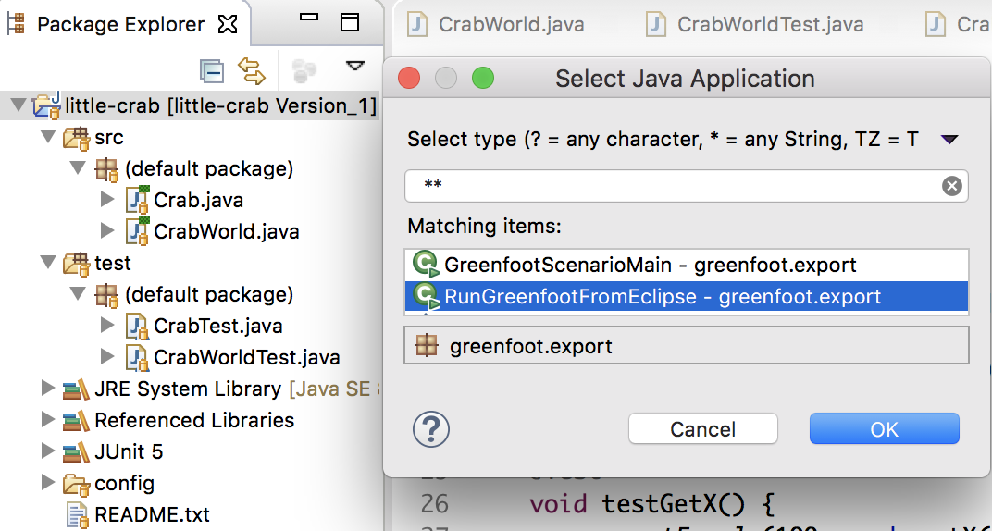
RunGreenfootFromEclipse must be selected

Slide 35
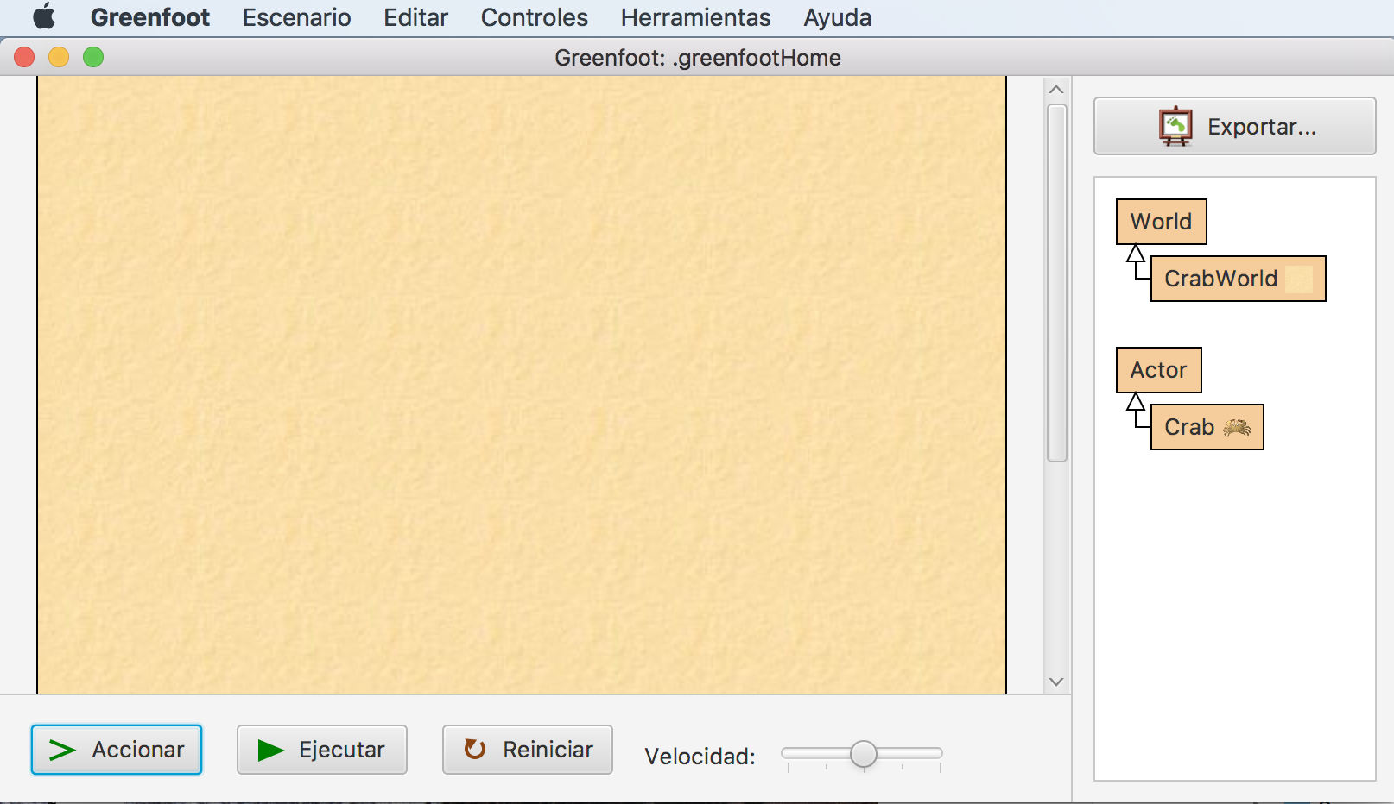
Execution in Greenfoot mode
In addition to running the world, the Greenfoot IDE is active to modify the behavior of classes, for example: adding actors to the world.

Slide 36
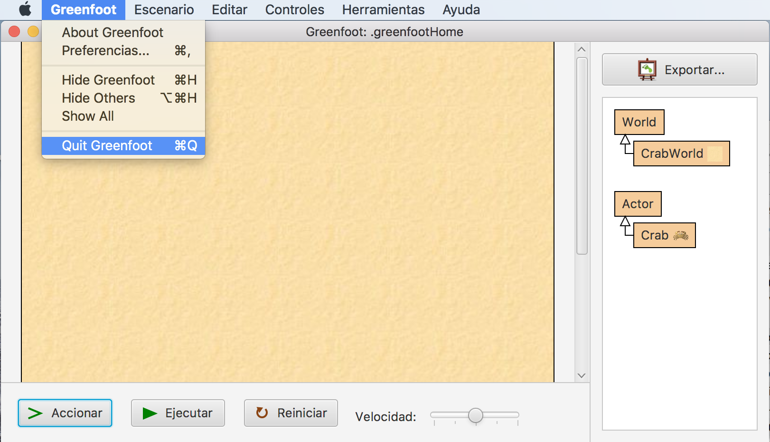
Quit to return to Eclipse + F5

Slide 37
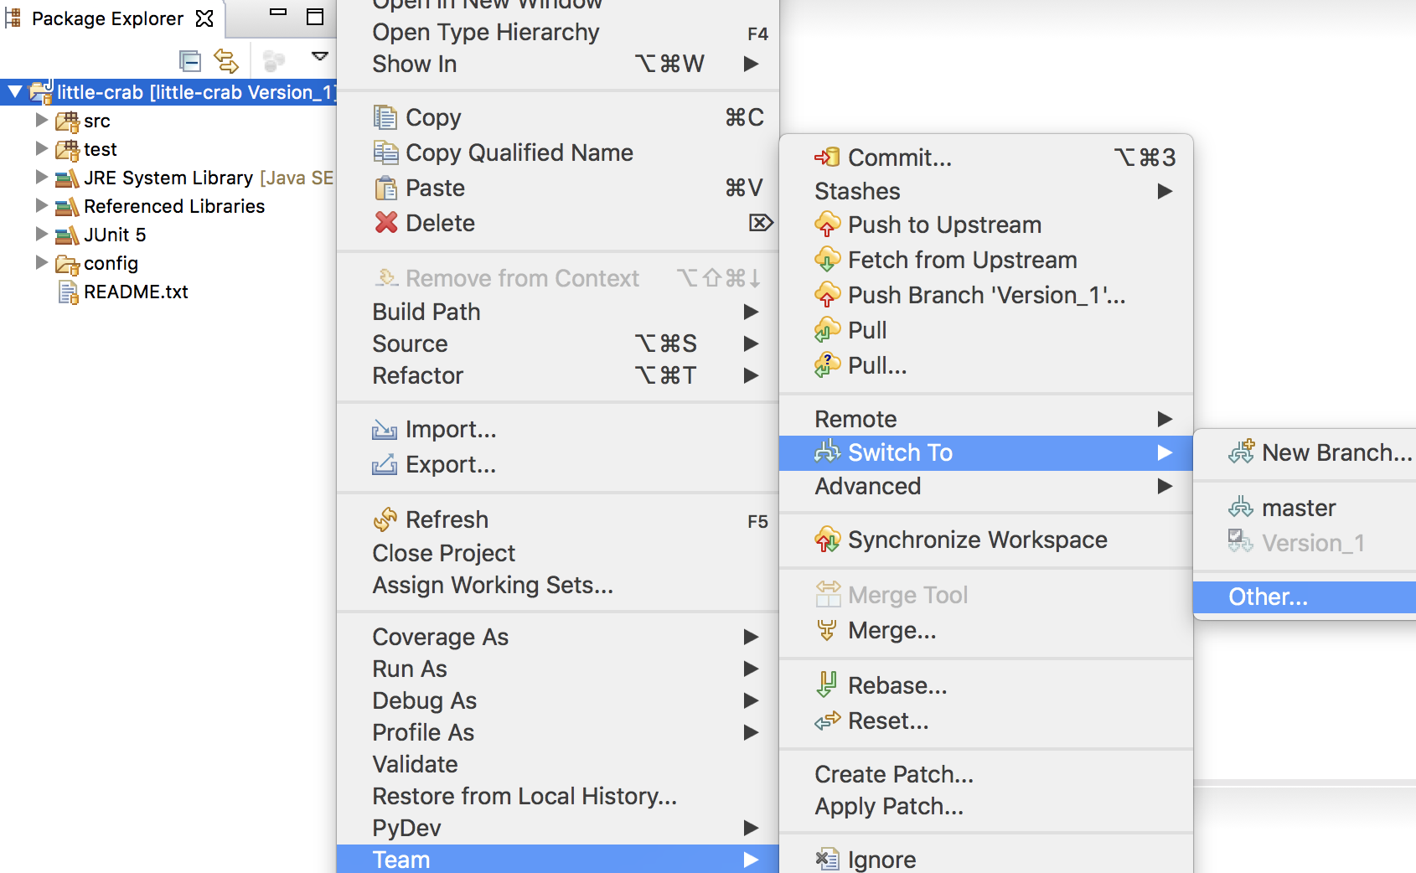
Let´s go to other branch

Slide 38
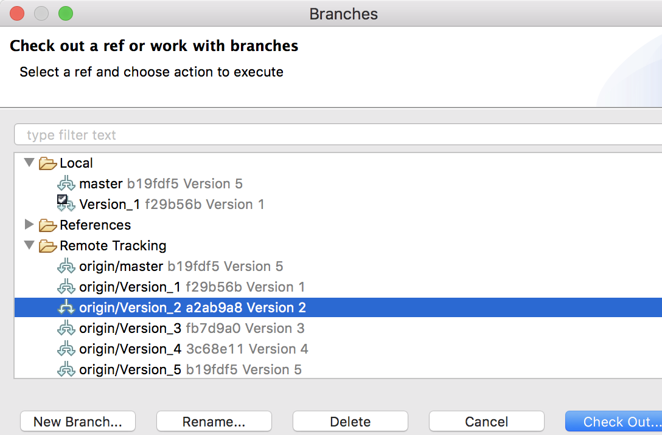
Version_2 can be selected

Slide 39
Version_2 is checked out as new local branch

Slide 40
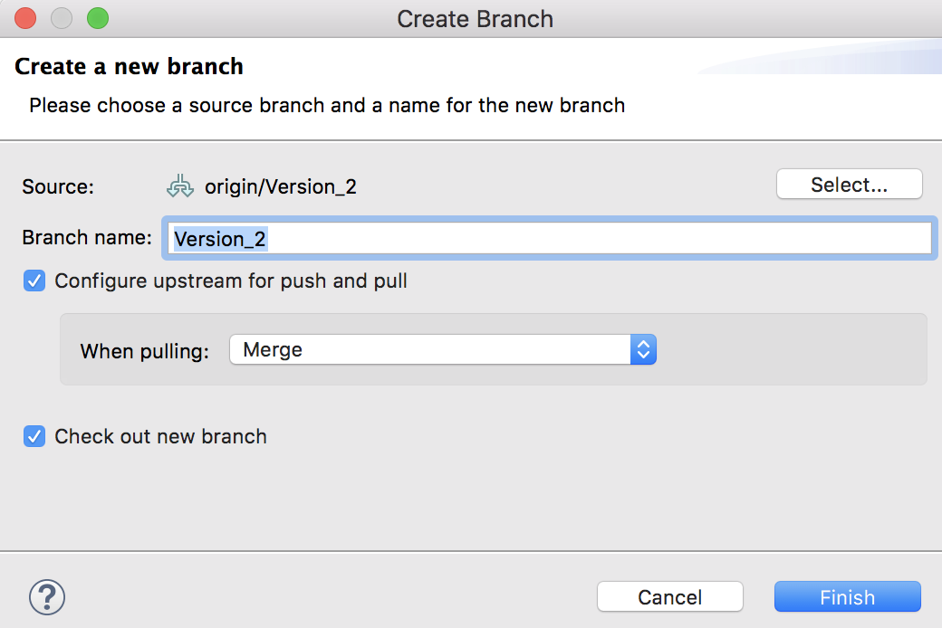
We end up with “Finish”

Slide 41
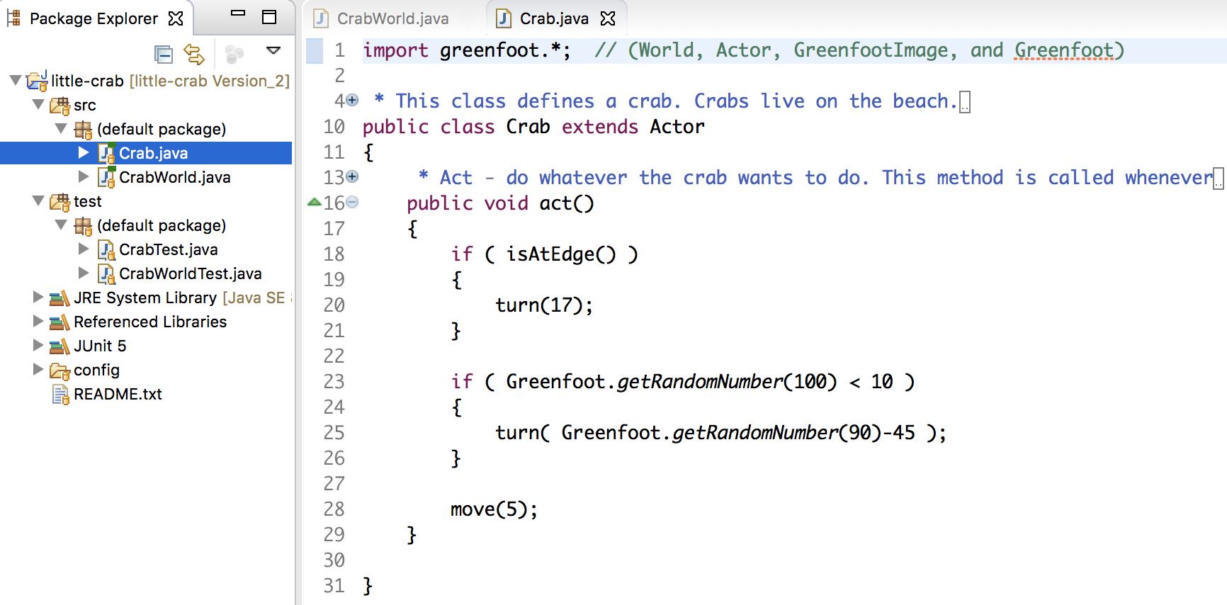
Version 2: Crab always moves 5

Slide 42
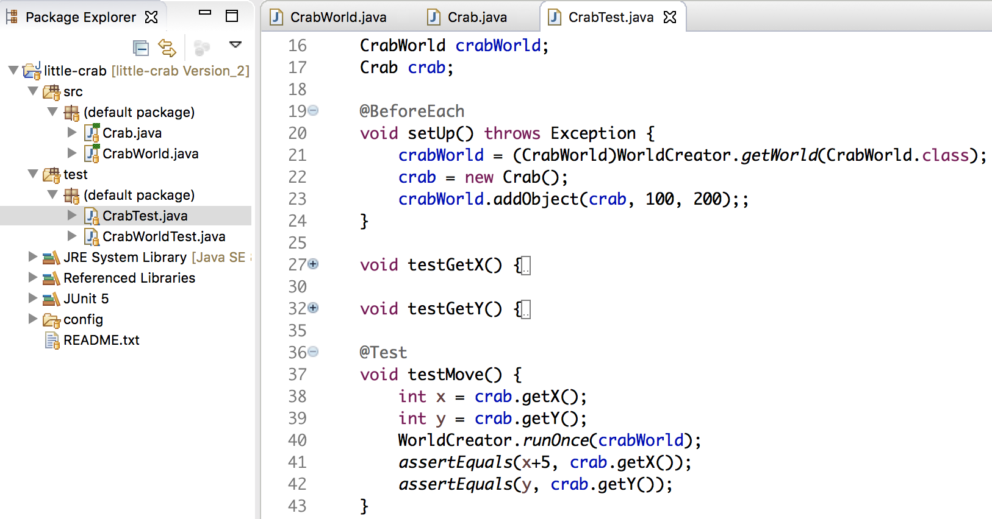
There is a new test for crab movement

Slide 43
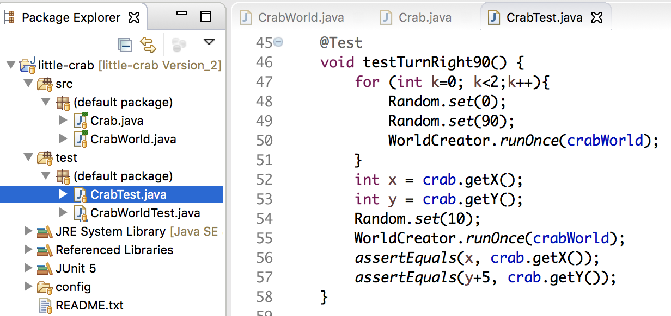
There is new test for crab rotates twice 45º

Slide 44
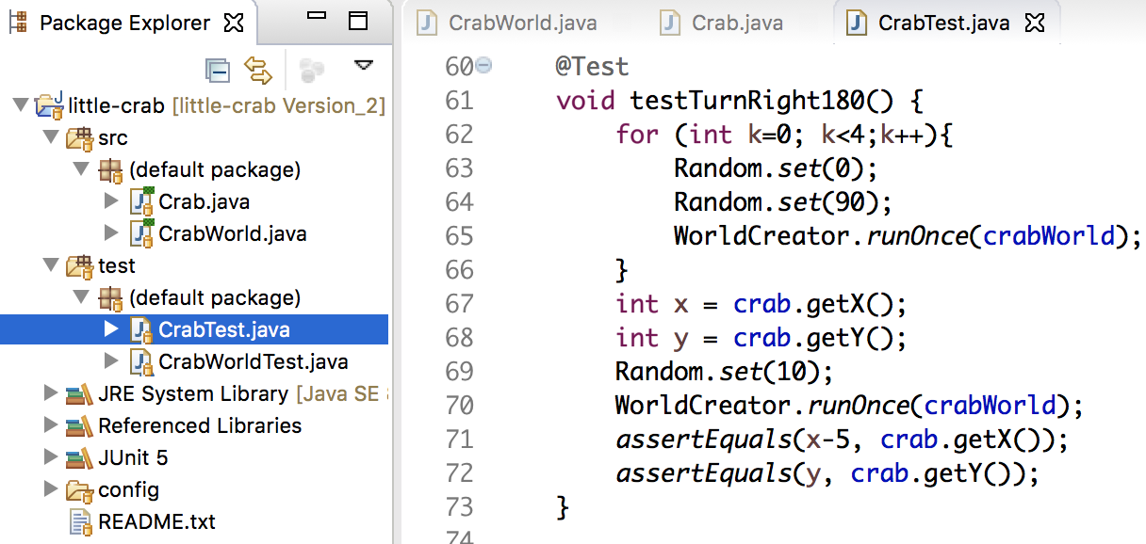
There is new test for crab rotates four times 45º

Slide 45
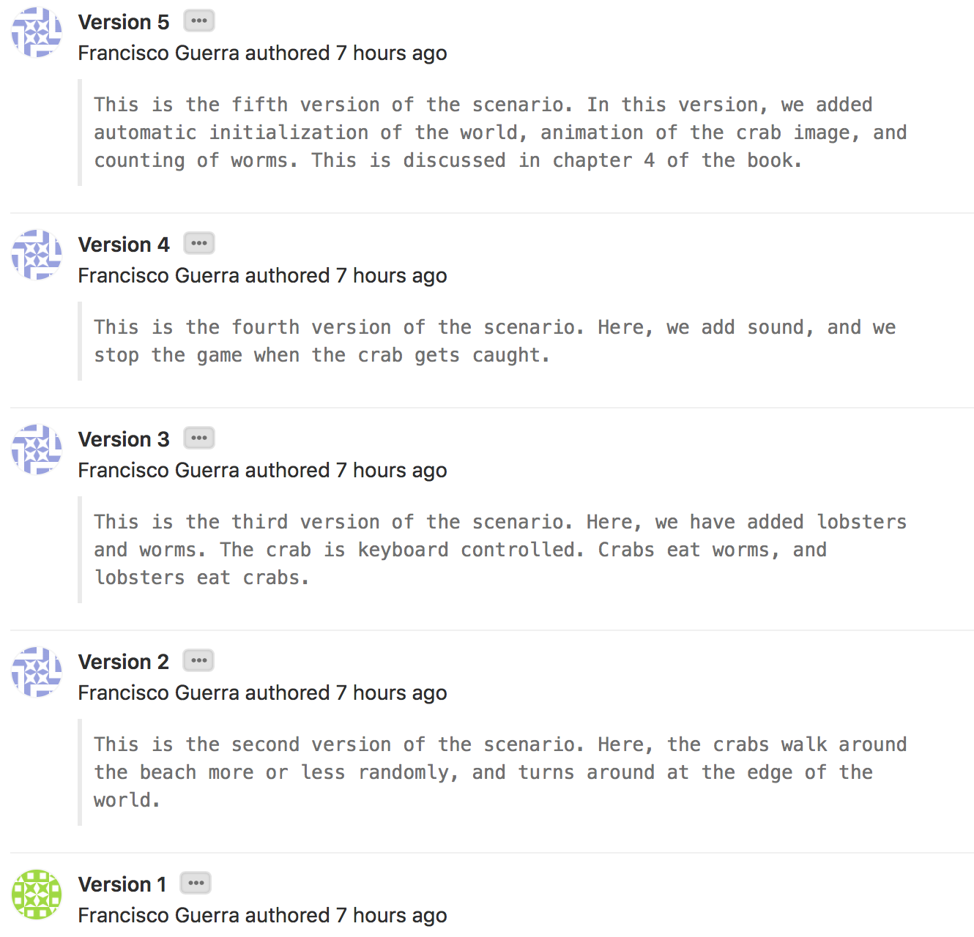
There are five versions with their behavior tests

Slide 46
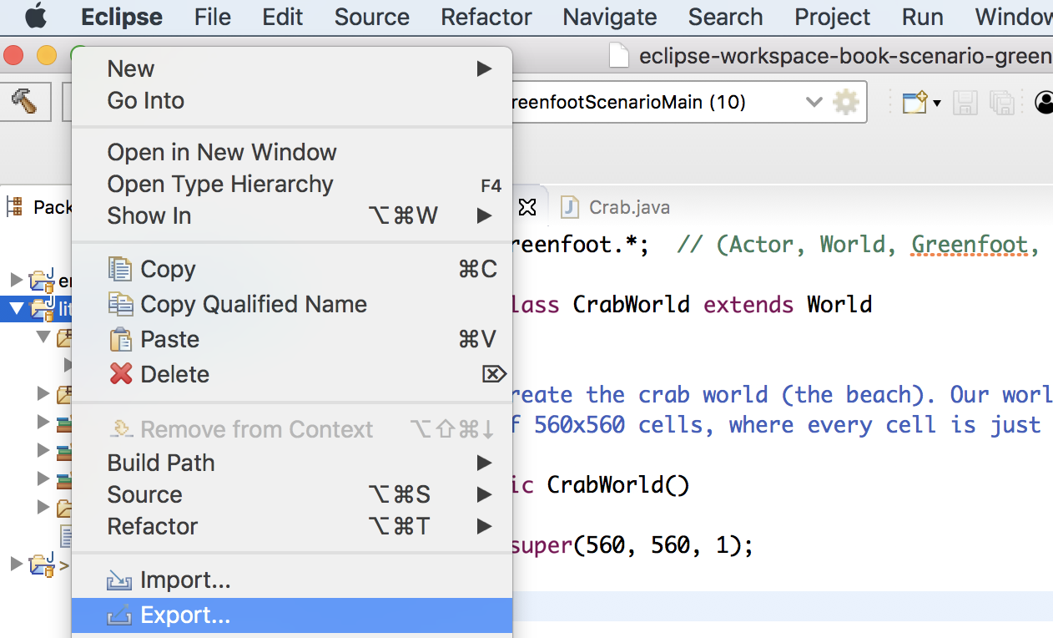
To take the project to another PC ...
Only the active version is copied (all versions of the “.git” folder are not copied)

Slide 47
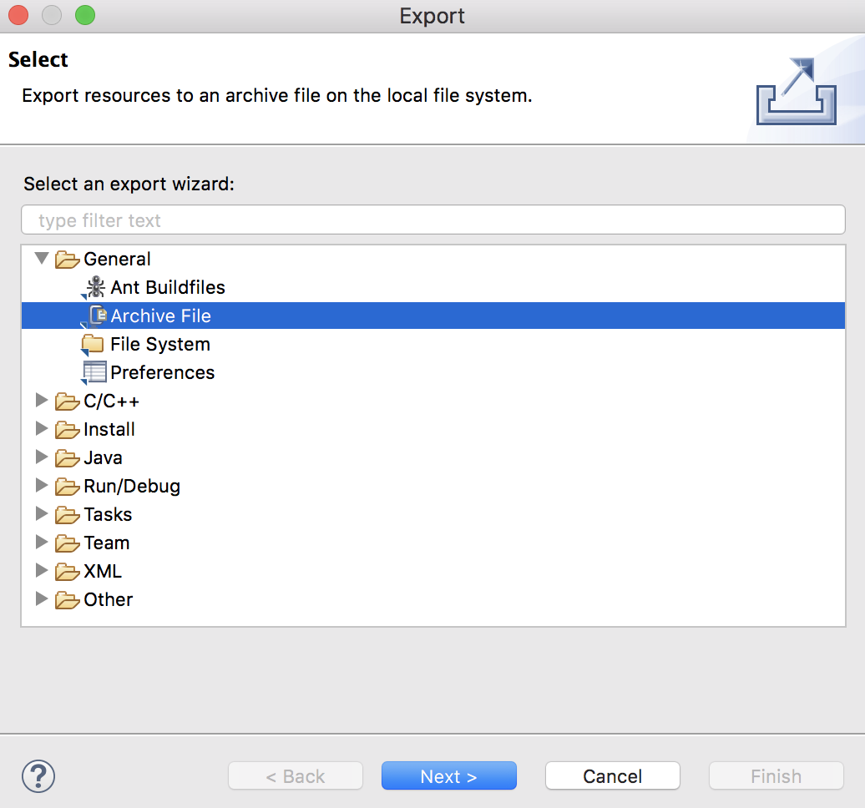
... we choose “Archive File” and “Next” ...

Slide 48
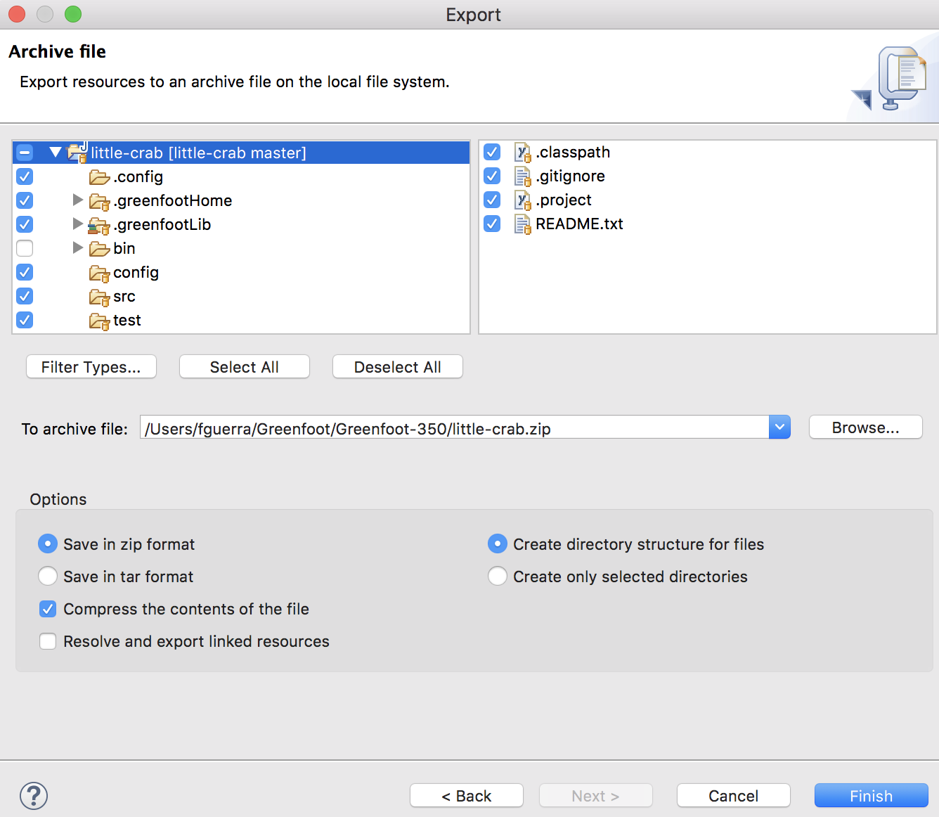
... we removed the bin folder ...

Slide 49
... with “Browse”, we choose location and file name ...

Slide 50
... we end up with “Finish”

Slide 51
We can import the zip …

Slide 52
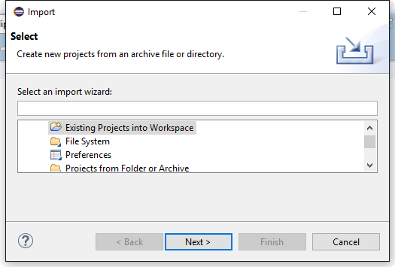
… first, we select a existing project

Slide 53
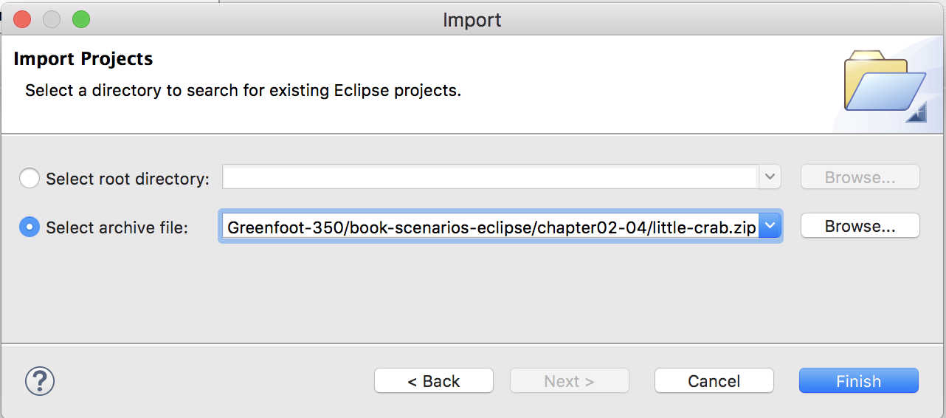
… second, we select the zip file …

Slide 54
… and third, we select “Finish”

